Slide 1

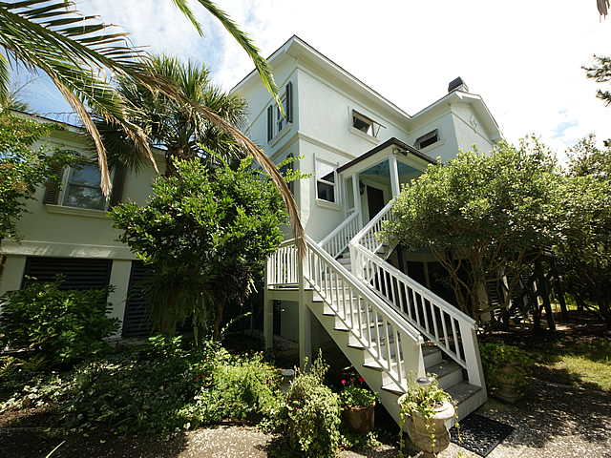
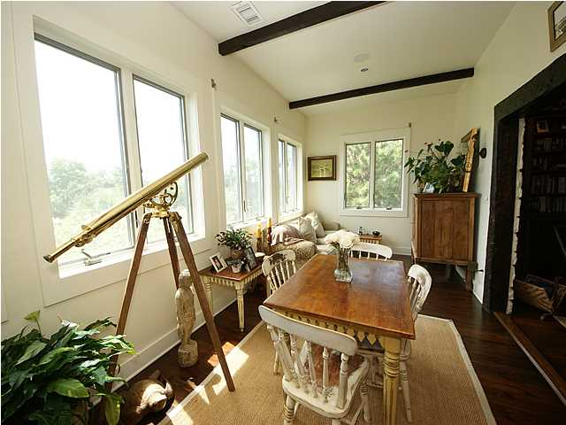
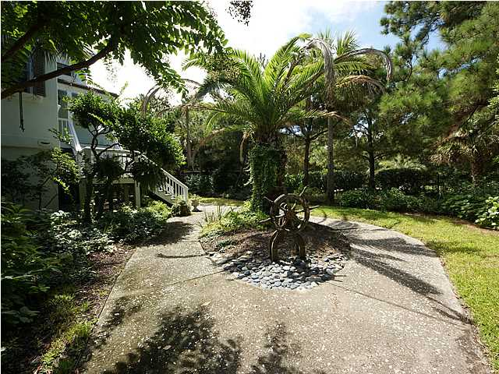
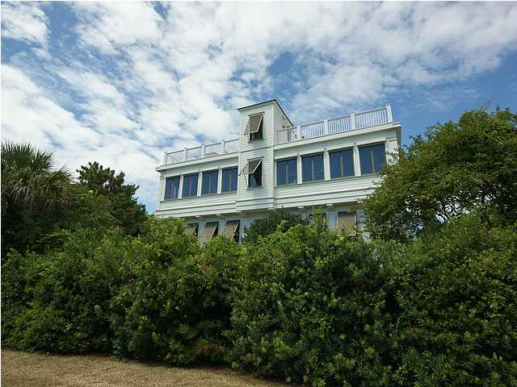



In the Spotlight…
1701 Atlantic Avenue - LP $2,139,000
2nd Row Beach Home On Sullivan’s Island
Home Features
• Remodeled in 2004, SQ FT 4,466
• Peak Views of the Ocean & SI Lighthouse
• Short walk to beach path, Sand Dunes Club & SIES
• Antique and Wide Plank Flooring
• Gourmet Kitchen with Granite & Pecan Cabinetry
• High-End Appliances including Two Ovens
• Two Large Rooftop Decks With Expansive Views
• Desirable, Quiet Residential Location on Sullivan’s
• Stone Fireplace with Huge Antique Mantel
• Spacious Backyard with Lots of Palms Trees
• Hurricane Shutters and /or Roll Downs
• Lush Landscaping with Well for irrigation
For the discerning buyer looking for something extraordinary and special. This 2nd row home offers peak views of the ocean and Sullivan Island’s lighthouse from the upper decks. This beautiful home has a style all its own and is situated on one of the most desirable, quiet streets on the Island. Just steps from beach, the Sand Dunes Club and short walk to the new Sullivan’s Island Elementary School. The Sellers spent significantly in a 2004 remodel to create this beach home with “European Flair”. The Seller spared no expense on the exterior of the home adding a European hard coat stucco and Hardy Plank as well as an Elastomeric coating which is excellent for the ocean environment and heavy winds. In addition, all windows have hurricane shutters and/or roll downs. Lush Landscaping provides the final touch!
Margaret Hekker
BIC, Owner
Lighthouse Realty Group, LLC
Cell-843-296-7520
mhekkerrealestate@gmail.com

