Slide 1
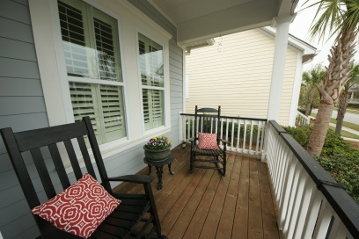
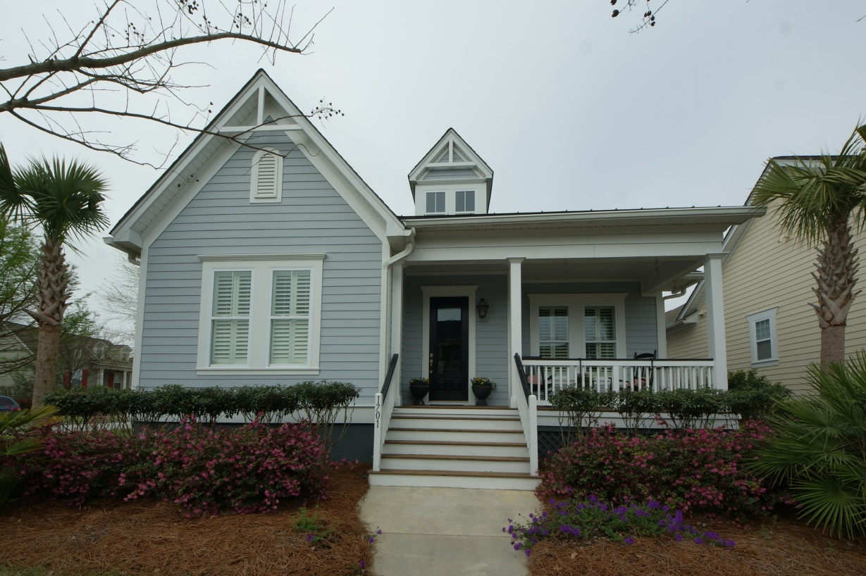
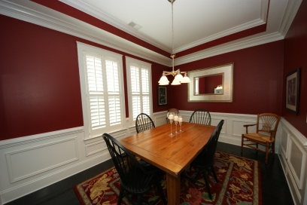
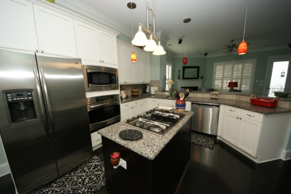
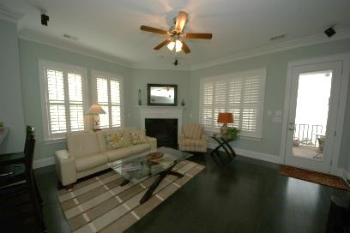
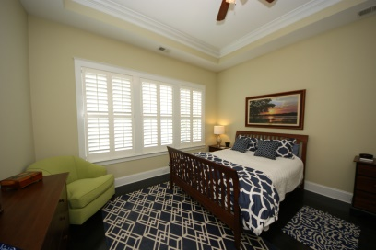
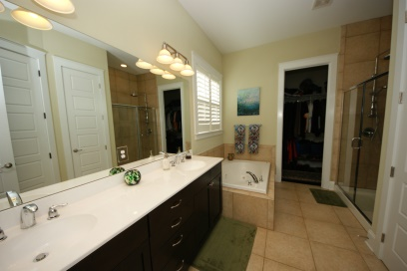
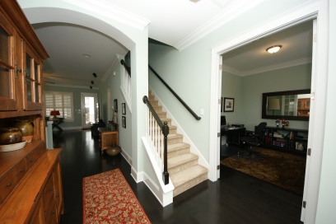
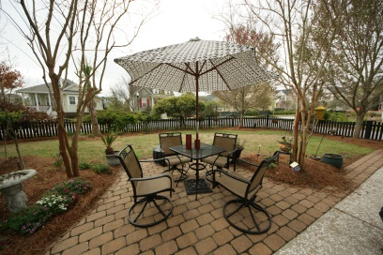
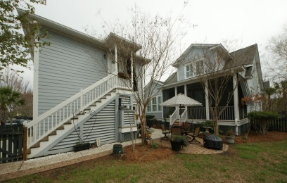
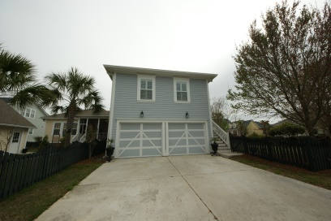
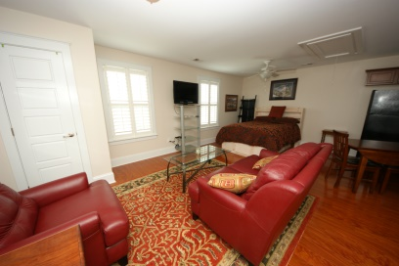
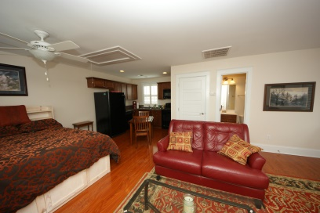


1701 Sailmaker Street
Smythe Park @ Daniel Island
Charleston, SC 29492
MLS# 15006333 ~ $679,000
Two Story Home located on Corner lot in Smythe Park. Two Piece Crown Moulding in the foyer, study, dining, powder, kitchen, owners retreat and family room. Ten-Foot ceilings with eight foot solid core doors on the first floor. Spacious kitchen open to the family room with SS appliances, gas cooktop and wall oven. A Ceramic tile backsplash, granite counter tops and a center island and a raised breakfast bar. Elegant dining room accented with chair rail and picture frame moulding. Gas log fireplace with granite surround in family room. First Floor Master suite with walk-in- closets. Dual sink vanity. Separate Double Car Garage with furnished apartment above, great mother-in-law suite or rental. Home has nice large screened porch off back with great landscaping. Main House has approx 2200 sq ft and FROG has 470 total of 2670..This Home was built by Weekley Builders. Its an energy efficient Home with High efficiency Natural Gas Heat, double- paned window and Tankless hot water heater. It is Energy Star Certified by Environments for Living.
John H. Beckroge
ABR, EPRO
jbeckroge@gmail.com
Mobile 843-367-3196

