Slide 1

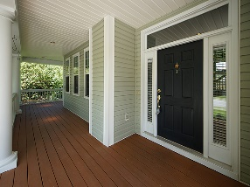
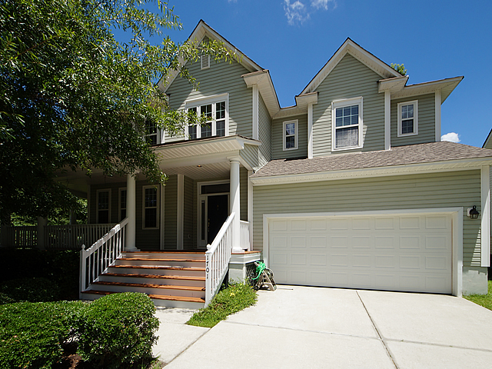
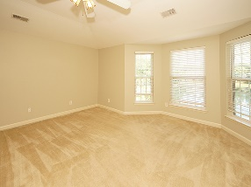
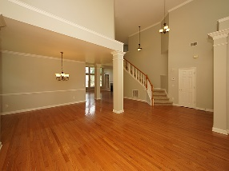
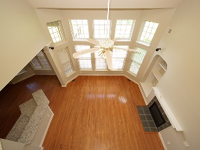
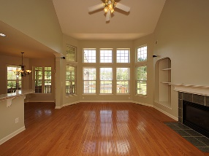
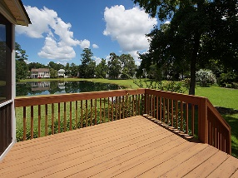
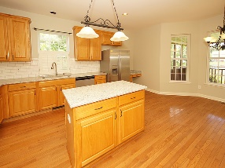
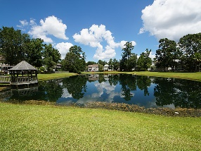

A Must See!
Move-in Ready
Debbie Himebaugh
(843) 324-6959
dhimebaugh@century21properties.com
www.DebbieHimebaugh.com
1701 William Hapton Way | Mt Pleasant | MLS# 17019840 | $475,000
Brand New Flooring!
Open and Spacious floorplan with vaulted ceilings and lots of natural light. This 4 Bedroom/3 bath home with the 4th downstairs being flex space, no closet (office or bedroom)adjacent to full bath has lots of custom features. Gorgeous wood flooring, Formal living room, dining room, central vacuum, Eat in Kitchen with new granite and stainless appliances, an island to complete. Large family room with fireplace, lots of windows with stunning views of the backyard and pond. Relax on the wrap around front porch or screened back porch with exterior large deck. Beautiful lot with only one neighboring property and community green space to left with access to Gazebo on Pond.. Close to shopping, great amenities, and Mount Pleasant schools...freshly painted makes this move in ready and a must see!
Century 21 Properties Plus | 3301 Salterbeck Ct Suite 100 | Mt. Pleasant, SC 29466

