Slide 1
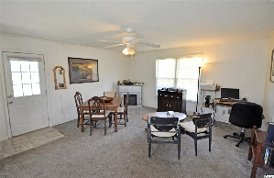
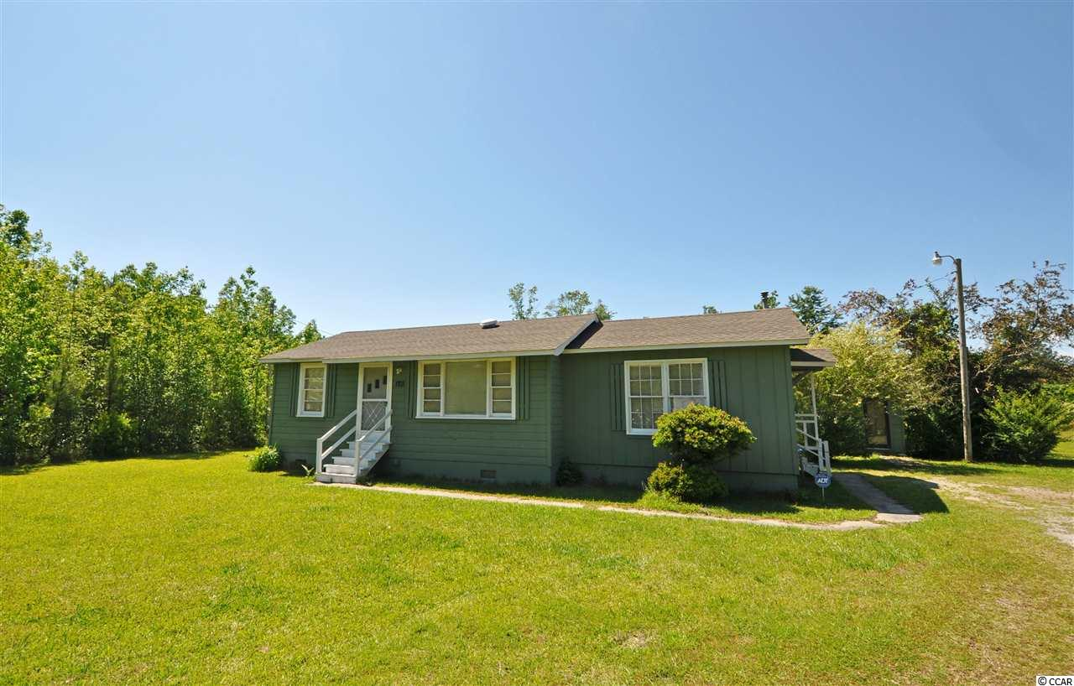
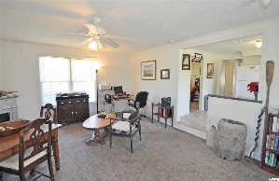
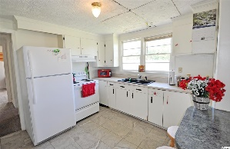
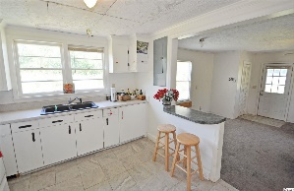
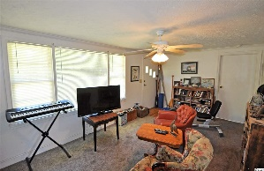
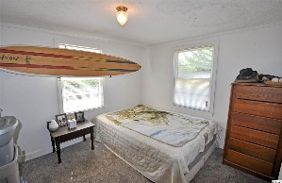
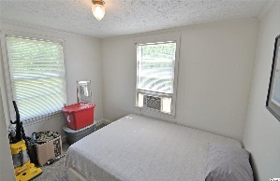
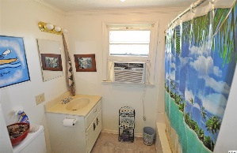
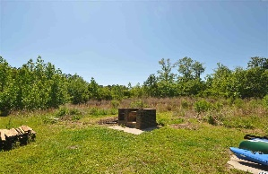
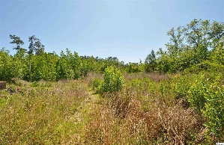


Approximately 2/3 of an Acre
Ready for Occupancy or Development
1703 Highway 57 N
Little River, SC 29566
Approximately 2/3 residential/development-acre for sale on Highway 57 North in Little River, SC. Property zoned Commercial Forest Agricultural (CFA), allowing for various commercial and residential uses. Property is located in proximity to future Highway 31 Extension (connecting into Brunswick County, NC), with easy access to Highway 9, Highway 31, and Highway 17. There are multiple residential development projects within 2-3 miles of this location. The 920-sq.-ft.-home has public water, sewer, phone, electric and Internet. This charming, cozy, cottage-like home is very well maintained and lives comfortably. There are two good-sized bedrooms, one full bath, and separate spacious formal living and informal family-room/dining areas. There is a small storage building; brick backyard grill; plenty of room for on-property exterior storage for boats, vehicles and the like; and a defined driveway to the home right off Hwy 57. The nice kitchen is in the heart of the home. There are window-unit air conditioners and space heaters. Lots of room for outdoor fun, too! It is a deep, rectangular lot, extending back up to 230'; road frontatge on Hwy 17 is about 132'. See virtual tour on listing for overview. Water and sewer are available along Highway 57. Survey available upon request. This attractive lot is located near many businesses and is in the charming Hamlet of Little River, Horry County's second oldest town, which is renown for its proximity to the Atlantic Ocean via the ICW and rich nautical history including being a popular pirate port. For boaters, there are several marinas nearby to buy or to rent boat slips. For golfers, there are numerous signature golf courses, plus restaurants, antique and thrift trails, recreation, shopping, access to major highways and medical services, and good schools and parks. It adjoins North Myrtle Beach, which was recently named one of the safest cities in the nation and with one of the best beaches in the U.S., the nearby Cherry Grove Beach, minutes away. However, taxes are levied at low Horry County rates. View this inviting, well-priced, mostly cleared .5 - 1-acre lot for a personal residential home or for its possible commercial potential today.
Deborah Collins
843-424-9013
dctidewater@yahoo.com
Connie Ross-Karl
702-306-2643
conniesross@aol.com
NEW WAY PROPERTIES MYRTLE BEACH

