Slide 1
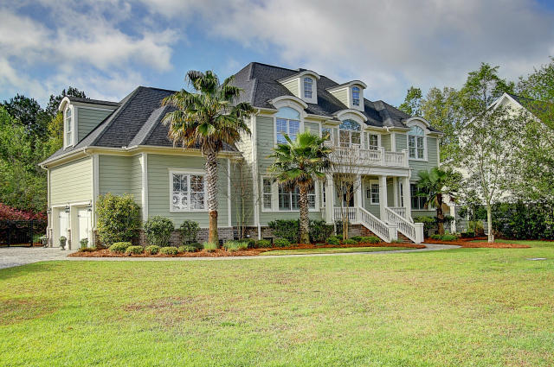
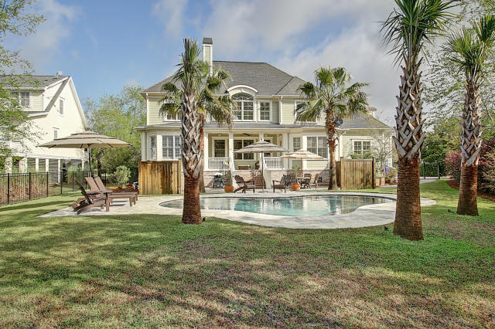
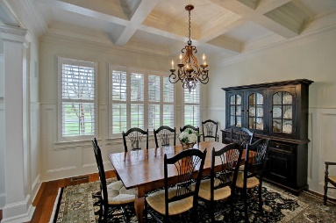
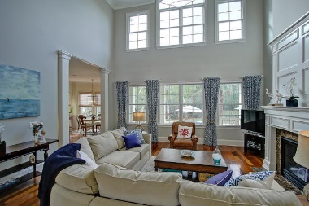
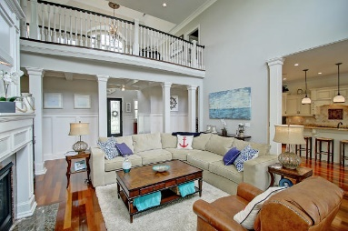
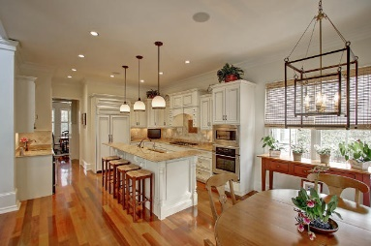
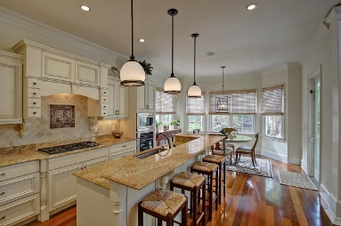
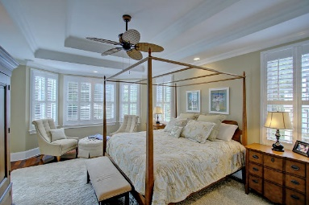
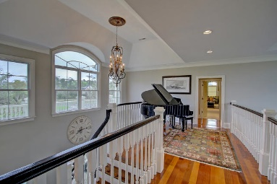
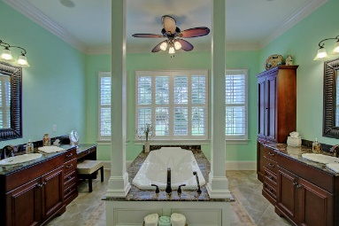
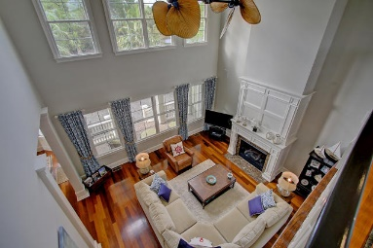
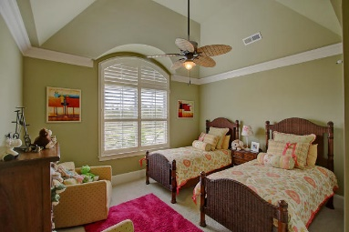
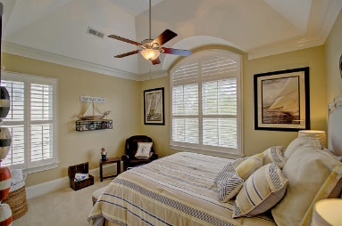
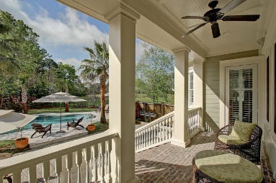
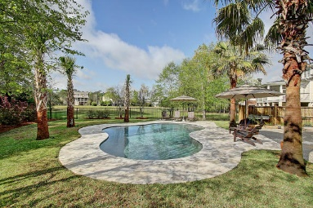
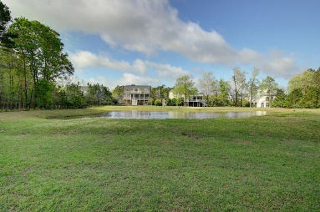


1705 Bowline Dr
Mount Pleasant, SC 29466
MLS# 16008380
$895,000
Dunes West Executive Home
Incredible home situated on large cul de sac home site with pond views and a new saltwater pool. This stunning home has it all. Be prepared to be impressed the moment you walk in the two story foyer, with its gleaming hardwood floors , custom wood work including tall baseboards and heavy crown molding . The eat in kitchen is a cook's dream with custom cabinetry, high end appliances, plenty of counter space and even a wet bar area with wine fridge. The great room is open to the kitchen and makes entertaining a breeze, this room again has a two story ceiling and a wall of windows to let in the natural light and view of pool area and pond. Large formal dining room with coffered ceiling and wainscoting. Master suite on main floor with incredible bath . A small office area and laundry room finish off the main floor . Upstairs you will find four additional bedrooms all with cathedral ceilings and crown molding including large closets with private baths in three of the bedrooms plus a oversized bonus room with wainscoting complete with surround sound capabilities . There is also a smaller laundry room on this floor. Landscaped front and rear yards, with privacy fenced area around the patio and pool. Crawl space has been encapsulated and has its own dehumidifier in place. The perimeter of home has a mosquito misting system in place as well and there is a two car garage with extra storage capacity. This is a special home that needs to be seen to be appreciated.
Clay Cunningham
O (843) 886-8110
M (843) 345-4647
clay@carolinaone.com
www.claysre.com
Carolina One Real Estate
1503 Palm Blvd Ste
Isle of Palms, SC 29451

