Slide 1
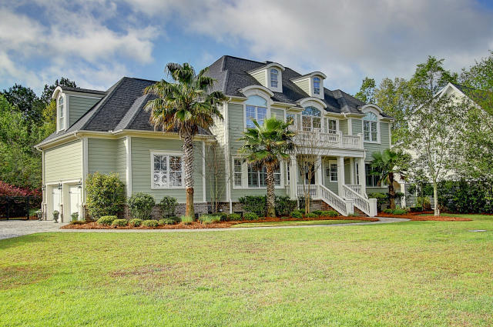
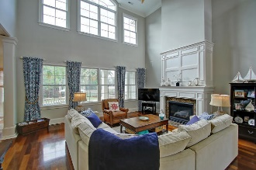
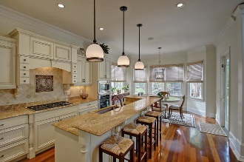
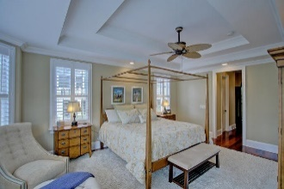
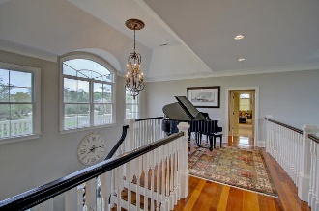
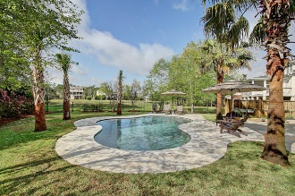


1705 Bowline Drive
Mount Pleasant :: MLS# 16008380 :: $875,000
Dunes West Executive Home Reduced!
Incredible home situated on large cul de sac home site with pond views and a new saltwater pool. This stunning home has it all. Be prepared to be impressed the moment you walk in…
Two story foyer with gleaming hardwood floors
Custom wood work including tall baseboards & heavy crown molding
The eat in kitchen is a cook's dream with custom cabinetry, high end appliances, plenty of counter space and even a wet bar area with wine fridge
Two story great room is open to the kitchen and makes entertaining a breeze
Wall of windows to let in the natural light and view of pool area and pond
Large formal dining room with coffered ceiling and wainscoting
Master suite on main floor with incredible bath
A small office area and laundry room finish off the main floor
Upstairs you will find four additional bedrooms all with cathedral ceilings and crown molding including large closets with private baths in three of the bedrooms plus a oversized bonus room with wainscoting complete with surround sound capabilities
There is also a smaller laundry room on this floor
Landscaped front and rear yards, with privacy fenced area around the patio and pool
Crawl space has been encapsulated and has its own dehumidifier in place
The perimeter of home has a mosquito misting system in place as well
Two car garage with extra storage capacity
This is a special home that needs to be seen to be appreciated.
Clay Cunningham
O (843) 886-8110
M (843) 345-4647
clay@carolinaone.com
www.claysre.com
Carolina One Real Estate
1503 Palm Blvd Ste
Isle of Palms, SC 29451

