Slide 1
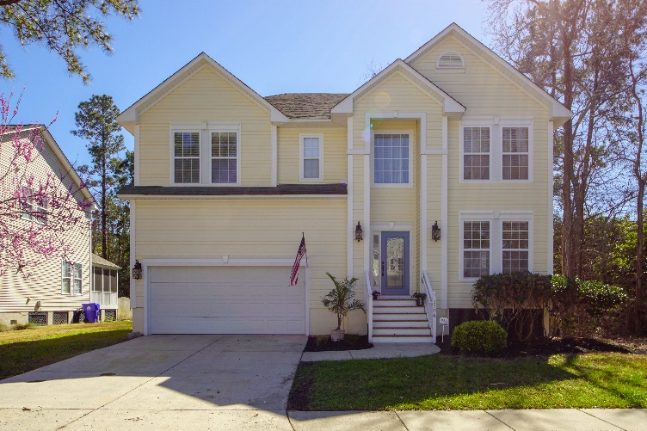
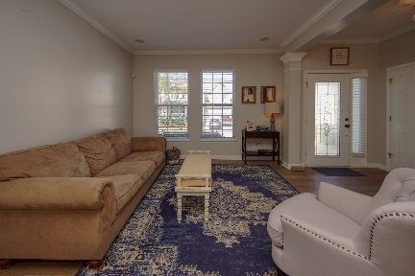
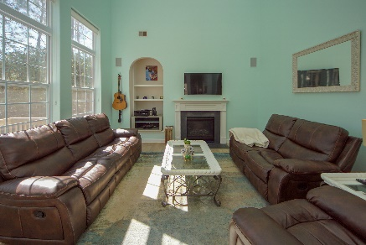
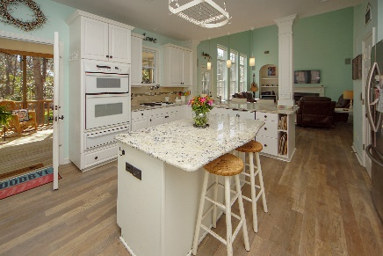
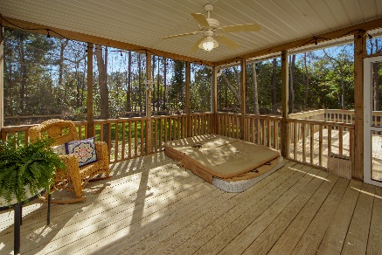
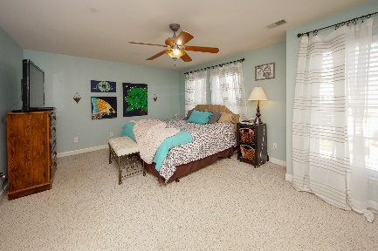
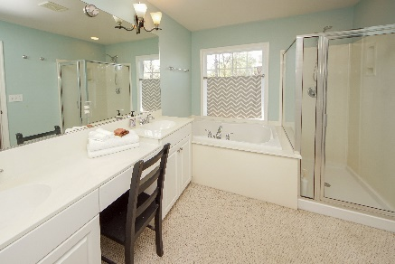
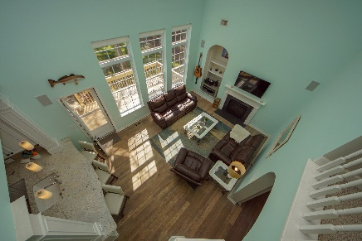
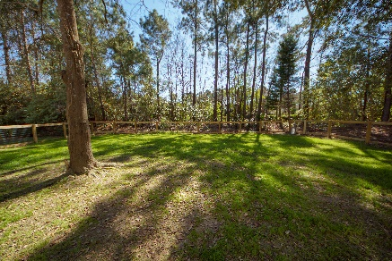

Wow!! Beautiful NEW Stainless Steel Appliances!!!
$10,000 Price Reduction!
1706 William Hapton Way
Park West
Mount Pleasant, SC 29466
MLS# 19006716
$440,000
3 Bedrooms | 2½ Baths
Come see this beautiful home in Park West! Great location close to neighborhood schools, recreation center, shopping, dining, pools, playground, walking and biking trails. Less than 30 minutes to Historic Downtown Charleston, or SC beaches! Home features an open spacious feel, great for entertaining friends and family. Chef's kitchen with granite counter tops, 42'' cabinets and stainless steel refrigerator. A screened in porch, additional deck for grilling, and a spacious fenced backyard. Upstairs has a great floor plan including a bonus area for tv viewing ,homework, exercise, home office, or an additional bedroom. Two large bedrooms with nice sized closets and a Wonderful Master Retreat make this home a great family home you'll want to make your own! Schedule a showing today!!!
Robin Iriart
Mobile 843-568-7720
Office 843-284-8834
Rickrobin@comcast.net
Gatehouse Realty, LLC
708 S. Shelmore Blvd, Ste. 102
Mt. Pleasant, SC 29464
www.gatehousecharleston.com

