Slide 1

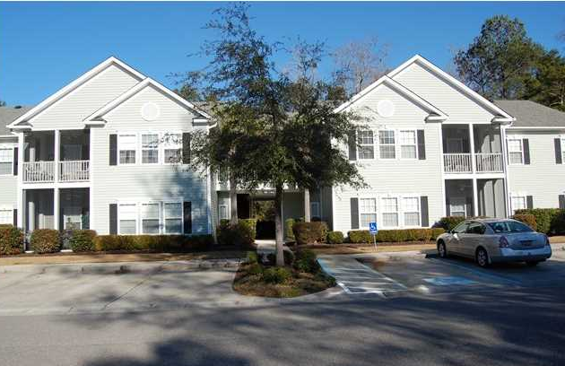
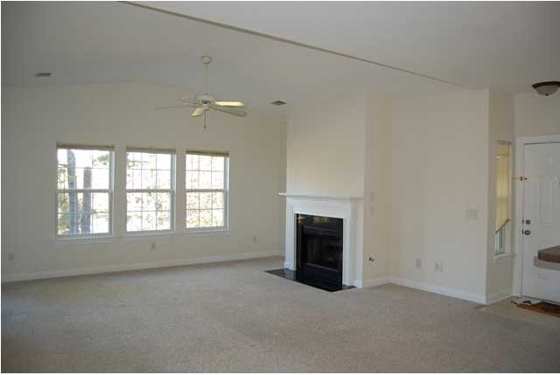
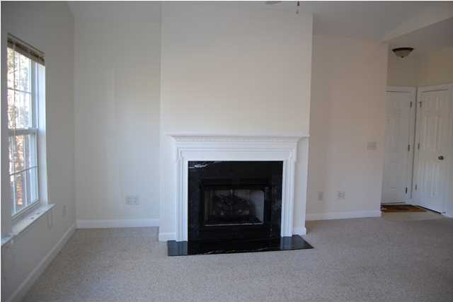
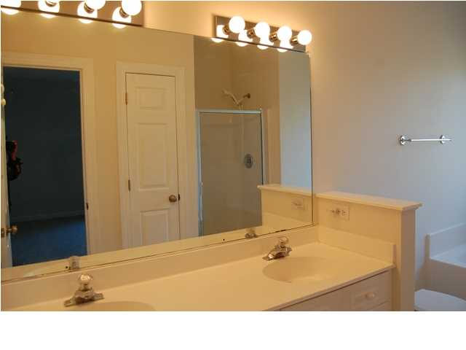
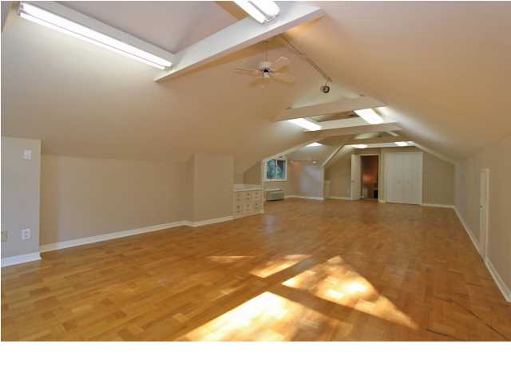
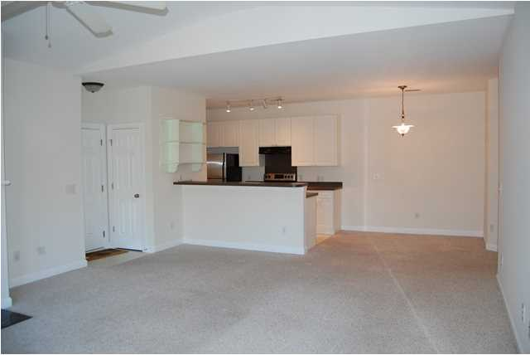
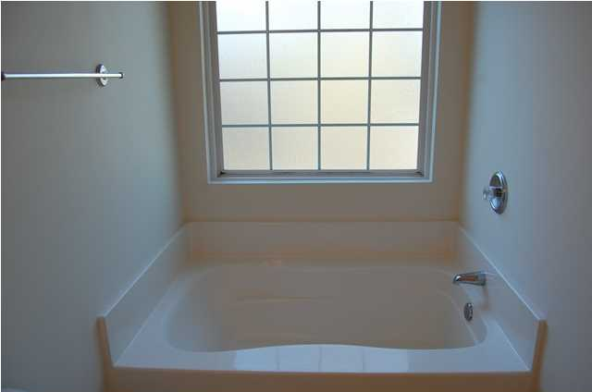
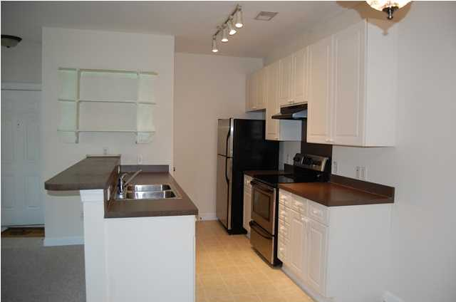
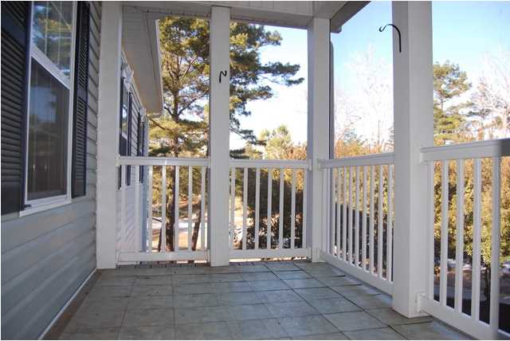
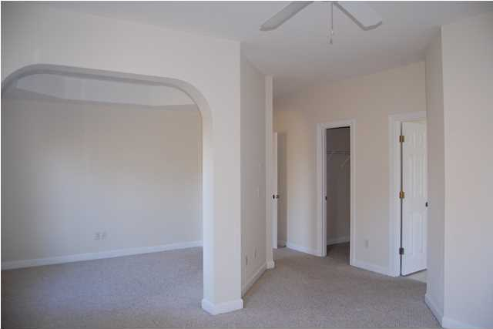
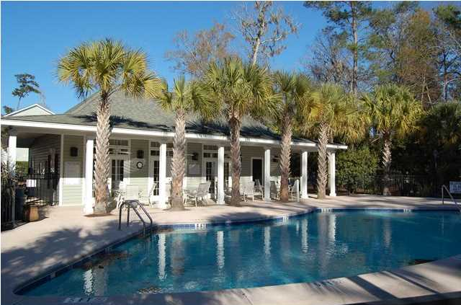



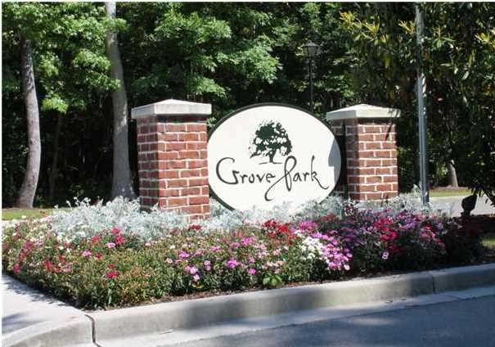

1707 N Elgin Ct
Grand Oaks Plantation
Charleston
MLS# 1402019 ~ $140,000
$1,000 Bonus to Selling Agent at Closing
With BIC Approval
See more at www.2011shellring.com
This beautiful home has 2BR and 2 BA and is located on the second floor so no noise above you and a very short walk to the club house and pool. The home has been well kept and maintained and even has been freshly painted. The open floor plan (the Buchanan) makes it very easy to entertain family and friends. The kitchen which features stainless steel and black appliances opens up into the den allowing the cook to be part of the fun. The Den has a gas fire place and vaulted ceilings. There is a screened porch off the Den a great place to sit and sip your coffee in the morning or relax after a hard days work. The master has two walk in closets and a sitting area that would make a great office or nursery. The master bath has dual sinks, garden tub and separate shower. There is also a separate laundry room. This home is bright and airy and a must see.
Paige Pollock
Cell - (843) 412-4447
paigep@carolinaone.com
www.paigepollock.com
Carolina One Real Estate
195 W Coleman Blvd, Mt Pleasant, SC 29464

