Slide 1
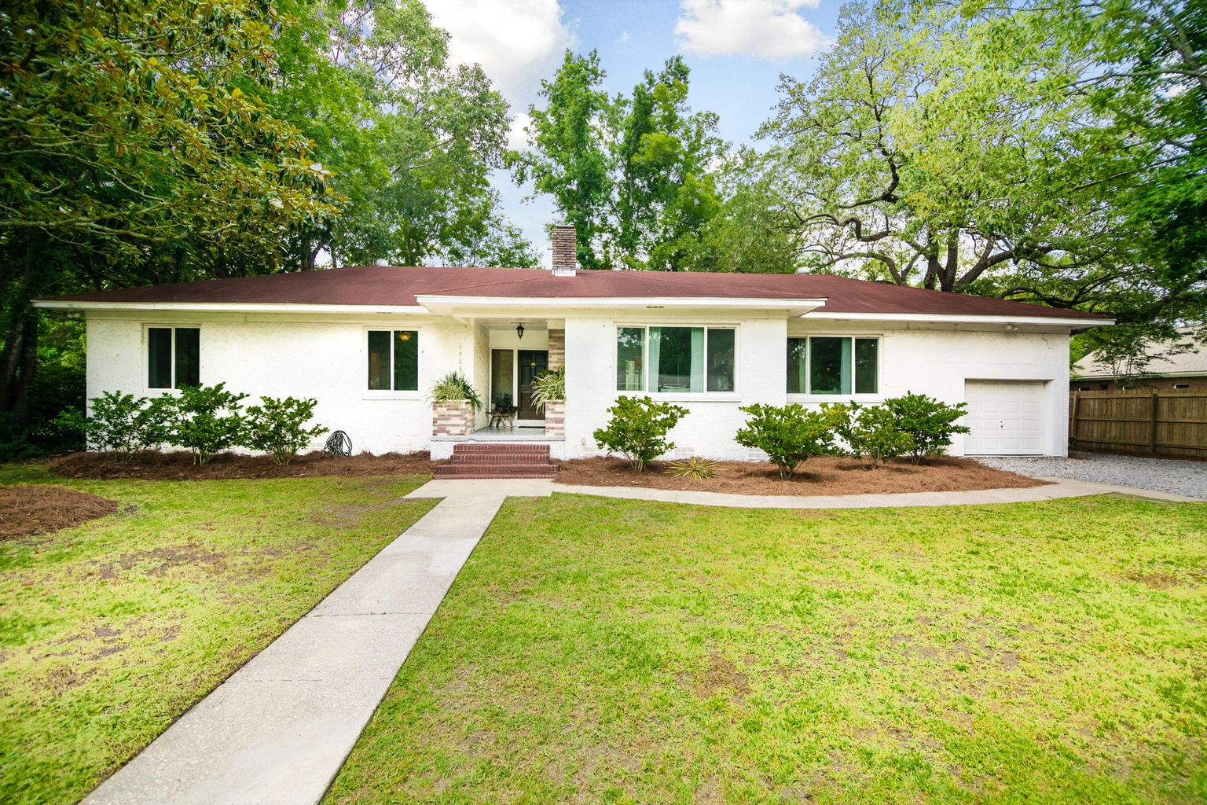
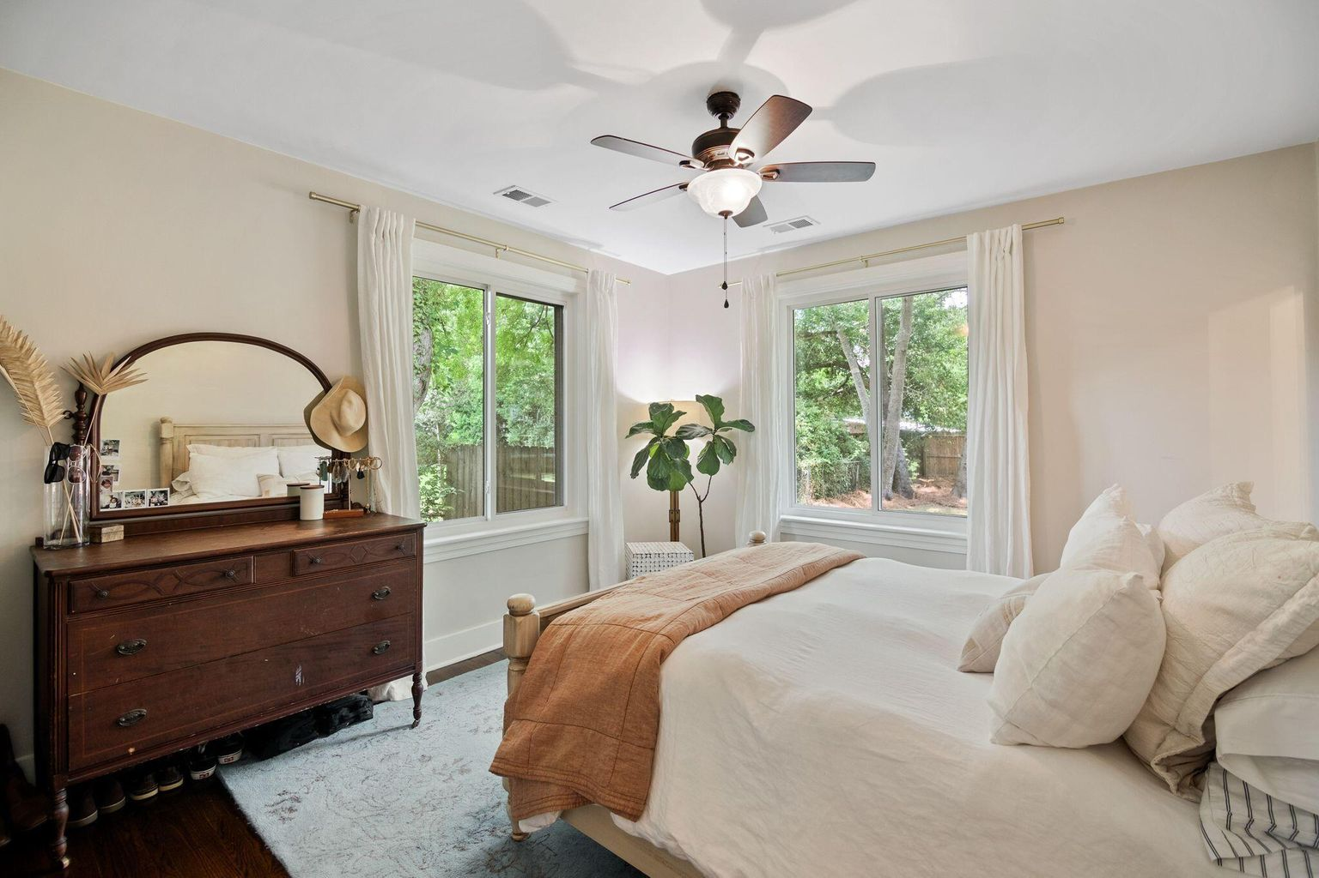
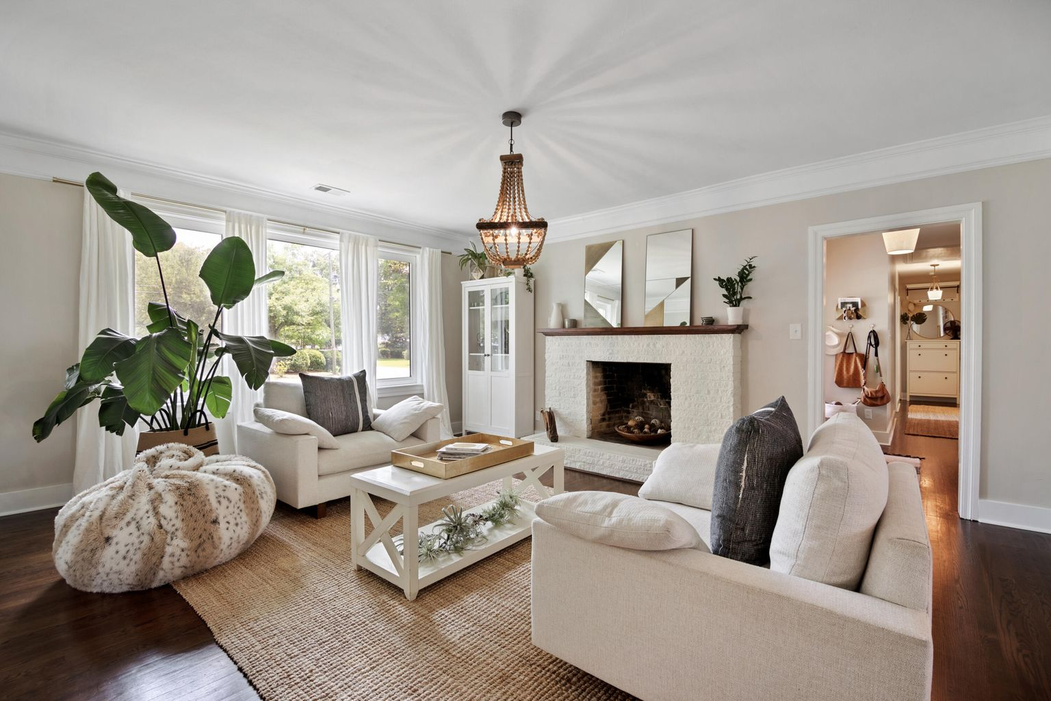
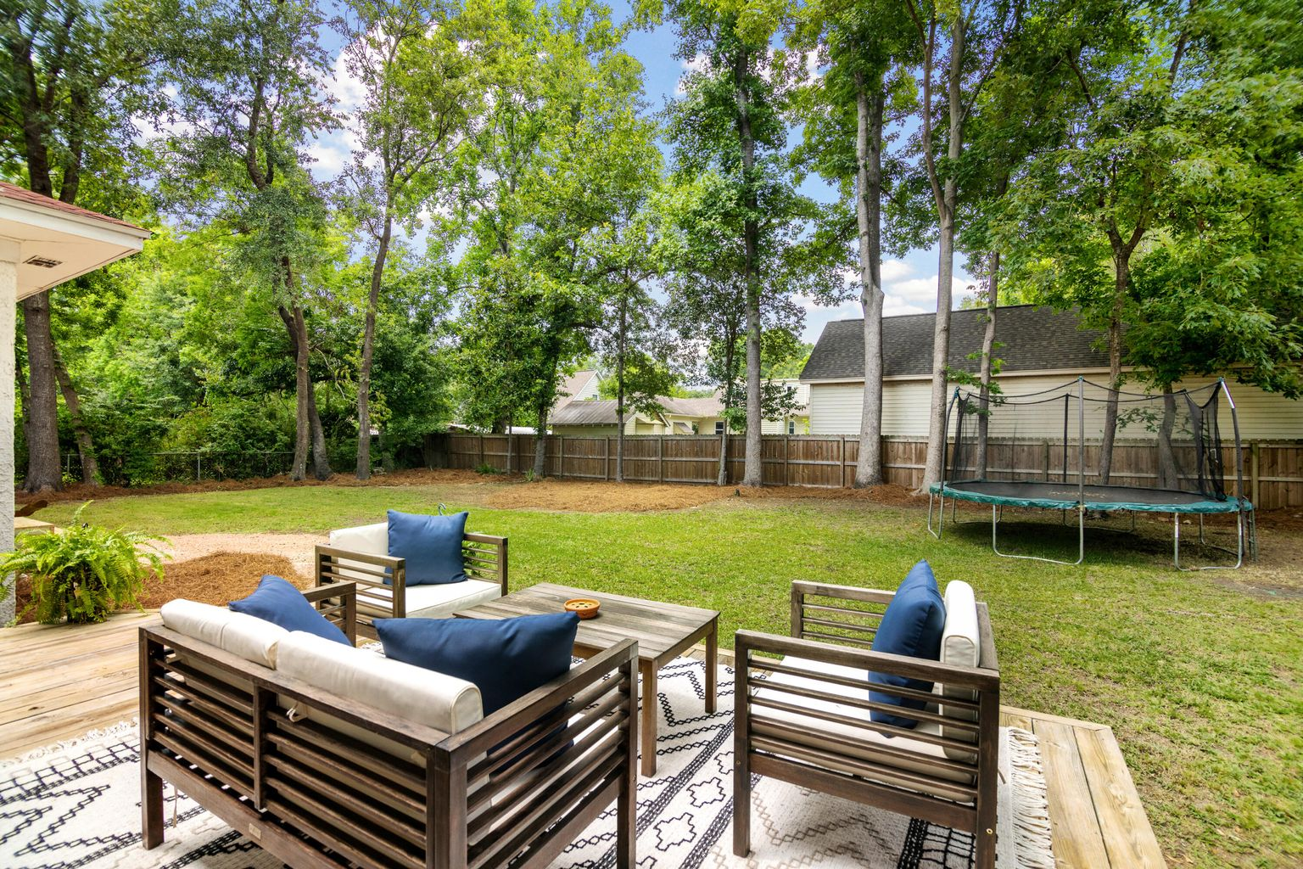
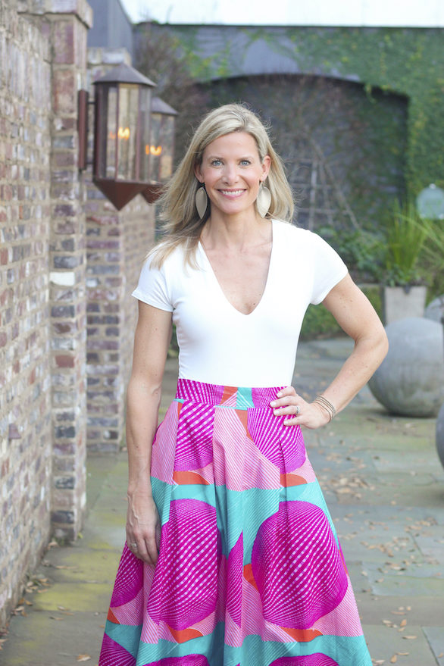

JAMES ISLAND GEM
1708 WAMBAW AVENUE
LAUREL PARK - CHARLESTON, SC 29412
Great Curb Appeal
Updated Throughout
Hardwood Floors
FROG/4th Bedroom
Deck
Fenced Back Yard
OFFERED AT $725,000
SARAH ELLEN LACKE
843.607.4330
SARAHELLEN@SMITHSPENCER.COM
SMITHSPENCER.COM

