Slide 1
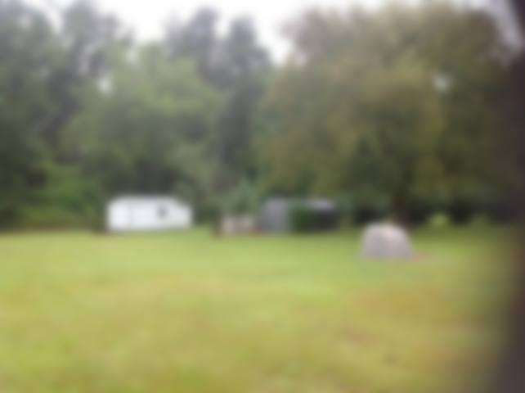
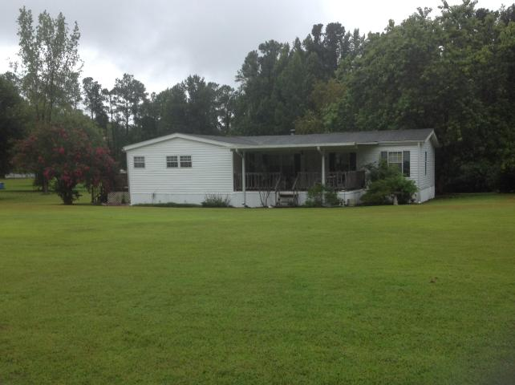
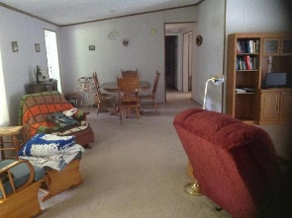
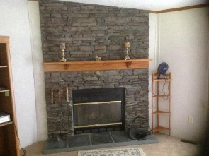
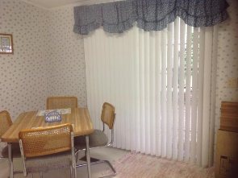
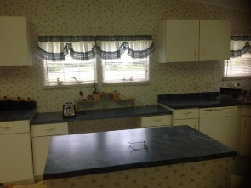
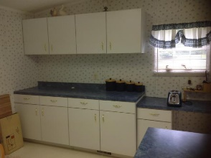
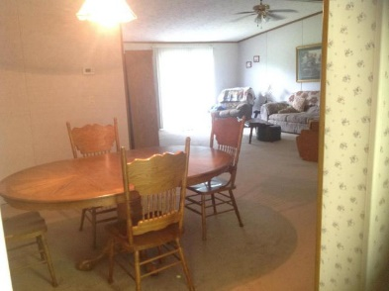
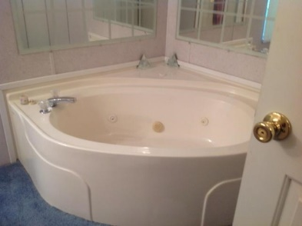

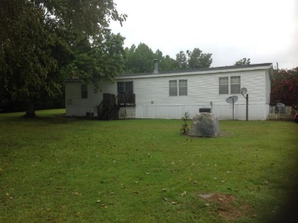

1.15 Acre Lot Within 5 Minutes Of
Rocks Pond Campground!
170 Meredith Drive
Eutawville, SC 29048 | MLS# 17022494 | $138,900
3 Beds | 2 Baths | 1,914 Square Feet
3 Bedroom/2 Bathroom well maintained mobile home zone 2 built with R30 ceilings and R13 side walls. Double paned windows and ceiling fans in most rooms. Large kitchen for family gatherings at the lake. Front porch is covered and back and side porch are three years old. HVAC replaced inside and outside in late 2012. This property 1.15 acre lot within 5 minutes of Rocks Pond Campground! Come see this awesome property today!!!
Carla C Davis
Mobile - (843) 437-4873
gaweber@tds.net
AgentOwned Premiere Group
141 A N. Main Street
Summerville, SC 29483

