Slide 1
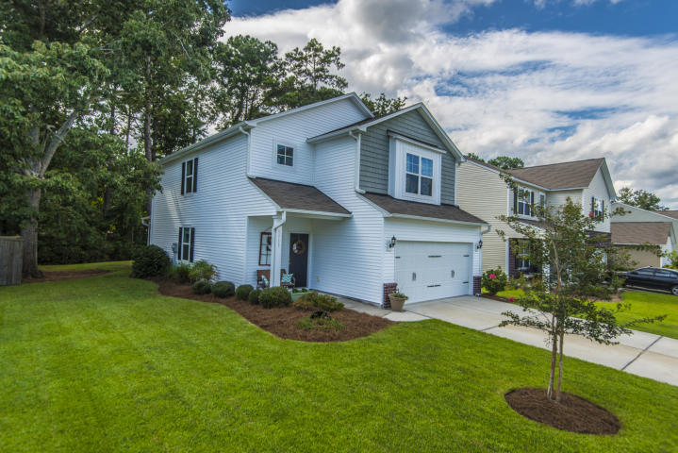
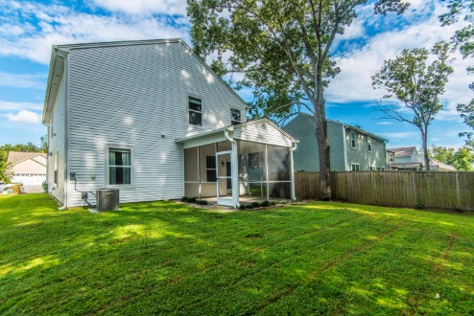
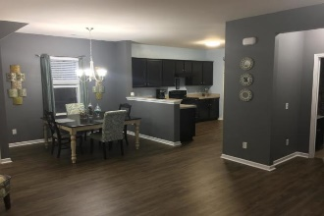
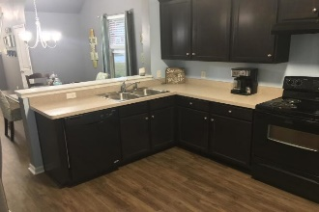
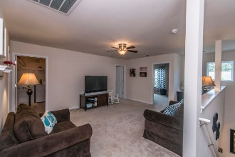
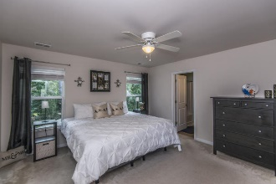
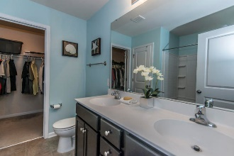
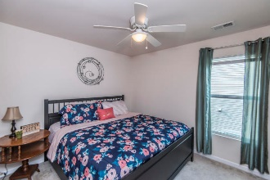
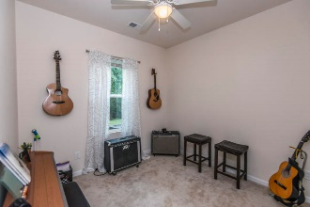
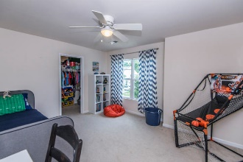
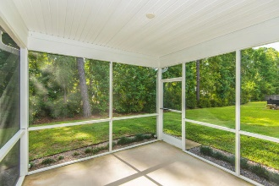
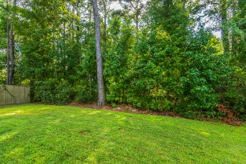

1711 Indaba Way Carolina Bay ~ Charleston MLS# 18032125 ~ $318,990
Bring Your Offer...
Ocean Views looking down 49th Ave
Great Rental Potential!
NO FLOOD INSURANCE REQUIRED
IMMACULATE, Single owner family home with large loft and laundry ROOM on second floor. Owner just installed new Cortec plank floors thru first floor living and kitchen. First floor guest bedroom has adjacent full bath, perfect for in-laws. Screened porch, quiet street and easements on right side and rear of home. Must see and move in ready.
Mary Warren ABR, RSPS, REALTOR
Mobile - (843) 224-6272
mwarren@carolinaoneplus.com
Carolina One Real Estate | 1265 Folly Rd | Charleston, SC 29412

