Slide 1
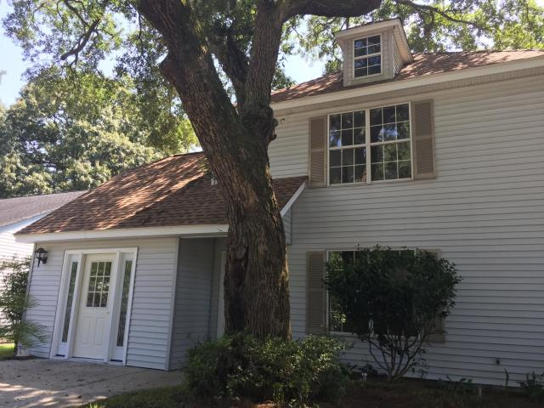
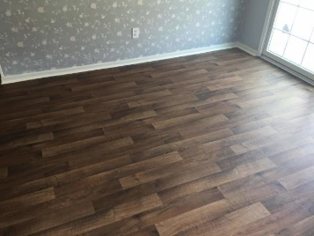
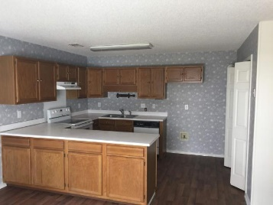
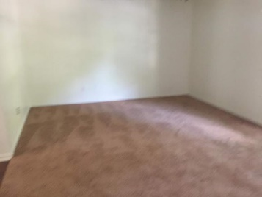
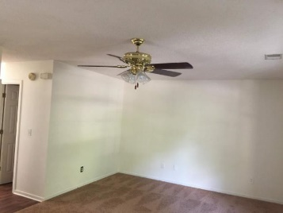
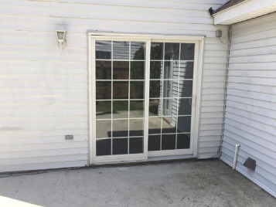
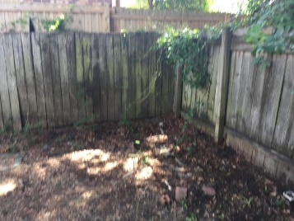

Lovely West Ashley Home
Buyer to receive 5 Day/4 Night cruise for 2.
~ ALSO ~
$1,000 Bonus to the Agent
Ratify by July 31, 2015, and close by August 30,2015
$500 Bonus
$1,000 Bonus
4% Commission
1711 Orange Grove Shores Dr
Orange Grove Shores ~ Charleston
MLS# 19020130 ~ $275,000
THIS CHARMING AND ADORABLE SINGLE FAMILY HOME LOCATED IN A BEAUTIFUL, QUIET WEST ASHLEY SUBDIVISION. THIS MOVE- IN READY HOME FEATURES 1,808 SQ.FT., A NEW ROOF AND HVAC SYSTEM, 4 BEDROOMS, (MASTER'S BEDROOM WITH PRIVATE SUITE BATHROOM), 2.5 BATHROOMS, SPACIOUS OPEN KITCHEN AND DINING AREA WITH VAULTED CEILING FANS. PATIO WITH SLIDINGS DOORS AND SHADY BACK YARD TO RELAX. EXCELLENT LOCATION ONLY MINUTES FROM I-26, DOWNTOWN CITY OF CHARLESTON, SCHOOLS ,SHOPPING, RESTAURANTS AND ENTERTAINMENT.
A GREAT OPPORTUNITY TO EXPERIENCE THE PLEASURES OF SOUTHERN HOSPITALITY LIVING.
Short Sale
Edward Washington
843-737-3347
ewashington@exitlowcountry.com
Exit Realty Lowcountry Group
3618 Ashley Phosphate Rd
North Charleston, SC 29418
exitlowcountry.com

