Slide 1
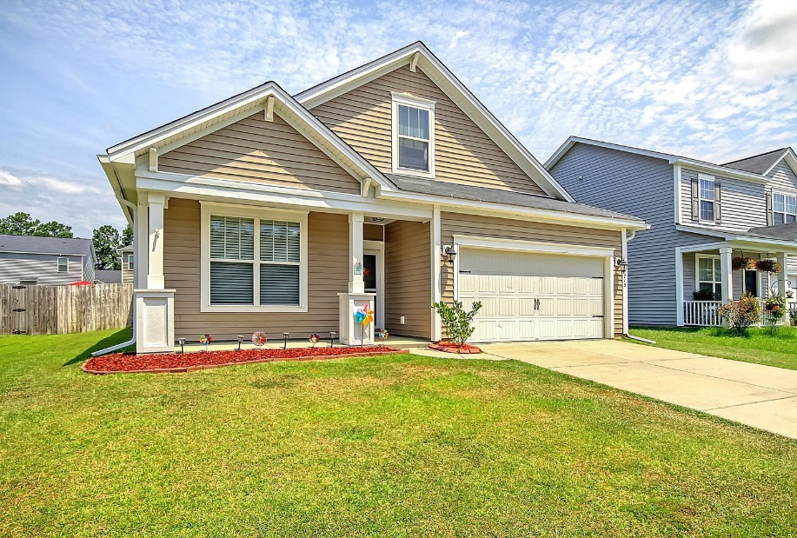
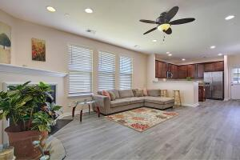
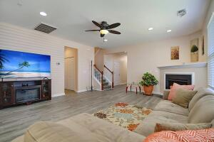
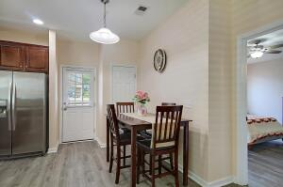
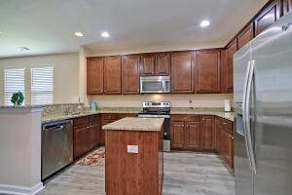
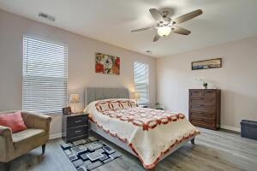
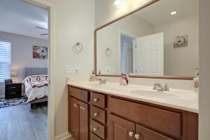
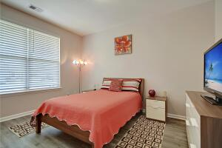
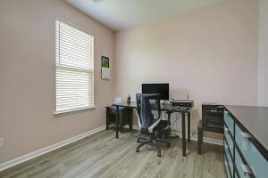
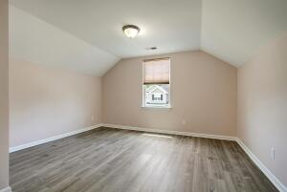
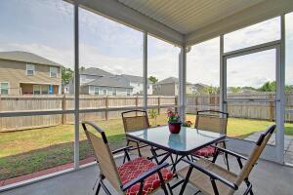
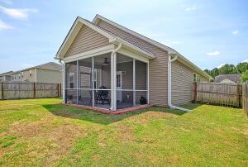
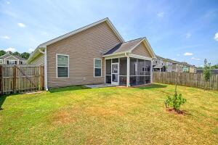


Summerville Beauty! Only $325,900!
1715 Diving Duck Lane
Drakesborough
Summerville, SC 29483
MLS# 22017398
$325,900
4 Bedrooms | 2 Baths | 1,873 sf
Welcome to 1715 Diving Duck Lane! This is the house you've been waiting for! This home has been well maintained with all new flooring throughout, fresh paint and recently installed gutters! Walk in to this home and you'll right away notice the open floor plan and gorgeous flooring. A bedroom to your left with a full bathroom right outside of it is perfect for guests. To your right is another bedroom, as well as the laundry room. The kitchen has plenty of storage, beautiful cabinetry with lazy susans built in, as well as an island, new stove, eat in kitchen area, breakfast bar and pantry. The kitchen overlooks the large living room. Off of the kitchen is access to the screened in back porch, patio and fenced in backyard. The primary bedroom is also off of the kitchen and is a great size. It offers a large walk in closet as well as its own bathroom with dual vanities and separate tub and shower. Head upstairs for the fourth bedroom, which can also be used as media room, exercise room, you name it. This room has a large walk in closet as well. Drakesborough is a sidewalk lined community and is zoned for Dorchester District 2 schools. Just minutes from shopping and the interstate, the location is ideal. Come see this house today!!
Larry & Kathy Mazalatis
Larry Cell 843-693-0529
Kathy Cell 843-693-0159
Office 843-871-9133
AGENTOWNED PREMIERE GROUP | 1800 TROLLEY RD | SUMMERVILLE, SC 29485

