Slide 1
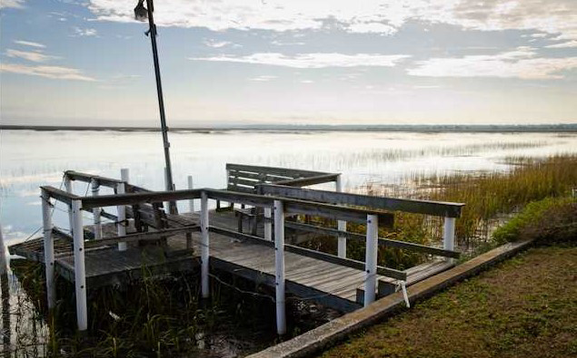
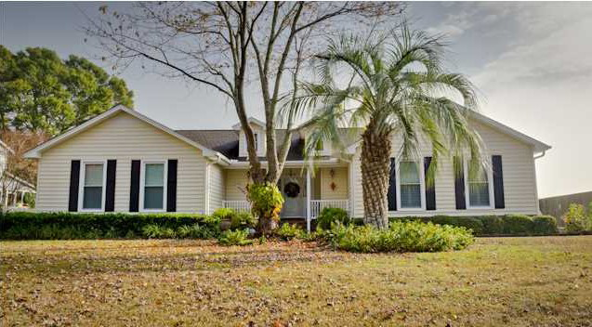
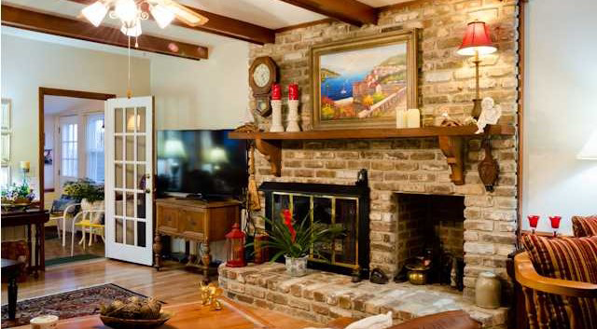
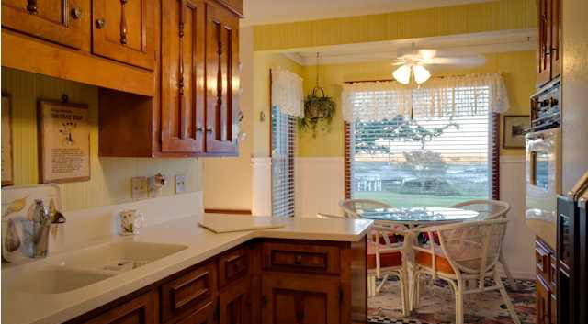
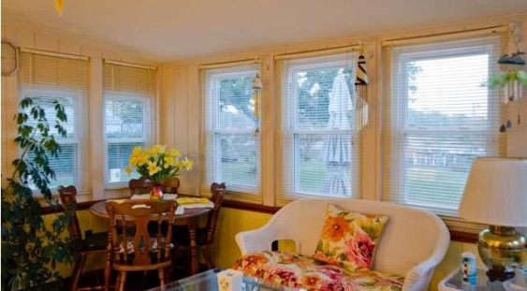

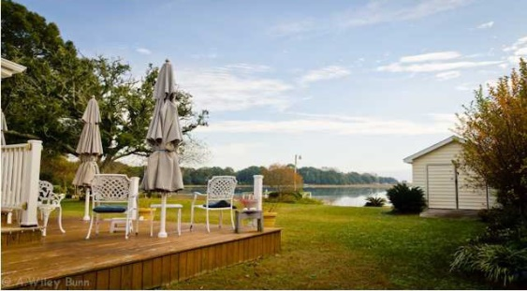
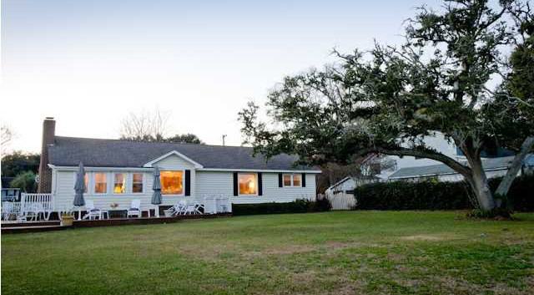


1716 Battalion Dr Secessionville ~ Charleston MLS# 1330157 ~ $459,900
**$3000k SELLING AGENT BONUS** w/ratified contract by 8/30/2014
*Priced to sell with $20,000 Price Reduction*
FLOOD INSURANCE IS ONLY $480/YR
No other home on JI compares to the impressive expansive views of the open marsh and creek you have from virtually every room in this house! When you wake in the morning you can look out your first floor master bedroom and see the sunrise over Morris Island lighthouse. As you prepare breakfast and drink coffee from the kitchen table, sunroom or rear porch/deck you can watch the dolphins and many coastal birds that make the marsh and tidal creek their home. Unlike many other marshfront/waterfront homes, the dock and boat lift are only a short distance from the grass area of the backyard saving on the ongoing maintenance of your dock! You can ride your bike or take a 5 minutes drive to the beach! This home also comes with a well landscaped yard with an irrigation system in place. Family room equipped with wet bar, computer desk and fireplace with gas logs. Kitchen has Corian Counter tops, built-in microwave, smooth top cook top, wall oven and dishwasher. 14 x 20 shed conveys. This home has been meticulously kept up with, having a 16 SEER Trane HVAC installed 2005, new roof 2002, new windows 2004, new garage door 2007.
This property is a must see and won't last! *Current flood insurance quote from Nation Wide
JERICHA A. MCGEE
Mobile - (843) 568-1767
jdelia@mycharlestonproperty.com
www.mycharlestonproperty.com

