Slide 1
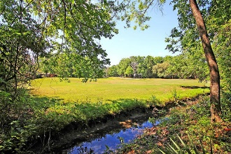
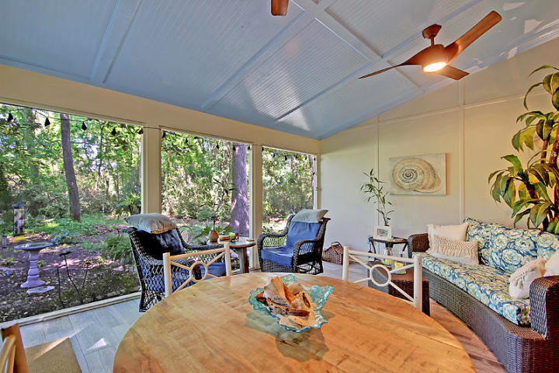
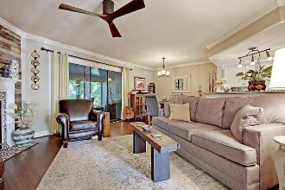
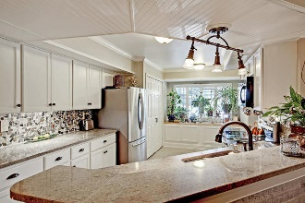
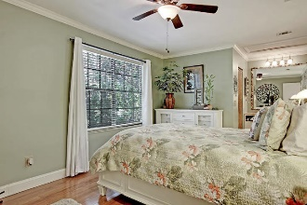
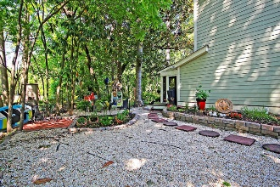
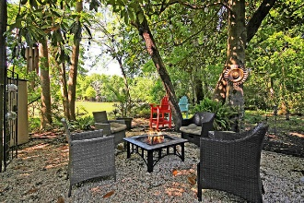
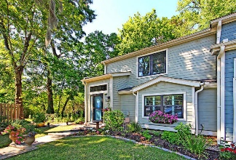
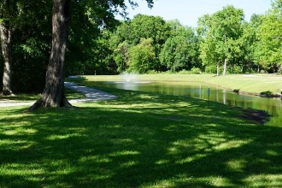
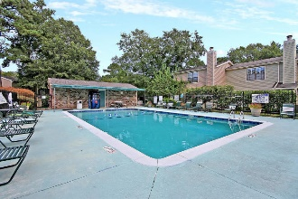
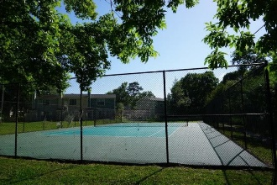


End Unit Townhome on Golf Course w/ Screened Porch
Starbucks card to first 10 agents
1716 Villa Maison
Montclair ~ Mount Pleasant ~ MLS# 19012569 ~ $274,900
Meticulously maintained and tastefully updated, this two story end unit townhouse is the quintessential location in Mount Pleasant achieving one of the best walking scores you'll find. Recent updates include new hurricane windows on the front, updated kitchen & baths inclusive of granite kitchen countertops, stone backsplash, new refrigerator, microwave, garbage disposal, and kitchen faucet, custom storage cabinets under the bay window, custom plantation shutters, bead board installed on the kitchen bulkhead, and ceramic tile flooring that extends from the kitchen into the hallway and foyer areas. The entire downstairs is an open living concept, with the kitchen open to the living room, screened Carolina Room, and private backyard. The screened Carolina Room is a recently added custom built room rarely found on these townhomes. Measuring 14' x 17' and screened floor to ceiling with no see-um screens, porcelain flooring, Haint Blue bead board ceilings, two large Koa wood ceiling fans, Hardy Plank walls, and exterior flood lighting. Direct access from the living room blends this area seamlessly together for added living space. The backyard living area is like no other and you will instantly fall in love. Extremely private and plush greenspace has been extensively landscaped and is one of the absolute best lots in the area. Custom landscaping includes stone raised bed, stone boarders, perennial shade loving plants, stone patio, pad for bicycle storage, unobstructed views of the Snee Farm Golf Course, and abundant mature shade trees to help keep the temperature down during warm summers. Back inside, the living room and dinning room feature newer Bamboo floors, bamboo ceiling fan, shiplap over the fireplace with river rock face, and custom enclosure doors to hide the tv in the living room. Upstairs are both bedrooms, each featuring their own private ensuite bathroom, both extensively updated. Montclair is all about the location. Featuring gated access, a community red light for easy entrance onto Hwy 17 both via car or to walk/bike to the Mount Pleasant Towne Center located directly across the street and a dozen restaurants with endless shopping, Starbucks, Lowes, Publix Grocery Store, and even the town Movie Theatre. Bike to the beach. The HOA includes water, exterior insurances, 2 pools, expanded fitness room with newer equipment, recently resurfaced tennis courts, and community lawn maintenance. If you're looking for a 'lock it and leave it' townhouse in the heart of Mount Pleasant with top notch amenities, close to shopping, restaurants, Hwy 17 and 526 as well as Downtown Charleston, and of course multiple beaches, look no further.
Jerod Coulter, ABR, REALTOR
(843) 513-3741
jerod@realtor.com | www.HomesOfMountPleasant.com
The Boulevard Company, LLC | 35 Broad Street | Charleston, SC 29401

