Slide 1
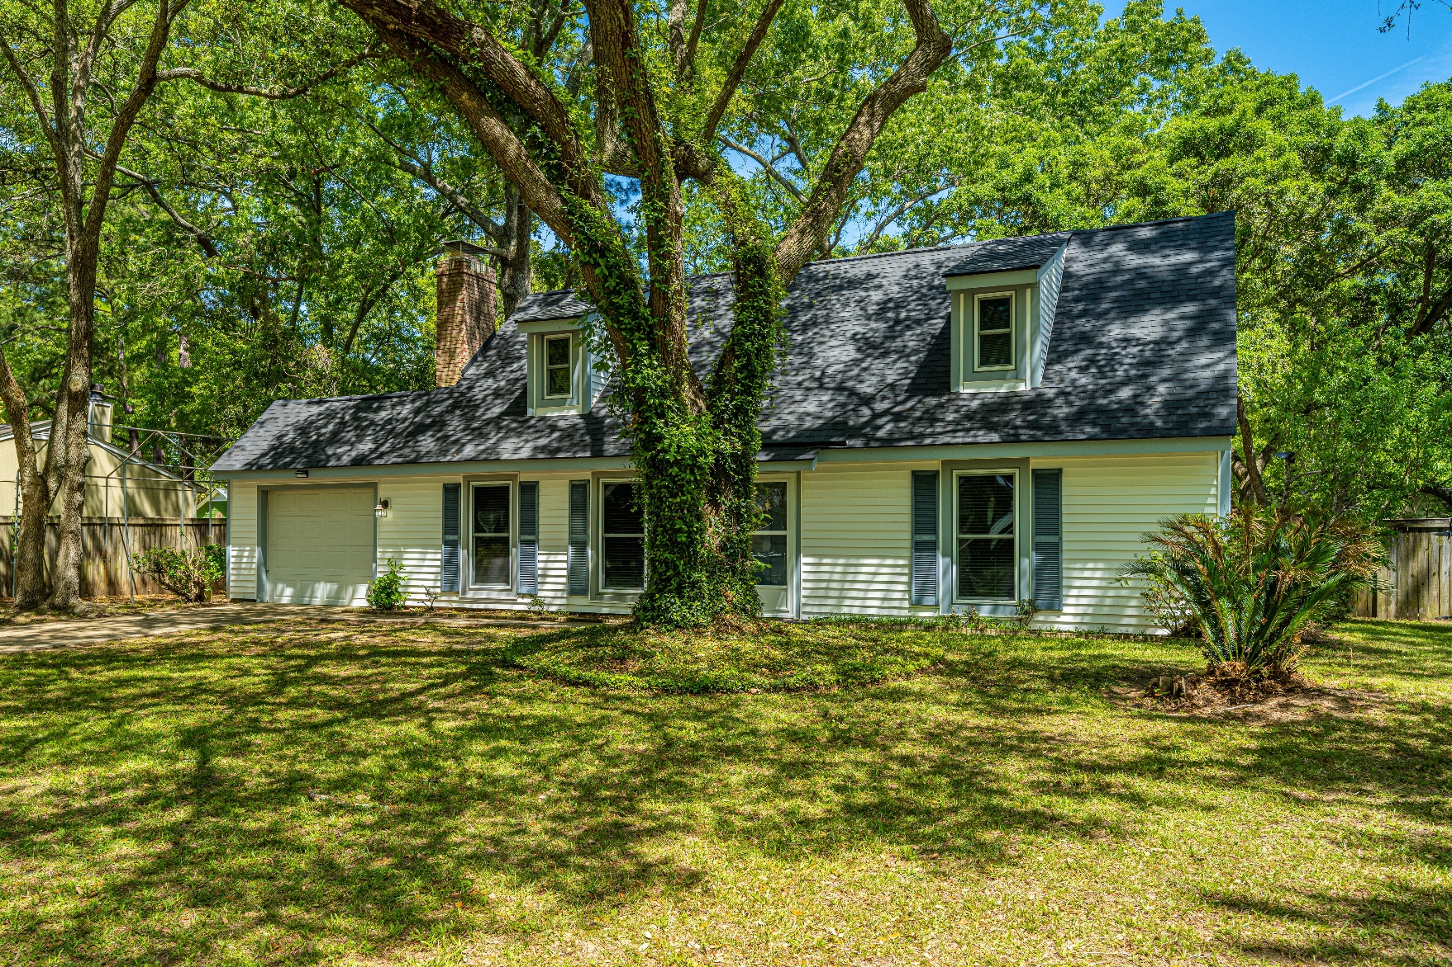
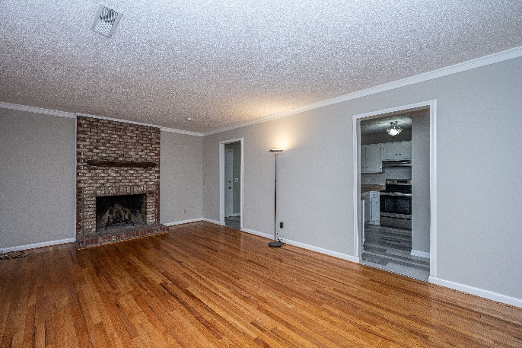
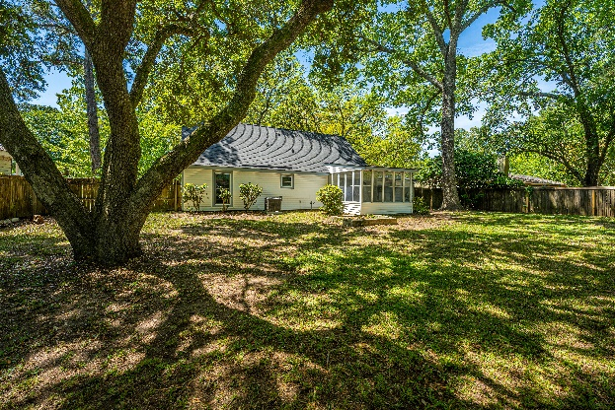
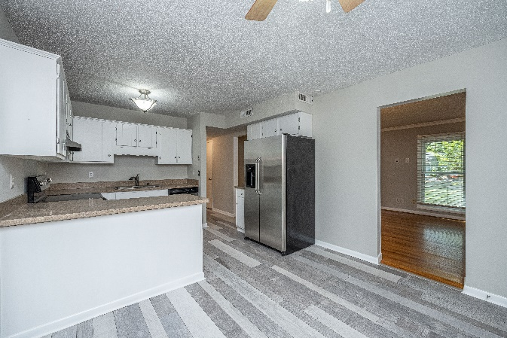


Superb Central Mt Pleasant Location!
1716 Nantahala Blvd
Mt Pleasant, SC 29464
Lower $500Ks
1518 SF
plus sunroom extra
4BRs, 2 Baths
Preferred School Zoning: Edwards, Moultrie, Beckham
Brand new roof, 2019 HVAC
Fresh interior neutral paint, some newer floors
Mature trees, spacious yard
Current Terminix termite bond can transfer
STEVE ROWE
,Realtor®
Retired Military. Active Agent.
(843) 303-7438
srowe@carolinaone.com
www.SteveRoweHomes.com

