Slide 1
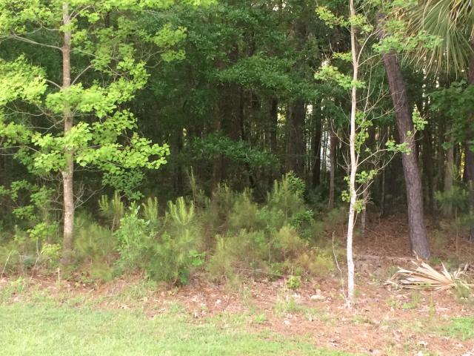
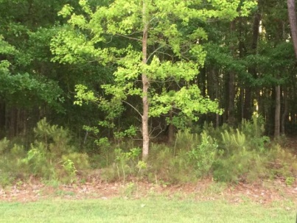
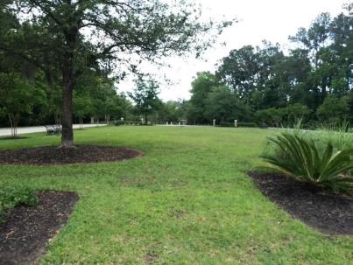
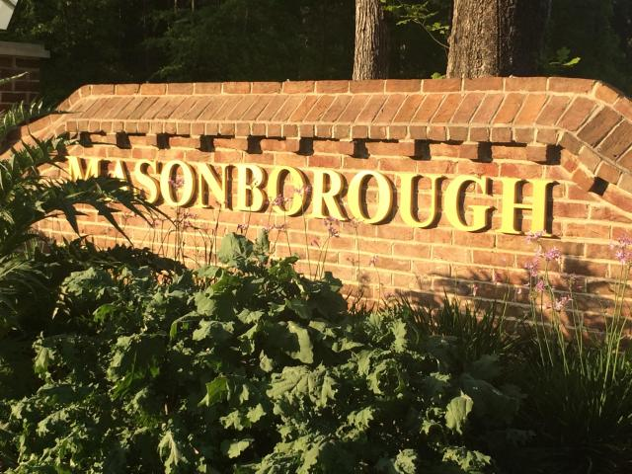
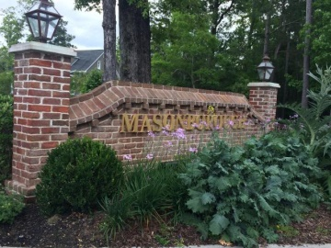
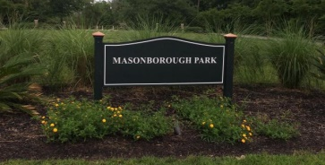



1717 W Canning Drive Masonborough Mount Pleasant, SC 29466 MLS# 15010485 · $175,000
55 and Better!
Build your
Custom Dream Home
Get it while you can…home site in popular Masonborough at Park West! Time is ticking and land is disappearing! Take advantage of Park West amenities including swim and tennis, homeowner’s clubhouse, a playground, jogging trails and a community crabbing dock. Don’t put off until tomorrow what you can do today!
Maria Woodul, ABR, CRS, SFR
Broker Associate
843.297.1836
MWoodul@carolinaone.com
www.MariaWoodul.com
Carolina One Real Estate
2713 Highway 17 North
Mt. Pleasant, SC 29466

