Slide 1
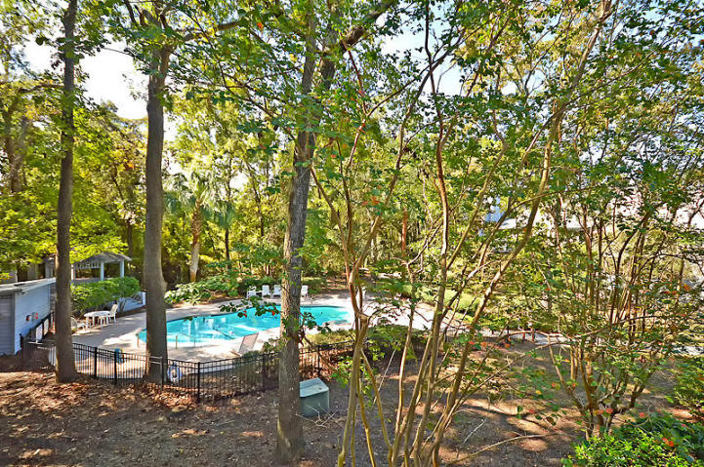
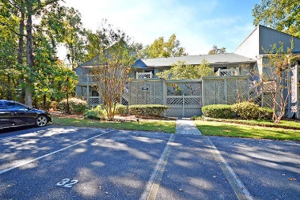
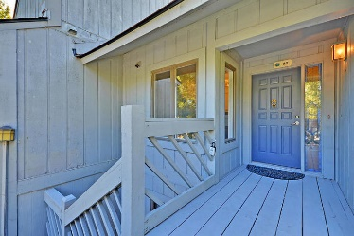
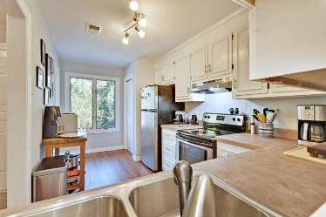
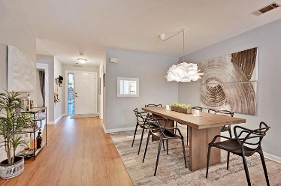
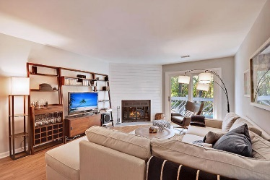
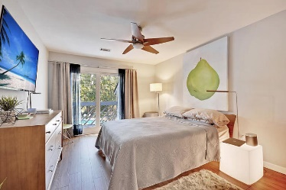
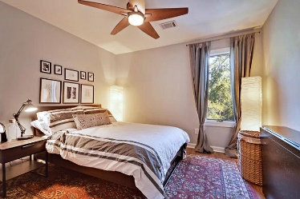
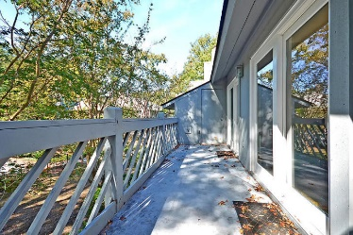

1718 Greystone Boulevard #32
Greystone · Mount Pleasant, SC 29464
MLS# 19029654 · $200,000
Gorgeous Listing
Fantastic Location!
Private second-floor condo is only 5 minutes to the Isle of Palms, a short drive to Downtown Charleston, and Mt Pleasant Towne Center is across the street! Newly remodeled living area has SHIPLAP around fireplace, BARN DOOR into master bedroom retreat, custom lighting, new flooring, and fresh paint everywhere. The floor plan has a great flow for everyday living. The kitchen is perfect for entertaining with stainless steel appliances, concrete countertops, a pass through to the dining area, ample storage space with lots of cabinets and a pantry. You'll appreciate the two spacious bedrooms and two full bathrooms. Family room and the master bedroom have outside access to the back porch with a gorgeous view of the neighborhood pool. This condo has it all!!!!
Stan Huff
843-670-2835
stan.huff@agentowned.com
Jill Marcacci
843-297-5590
jill@agentowned.com
www.agentownedrealty.com
AgentOwned Realty Co. Preferred Group, Inc. | 824 Johnnie Dodds Blvd | Mt Pleasant, SC 29464

