Slide 1
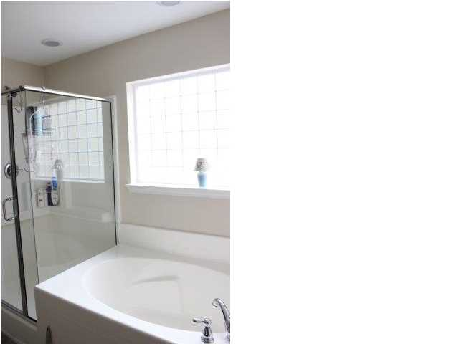
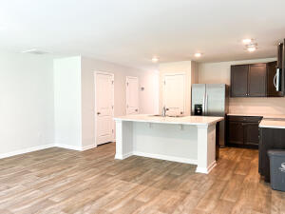
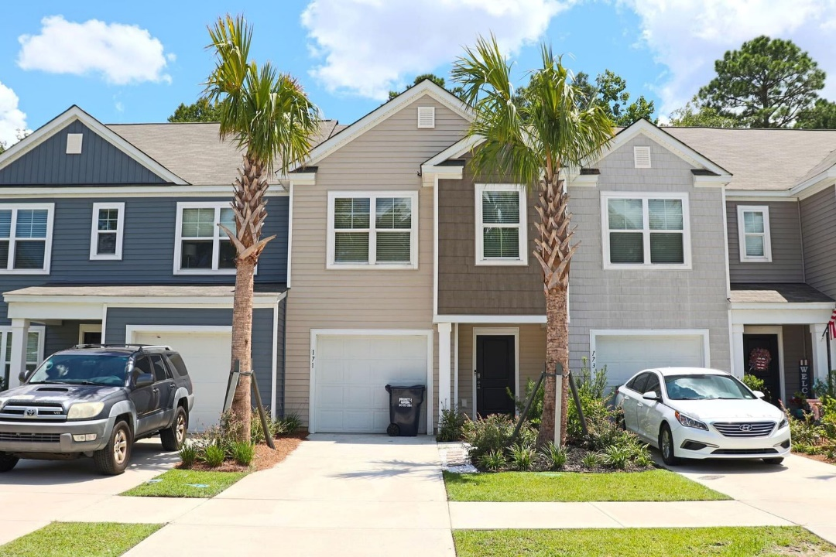
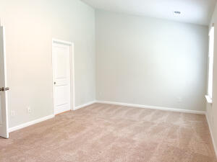
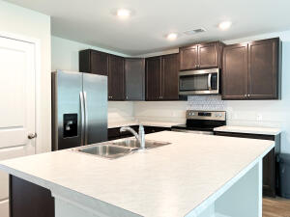
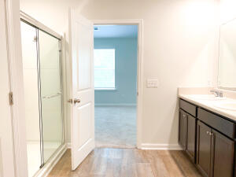
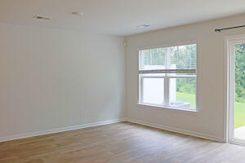
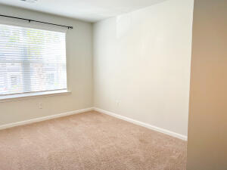
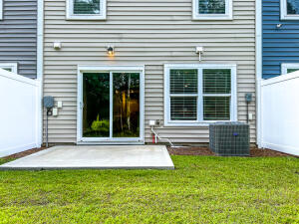
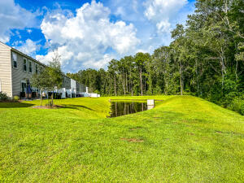

Open House Sunday September 18th 11-2
Free Charleston Print to First 10 Visitors
Register for a Housewarming Gift Basket!
171 Rosefield Court
Palmetto Reach | Summerville
MLS# 22021284 | $303,000
MOVE IN READY!
Come check out this open concept townhome built in 2021. It sits in the back of the Palmetto Reach community, just off Miles Jamison Rd, and backs up to a wooded area for extra privacy. The home includes a one car garage. The downstairs living area includes a living room, dining area, and huge kitchen with a large island! Just off the living area is the patio and backyard. Upstairs, you will find three bedrooms, a guest bathroom, and laundry. The master suite includes a large bathroom with a dual vanity, large shower, and a large walk in closet. A quick ten drive into Summerville, you are close to al your favorite restaurants and shops!
Joanie Rhoten
Office: 843-261-7166 | Mobile: 513-518-7475
joanie.rhoten@agentownedrealty.com
www.agentownedmainst.com
AgentOwned Realty Co. Premier Group | 141 A N. Main Street | Summerville, SC 29483

