Slide 1
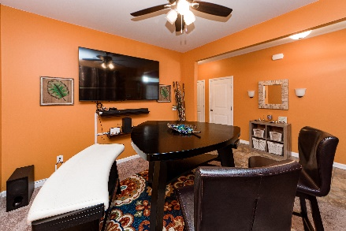
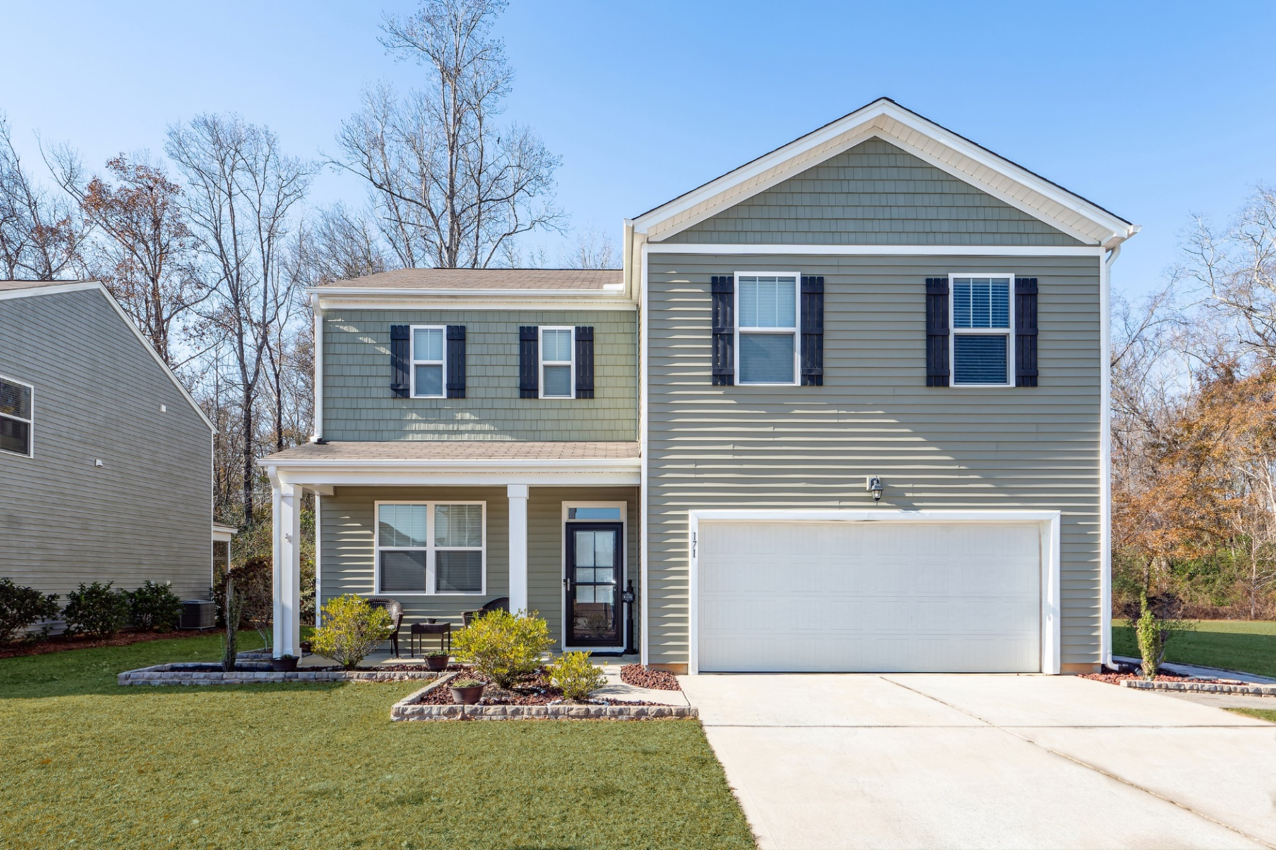
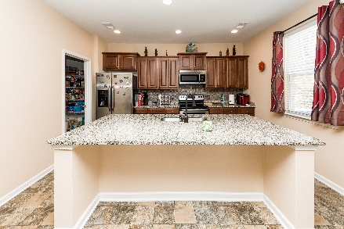
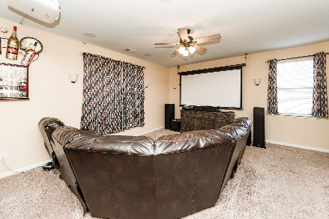
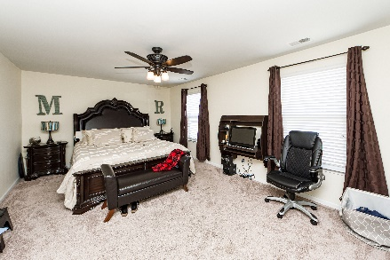
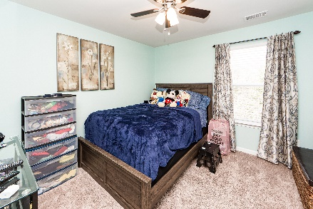
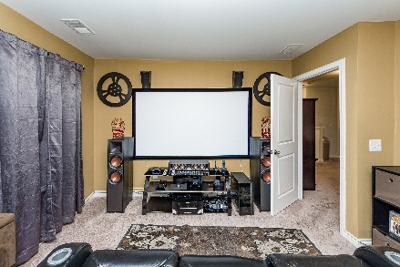
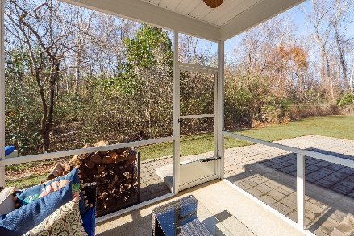
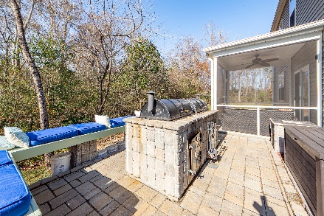


171 Stoney Creek Way
Stoney Creek
Moncks Corner
MLS# 22031172
$385,000
Open House March 5th from 11a–2p
The Galen plan is the flagship line up with an astonishing 2432 square feet 4 bedrooms, 2.5 baths. This home offers a wide open plan on the main floor. The flex room welcomes you to a perfect dining room, or in home office. Vinyl and Carpet flooring downstairs, and granite counter tops in the kitchen, with a large great room upgraded w/ surround sound speakers. Leading to an outdoor living space you must see! The patio area is covered and screened flowing in a stone paved dining area complimented by the stone enclosed grill and smoker. Upstairs will lead the way to the spacious Owner's suite and ensuite. Across the corridor will be 3 bedrooms and 1 full bath.
Take a virtual tour!
Shanaya Hammond
843-345-1082
hammondspace@gmail.com
The Space Company | 3110 North Carolina Avenue | North Charleston, SC 29405 | thespacecompany.com

