Slide 1
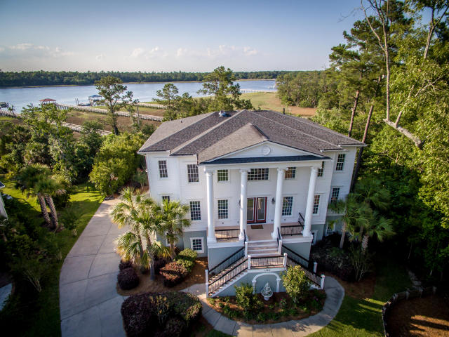
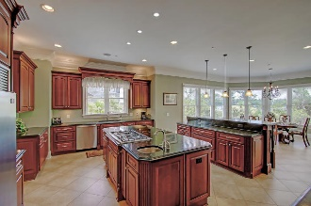
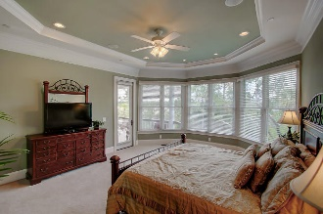
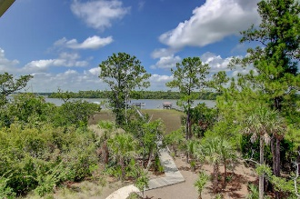
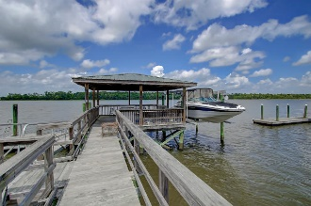
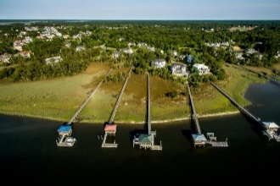


1720 Bowline Drive Dunes West :: Mount Pleasant MLS# 16020876 :: $1,595,000
Truly a Gem on the Wando Price Reduced...Bring Offers!
Classic low-country home on the Wando River with a private deep water dock, large covered pier head, boat lift and floater. Enter this gracious home into a soaring two story foyer with views of the river. A large formal dining room to the left and a private study on your right. Continue through the foyer into the great room with custom bookcases, gas fireplace and floor to ceiling glass overlooking the river. Chef's kitchen is adjacent to great room with top end appliances, custom cherry cabinets, large island, pantry and bar area. The master retreat is just off the great room again with river views and incredible bath with his and hers large walk in closets, oversized steam shower with all the bells and whistles. In addition the main living level has laundry and powder room. Take the sweeping staircase upstairs to find four bedrooms. One is a second master again with walk in and steam shower. The other have private baths, a media/playroom with access to large deck with incredible river and sunset views . Most all of the rooms have river views. The lower level has endless possibilities. mother in law suite, playroom. Also a bedroom and bath on this level in case you need a sixth bedroom . Opens to private patio with hot tub that stays. Three car garage plus extra storage. Some of the home features include impact windows and doors, fire sprinkler system, lifetime Rhino Shield paint on exterior, tankless hot water heater, lawn irrigation, plumbing stubbed for bar/ ice machine. Come see for yourself and enjoy the lifestyle of waterfront living at its finest!
Clay Cunningham
O (843) 886-8110
M (843) 345-4647
clay@carolinaone.com
www.claysre.com
Carolina One Real Estate
1503 Palm Blvd Ste
Isle of Palms, SC 29451

