Slide 1
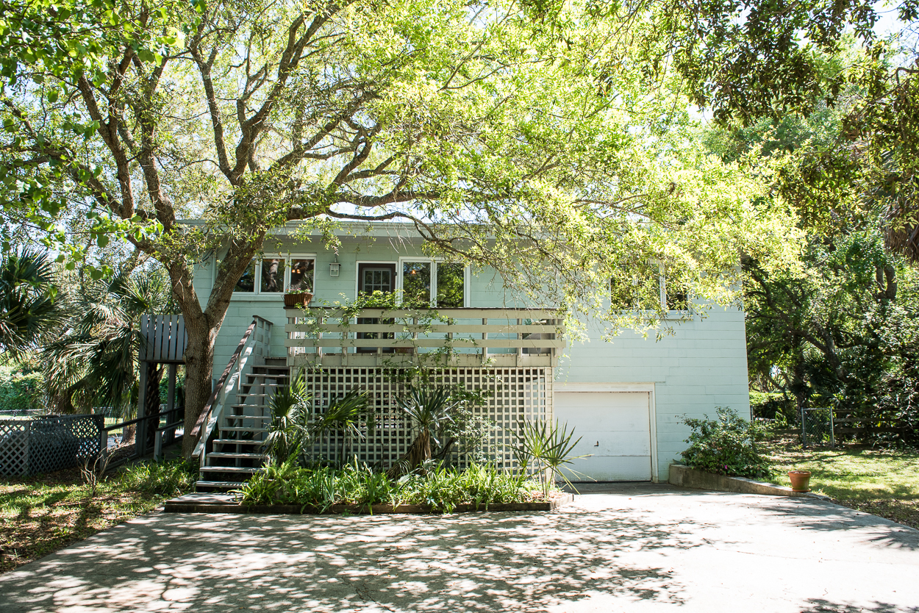
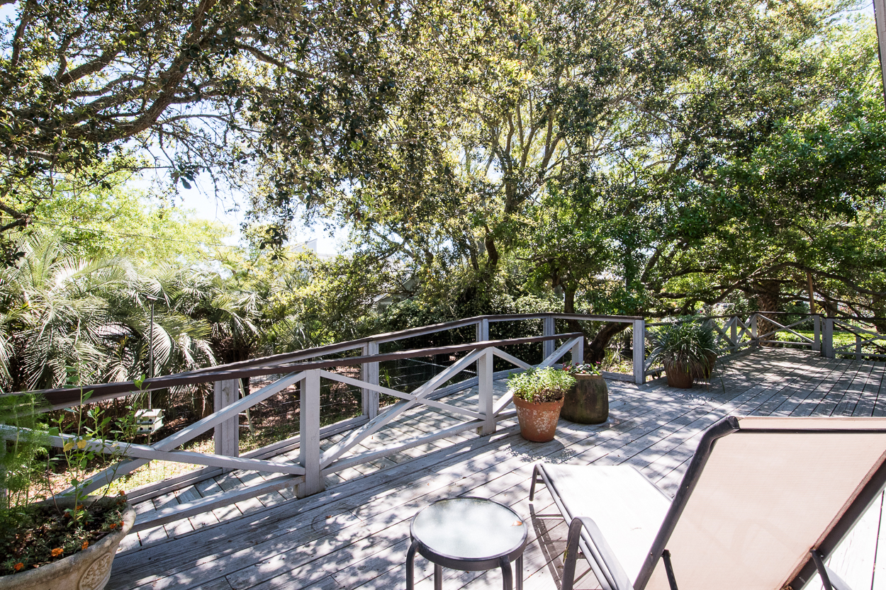
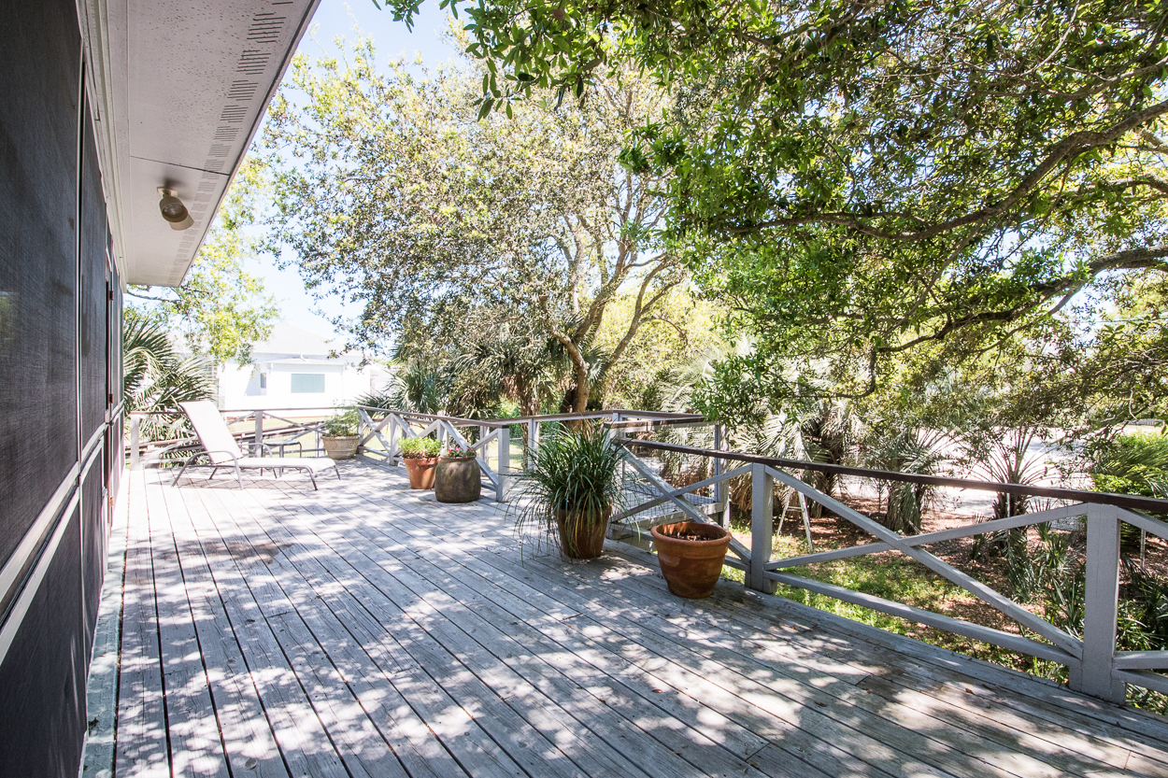

1721 Atlantic Avenue Sullivan’s Island
Ocean view
Private Beach Pathway
Where the “locals” live
Perfect place to build a dream home
House in move-in condition (selling As Is)
Property has rental history
Offered at: $1,600,000
MLS: 16010612
Connie Dittrich Carolina One Real Estate 843-475-7993 cdittrich@carolinaone.com

