Slide 1
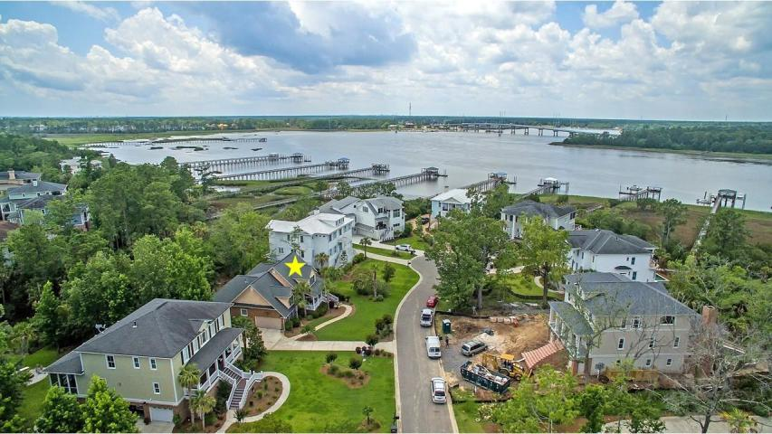
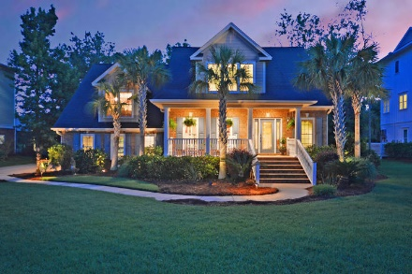
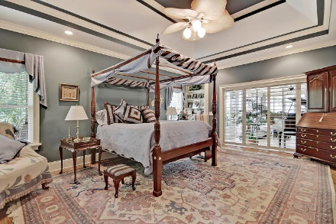
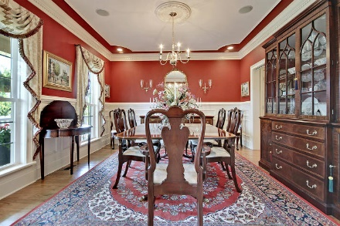
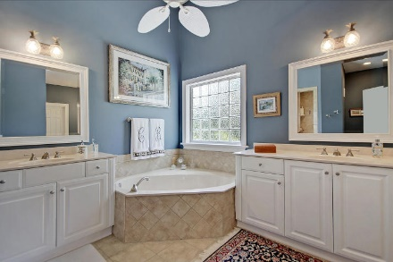
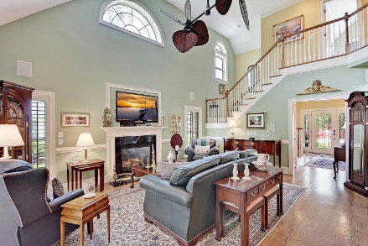
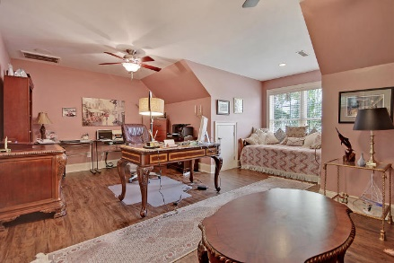
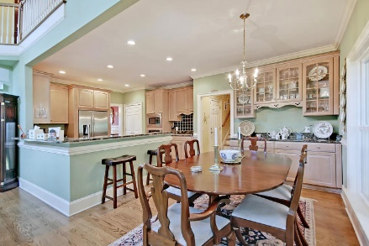
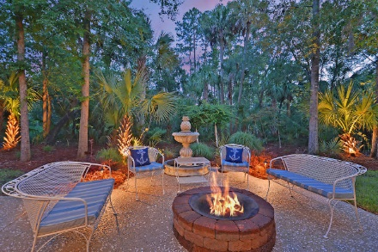
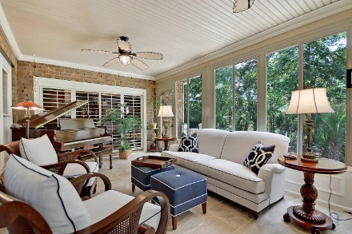
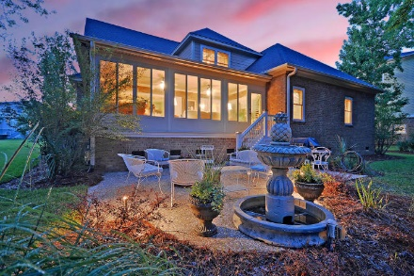
LUXURY IN DUNES WEST!
SUPER LOW PRICE!
Price Reduced!
1721 Bowline Drive
Dunes West ~ Mount Pleasant, SC 29466 ~ MLS# 18017341 ~ $649,900
Situated on a peaceful cul-de-sac in Dunes West that backs to the Wando River, this two-story home is well appointed & waiting for you! From the moment you step foot inside, you'll notice the beautiful upgrades like the intricate trim work in the crown moulding, two columns that welcome you into the formal dining room, wainscoting, hardwood floors, a decorative tray ceiling in the master, tile backsplash in the kitchen and glass front cabinets in the eat-in area of the kitchen. The beautiful two-story living room boasts a fireplace & tropical, double ceiling fan while the sunroom boasts stunning wraparound views of the wooded backyard. A front porch & back patio with fire pit are wonderful spots to enjoy the outdoors. This golf community has resort style amenities that you'll just love!
Additional features include:
Spacious, open floorplan
Staircase in the front and back
Remodeled sunroom with heated and cooled tile flooring and moulding
Stately dining room perfect for entertaining
Great room with soaring vaulted ceilings and fireplace
The kitchen opens to the great room and includes granite countertops, tile backsplash, a gas cooktop, a wall oven, a built-in microwave, and an eat-in area with a built-in buffet with cabinets
Master bedroom with stunning tray ceiling and access to the sunroom, and master bathroom with two vanities, a soaking tub, and a large step in shower with dual shower heads
Backyard patio to enjoy the lowcountry climate
Tinted windows
Alarm system
New HVAC
Rinnai tankless water heater
Beautiful gas lanterns in the front and driveway
Landscape lighting and separate irrigation meter
Lovely water views to enjoy the sunsets
Great amenities including a security gate, golf club, swimming pool, tennis, boat ramp, and walking trailing
Book your showing today!
Chip Walsh chip@mattoneillteam.com 843-822-4663

