Slide 1
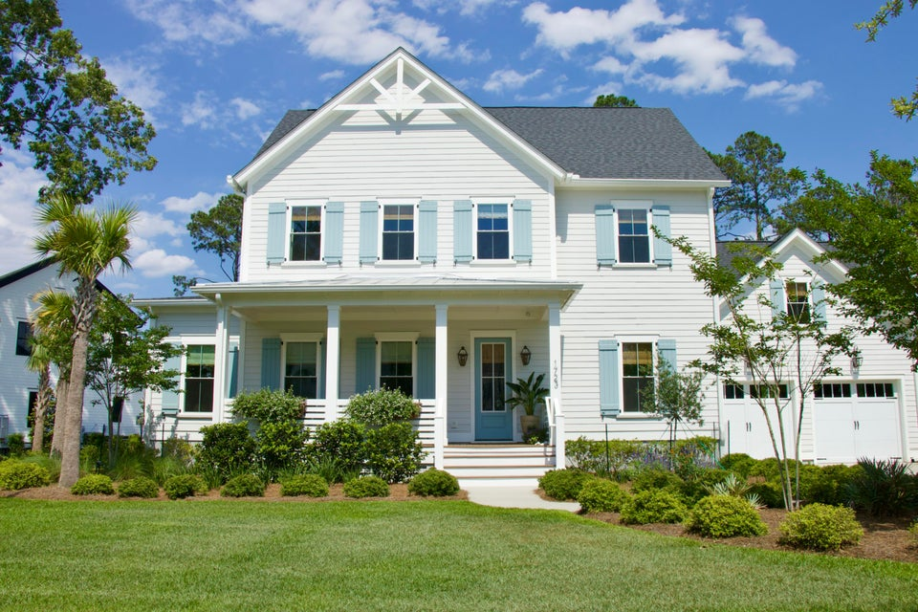
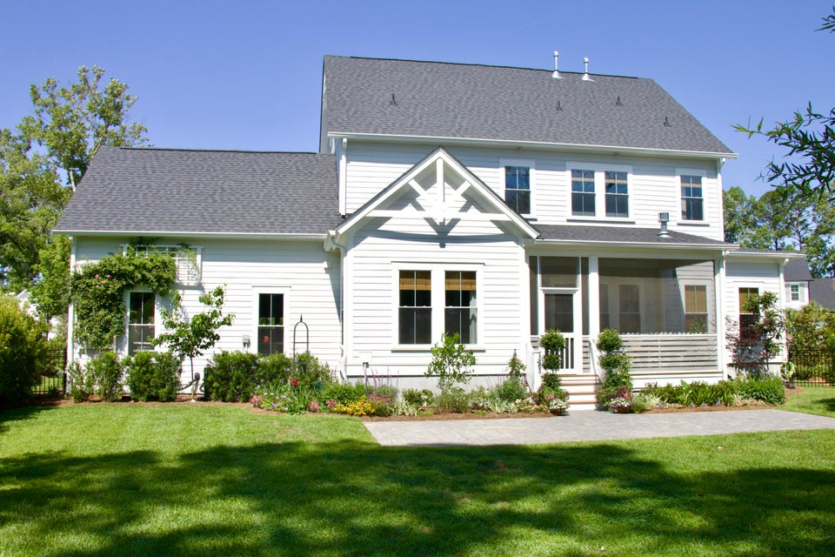
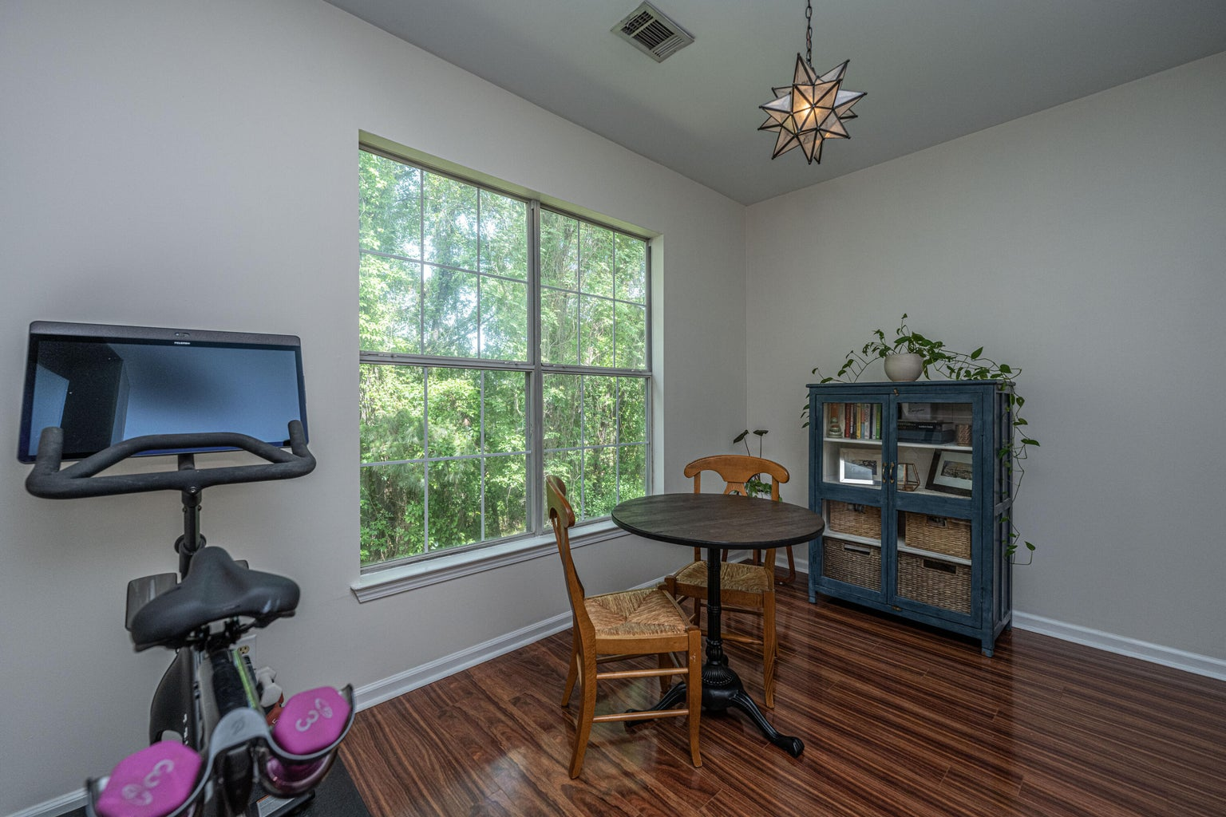
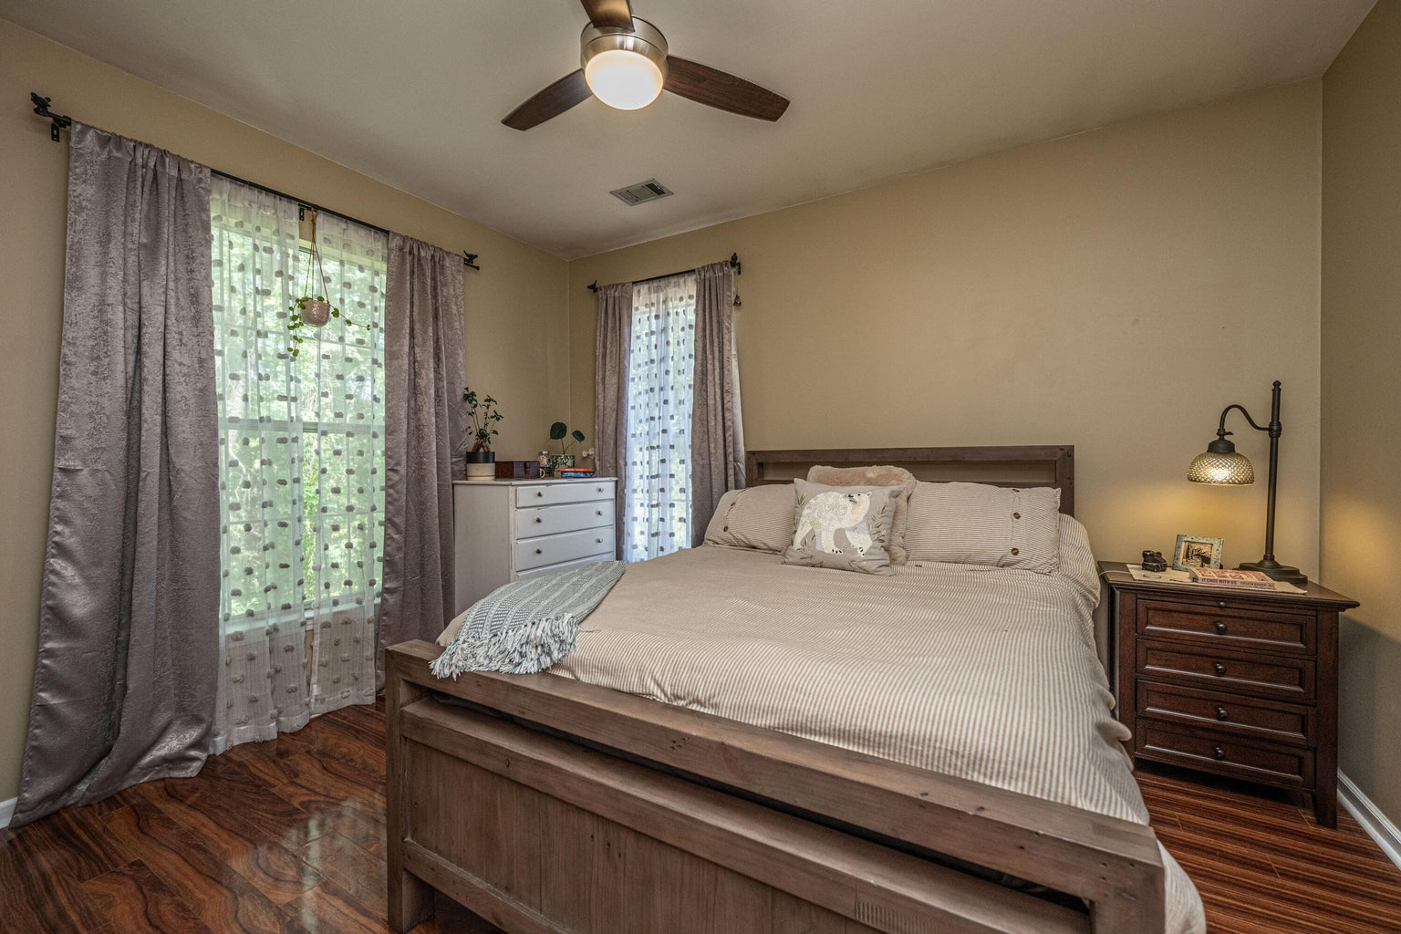



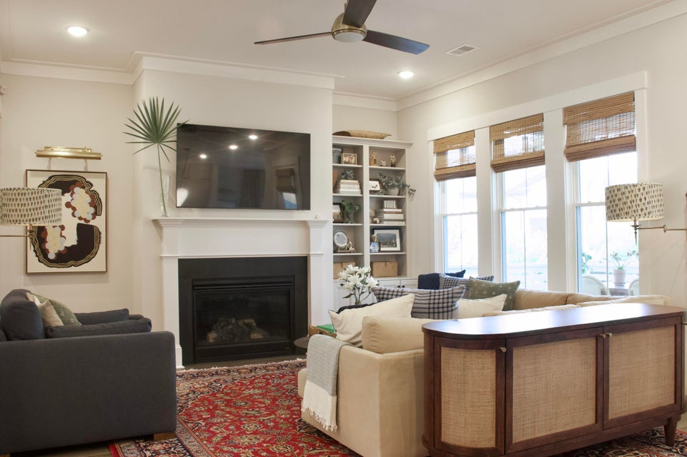
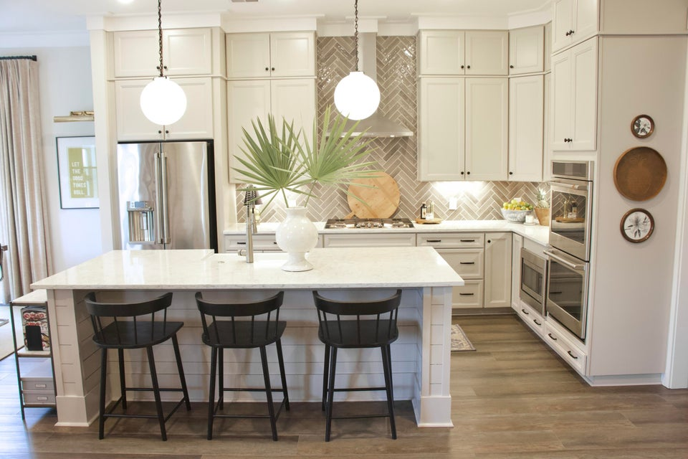
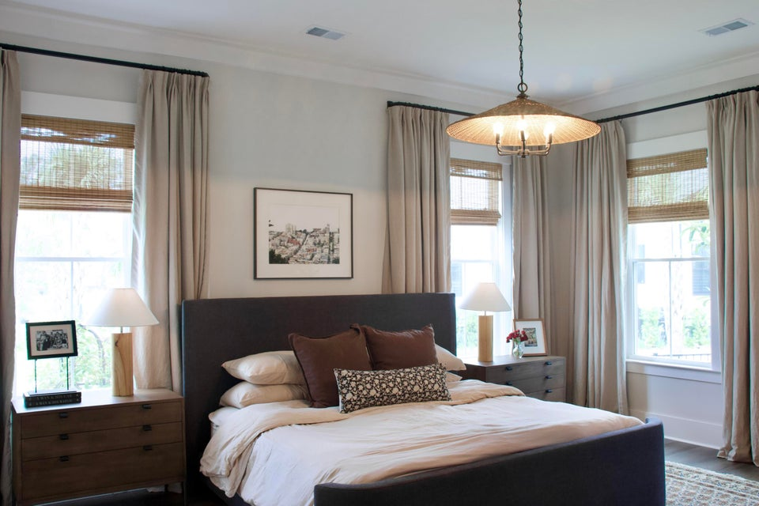
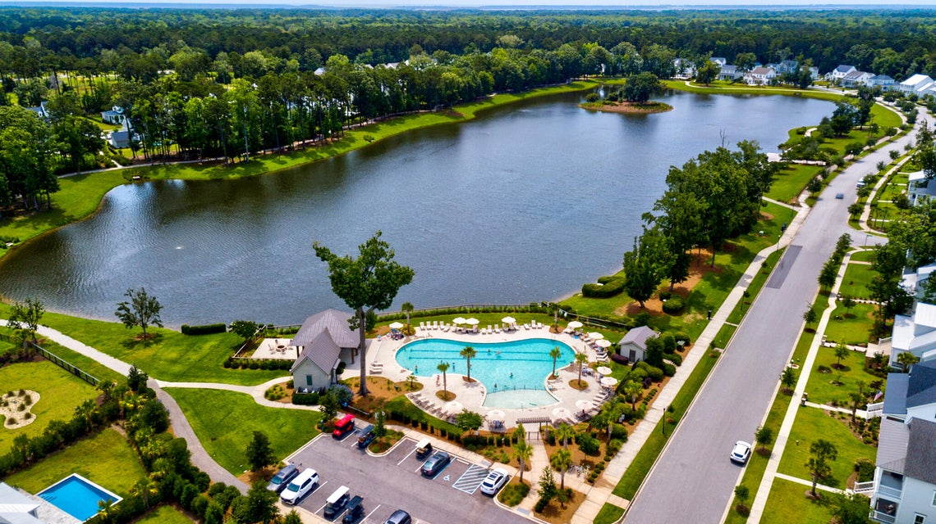

Open House Wednesday, July 9th from 12-3
This stunning 5br, 4.5ba low country custom built home by Simonini Home Builders has been meticulously cared for situated on a .60 acre heavily treed lot on large pond in private gated community of Popular Grove. This spacious , two story, 4721 square foot home features master bedroom suite on the first level, full front porch, beautiful heart pine wood flooring, large entry foyer which separates the private study from formal dining room, open gourmet kitchen with Wolf 6 burner gas stove, built in SubZero refrigerator/freezer, dishwasher, microwave oven and large pantry. Half bath/Powder room under stairway and large utility room for washer and dryer and deep sink and built in cabinets off hallway. The smaller den with gas log fireplace opens to kitchen and breakfast room. The larger fireplace opens to kitchen and breakfast room and offers expansive views of the water year-round. The living room with its second gas log fireplace is great for entertaining away from dining areas. The large master bedroom suite is located on the first level and has travertine tile flooring in the master bath, his and hers walk in closets, separate vanities, soaking tub, and a large separate shower. There is a game room with separate stairs over the two-car garage large enough for a pool table. The second level boasts 4 spacious bedrooms and three bathrooms. On the rear of home is a large screened in porch and open deck overlooking firepit and pond. To reduce maintenance the exposed wood decking has been replaced with Trex decking and exposed rail caps with PVC. Yard has irrigation system and 120-gallon buried propane tank. Sellers just replaced roof with 50 year architectural shingles with transferable warranty. The two electric water heaters have been converted to a single LP gas fired tankless water heater. New epoxy coating on floors and newly finished walls now in two car garage. Neighborhood amenities include Privacy gate, Boat Ramp, Dock facilities, Exercise area, Pool, RV/boat storage and walking/jogging trails. Don't forget the fantastic equestrian center for your horses!
1723 Bolden Drive
Carolina Park | Mount Pleasant, SC 29466 | MLS# 25014763 | $1,550,000
Welcome to 1723 Bolden Drive, a beautiful home in the wonderful Riverside neighborhood. This home was built in 2022 and has been lovingly cared for with many updates added. There are four bedrooms, each with its own full bath, plus two large flex spaces and an additional half bath. Property backs up to a wooded buffer, ensuring peace and privacy, with an additional 7ft privacy hedge along both sides of the backyard fence. Neighborhood is known for extensive walking & biking trails, a beautiful community pool overlooking Bolden Lake, a private dock on the Wando River, tennis & pickleball courts, playgrounds, numerous community events and festivities, and Carolina Park Elementary only a short walk / bike ride down the road.
4
3
1,844
Robyn Lane
843-222-5599
robynlane01@icloud.com
Jenny Siggelkow
843-901-3494
jcsiggelkow@gmail.com
ERA Wilder Realty | 802 Johnnie Dodds Blvd | Mt. Pleasant, SC 29464

