Slide 1
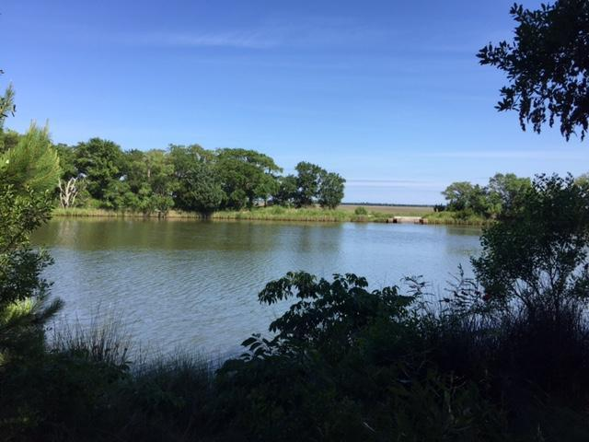
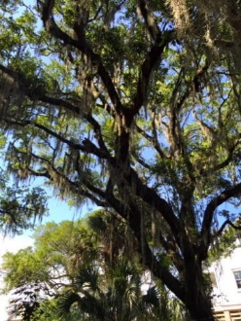
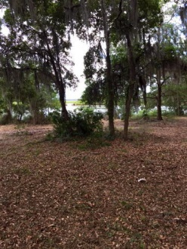
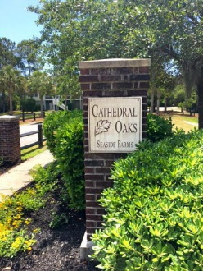
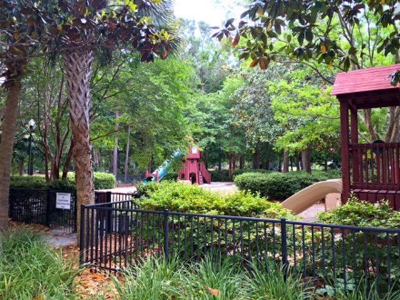
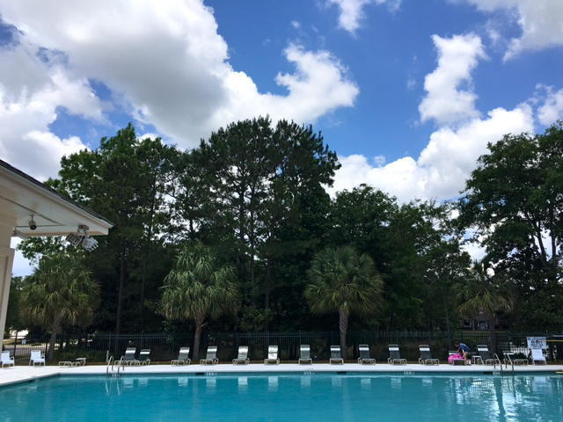


1724 Canyon Oaks Drive Seaside Farms ~ Mount Pleasant, SC 29464 MLS# 16014442 ~ $375,000
This is your chance to own one of the last waterfront and marsh front lots in beautiful Cathedral Oaks!
This beautiful lot looks out at the private lake with views extending out into the marsh beyond. Imagine relaxing on the porch of your custom elevated home, gazing through your majestic live oaks, enjoying the year round breezes and tranquility this lot offers. This is a true find South of the IOP. Walk or bike to Basil, Opal, Target and Harris Teeter along with many other shops and restaurants in very desirable Seaside Farms. This truly is a slice of heaven just waiting for you. Build you own custom one of kind home. January 2016 change to Flood Zoning - now in a AE Zone! Neighborhood amenities include gorgeous walking and biking trails, a large community pool and a fun playground area!
*Listing agent is owner. *Contact Listing Agent to walk the lot with you. *Covenants + Restrictions state builder has first right of refusal. *Geotechnical Engineering study (soil boring) completed. *Boundary and Topographic Tree Survey completed. *Tree Risk Assessment completed. **If interested: House plans have been drawn with Flatfish Island Design Architects and Structural Engineering Set completed.
Jennifer Alspector 843-847-1565
jennifer.alspector@agentownedrealty.com www.AgentOwnedRealty.com
The AgentOwned Realty Co.
824 Johnnie Dodds Blvd.
Mt. Pleasant, SC 29464

