Slide 1
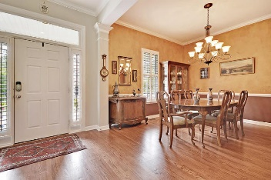
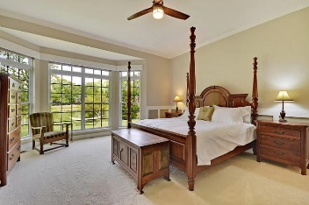
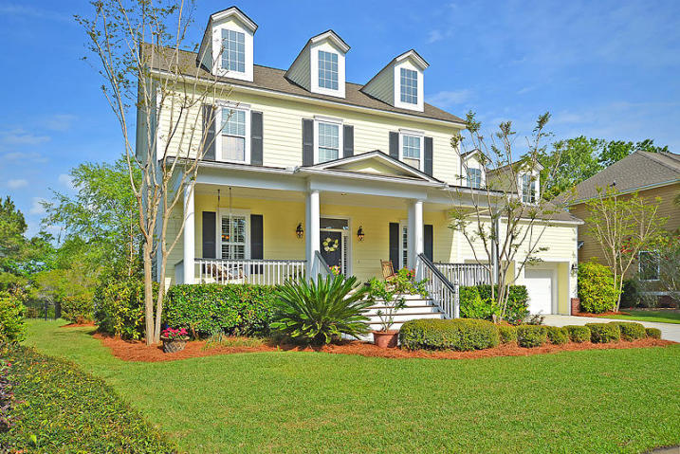
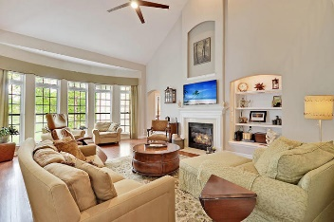
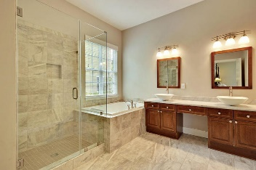
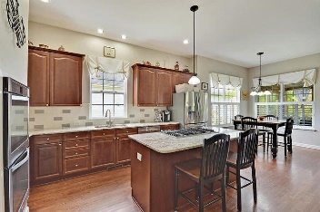
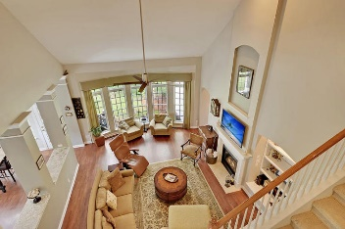
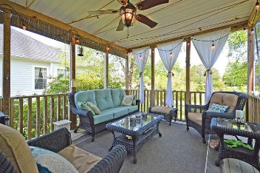
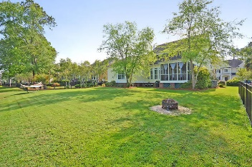
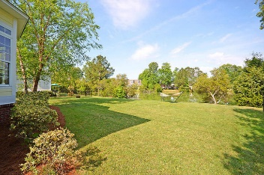
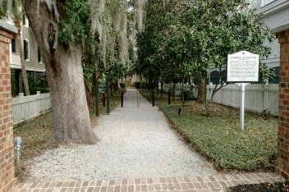
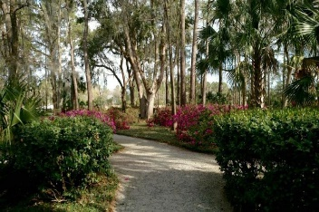

1725 James Basford Place Mount Pleasant · MLS# 17011136 · $549,000
New Listing in Park West!
Loaded with Updates
Updated home with STUNNING POND VIEWS in desirable Park West - Wheatstone neighborhood. This move-in ready home has great curb appeal, mature landscaping and a full-width front porch with a relaxing porch swing. Beautiful open and bright floor plan features five bedrooms and three 1/2 bathrooms. Hardwood flooring is throughout the first floor open areas with new carpeting on the 2nd floor. The foyer opens into a formal dining room with chair rail and crown molding. The private office/living room also has crown molding. The upgraded kitchen is equipped with new Whirlpool Gold Series stainless steel appliances including double ovens and a Jenn Air 36” gas cooktop, a customized pantry with dual 8’ doors, a decorative tile backsplash, White Springs granite counters, recessed lighting, and island seating as well as a spacious breakfast area. The kitchen opens to a large family room with new 56" LED ceiling fan, gas log fireplace, built-in shelving, and features 5 large bow windows with transoms overlooking the pond. The owner's suite is on the main level. It also features large bow windows and transoms with a peaceful view of the pond. Crown moulding and custom trim, new bedroom carpet, and a new LED ceiling fan complete the restful suite. The owner's bath includes large-format ceramic tile floor, custom walk-in frameless tile shower with a separate soaking tub, white carrara marble counter and dual vessel sinks, new LED vanity light fixtures, and a large walk-in closet with built-in storage system.
This main level also has laundry room with a utility sink and ample storage shelving. The tranquil screened porch is sure to be a favorite escape to relax and enjoy the stunning sunsets on the beautiful private pond (known by the residents for having great fishing). The second floor contains the other 4 bedrooms and 2 full baths. The largest bedroom can easily be used as a recreation room. Extensive attic storage is easily accessible. Other features include a 2-car garage with extensive overhead loft storage, 4 zone lawn irrigation system, upgraded HVAC system, Rennai tank less hot water heater, and plantation shutters (foyer, dining room, office, eating area). Park West amenities include 2 pools, a clubhouse, play area, six-lighted tennis courts, a crabbing dock and miles of trails for walking and biking. It is a short trip by bike or golf cart to stores, gyms, offices, restaurants, and the award winning schools that are located in Park West. The Mt. Pleasant Rec. Center and sports complex are also located in the neighborhood! Only a short drive to the beach and historic downtown Charleston. Window treatments, and TV mounts convey. TV's do not convey. Buyer to pay ALL Transfer fees. Seller is a licensed SC Realtor, but not the listing agent.
Stan Huff
843-670-2835 stan.huff@agentowned.com
Jill Marcacci
843-297-5590 jill@agentowned.com
www.agentownedrealty.com
AgentOwned Realty Co. Preferred Group, Inc. | 824 Johnnie Dodds Blvd | Mt Pleasant, SC 29464

