Slide 1
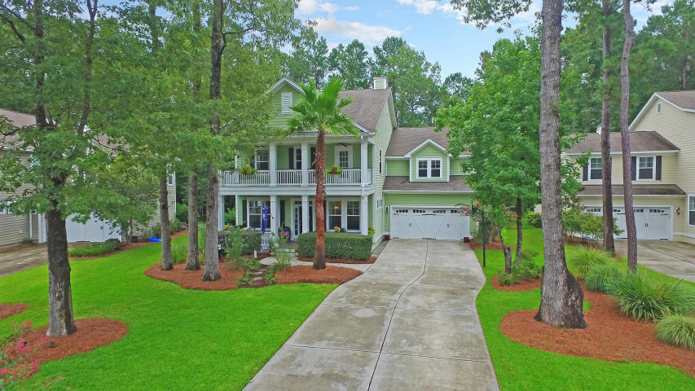
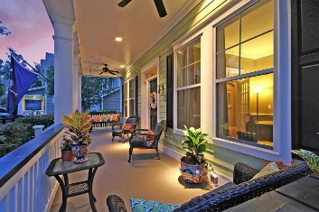
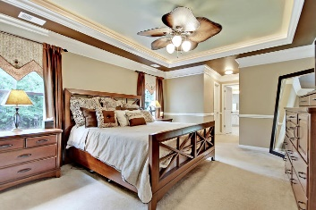
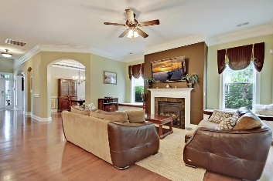
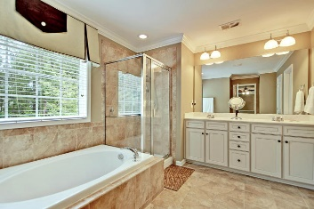
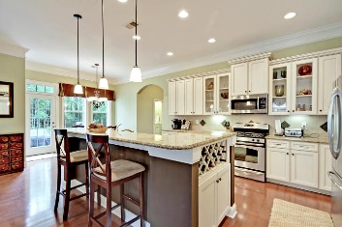
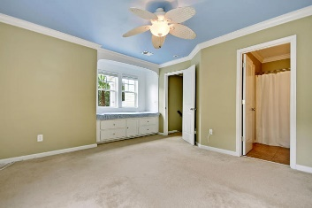
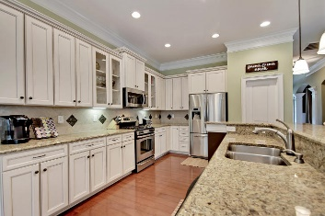
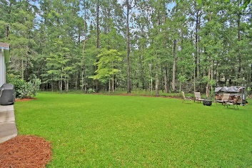
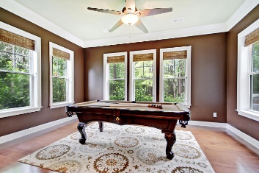
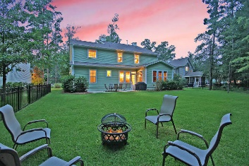
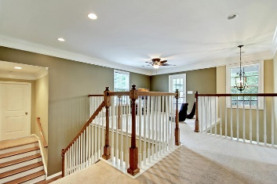
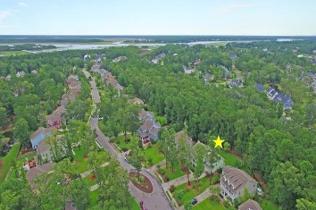

Price Reduced!
Open House Saturday, July 29th from 1-3
1725 Wellstead Street
Park West ~ Mount Pleasant ~ MLS# 17020516 ~ $624,900
Situated in the Pembroke section of Park West, this spacious two story home is THE ONLY home in this price range with 5 bedrooms, 2 offices, and 5 full bathrooms with a full guest suite on the main level! A two story foyer, French doors leading to the office, transom windows, an archway leading to the sun room, a tray ceiling and wainscoting in the dining room are just some of the unique features in this home that help it stand out. The gourmet kitchen features granite counters, pendant lighting, a breakfast bar, built-in wine rack, stainless steel appliances and a gas range, a pantry, an eat-in area and looks into the living room with its cozy fireplace. The owner’s retreat has a tray ceiling, two walk-in closets and a large en-suite bath with dual vanity, walk-in shower and garden tub.
Additional features include:
Gorgeous features throughout much of the first floor including wide plank hardwood floors, crown moulding, trim, wainscoting, and recessed lighting
The master suite features double tray ceilings with trim and concealed accent lighting
Mudroom to keep things organized and tidy
First floor guest bedroom
Home office
All bedrooms on the second floor have walk-in closets
Large second floor loft space
Second floor laundry room
Central vacuum
Whole house water filtration system
Home security system
Custom window treatments and built-in window seats with storage and custom cushions
Seven zone lawn irrigation plus drip system for piazza porch baskets on two levels
Patio has two gas hookups for grill
Towering trees in the front yard and a double long driveway create a lovely entry
Home backs up to private woods
Double Piazzas with swings and ceiling fans.
Huge, private backyard, big enough for a pool!
Book your showing today!
Matt O’Neill matt@mattoneillteam.com 843-532-4220

