Slide 1
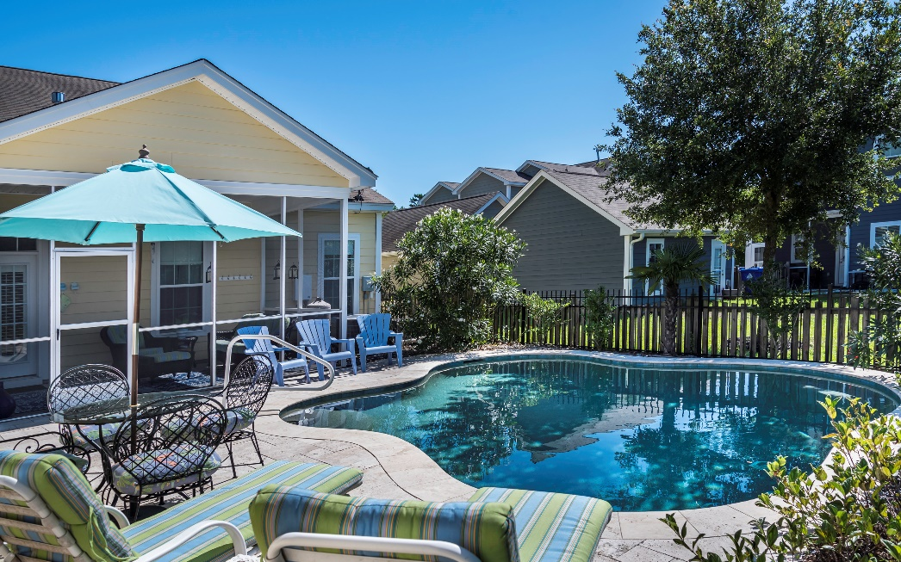
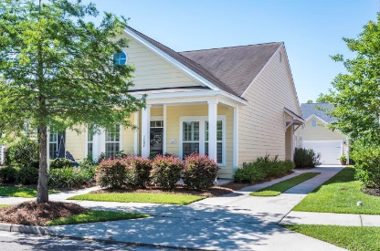
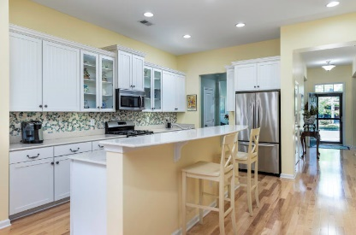
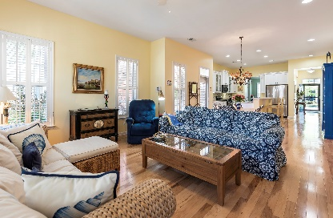
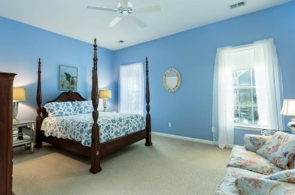


OPEN HOUSE Sunday, July 14th 1pm to 4pm
Location! Location! Location!
5 miles to IOP and Sulllivans beaches 7 miles to historic downtown Charleston
1727 Batten Drive
Boltons Landing
3 Bed 2 Bath | Sq Ft 2,252 | Built 2010 | Listed for $372,900 | MLS# 19019968
This charming , spacious one story coastal cottage style home is located in the Jasmine Gate sublet of Bolton's Landing. Built in 2010, this one owner home has been meticulously maintained. 10' ceilings, 42'' kitchen cabinets with beadboard and glass fronts. Designer paint colors throughout evoke coastal southern living. Stainless appliances, gas range, refrigerator conveys. Pantry and butlers pass through just off kitchen leads to dining room (currently used as formal living/sitting area). Laundry room w/shelving and the washer & dryer convey with home.
Large great room with gas fireplace flanked by built-in bookshelves. Spacious master with 2 closets (one is walk-in) and ensuite with soaking tub, shower and dual vanities. 2 additional good sized bedrooms with generous closet space. Study/office. Relax on your screened porch or cool off in your salt water pool (heated) with travertine tile decking.2 car detached garage with overhead storage. Tankless hot water heater, security system. Beautiful well kept neighborhood with ponds and walking trails. 11 miles to Boeing, 20 miles to Folly Beach. Your clients will love this home. **light fixture appearing in photo over table has been replaced. Some furniture available to purchase outside of sale.
Teresa Porter Realtor/Certified Negotiation Expert
(843) 300‐5822
Teresa.Porter@AgentOwnedRealty.com
www.AgentOwnedRealty.com
The AgentOwned Realty Co.
824 Johnnie Dodds Blvd.
Mt. Pleasant, SC 29464

