Slide 1
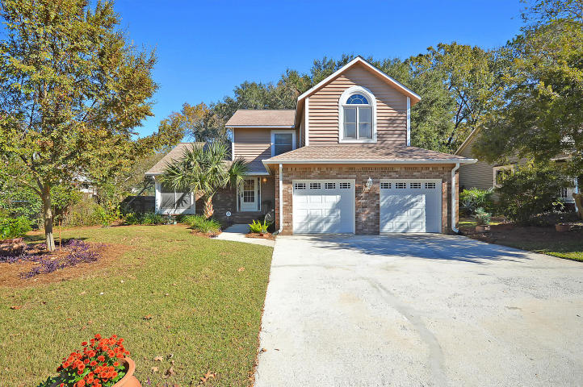
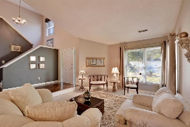
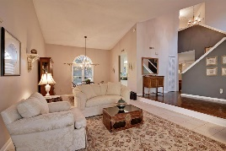
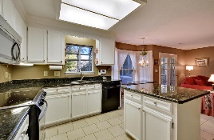
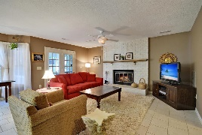
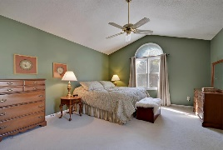
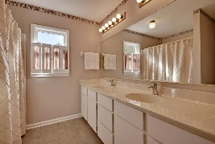
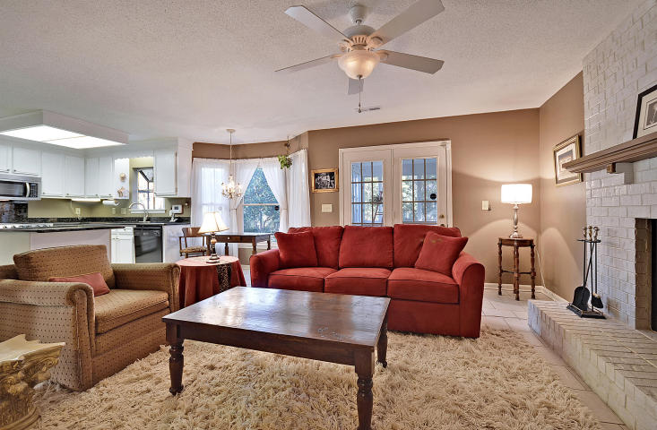
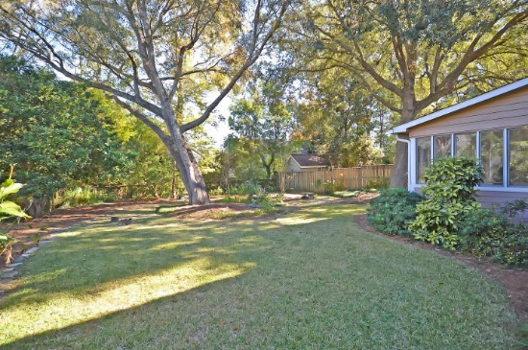
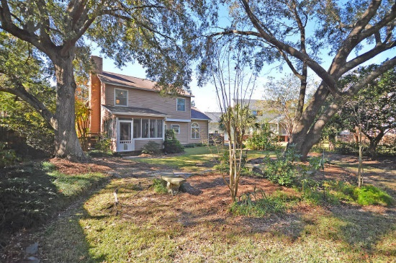

1728 W Sandcroft Drive Rice Hollow ~ Charleston, SC 29407 MLS# 16030063 ~ $305,000
Soaring Ceilings, Open Concept & Dock
Come See Your Dream Home Today!
$20K below all other homes in neighborhood!
Don’t miss this Amazing Opportunity! In the heart of West Ashley’s most desirable area, you are minutes to I-526, Roper Hospital, Restaurants, Schools & great Shopping! Sip your coffee and relax in your Spacious Backyard with mature landscaping, 2 huge LIVE OAK trees, and plenty of birds. You are welcomed in by a charming wood front door & period inlay wood flooring - so much character! The Open & Airy Living Room is perfect for entertaining (and dancing), a grand piano or just relaxing. Open Concept Living with the painted brick fireplace as a focal point. Stainless Steel Refrigerator, Stove & Microwave. All kitchen cabinets recently refurbished & topped off with beautiful granite countertops. Upgraded faucet & Garbage Disposal. Rheem HVAC NEW 2012. Hot Water Heater NEW 2010. All wood siding replaced & painted as needed 2016. NEW paint in both Bathrooms. NEW Roof 2010. Gutters throughout home. The Master Bedroom has a vaulted ceiling and is flooded with natural light. Lots of room for even large furniture! Cultured marble countertops in all the bathrooms are maintenance free! Upgraded toilets throughout. Did you see the laundry room? So much storage! This home has it all! Maintenance free tile floors, 2 Garage Door Openers, Ceiling Fans in all rooms, and an Alarm System.
Call or email for details: (843) 214-8451 or Robin@ThePhillipsRealtyGroup.com

