Slide 1
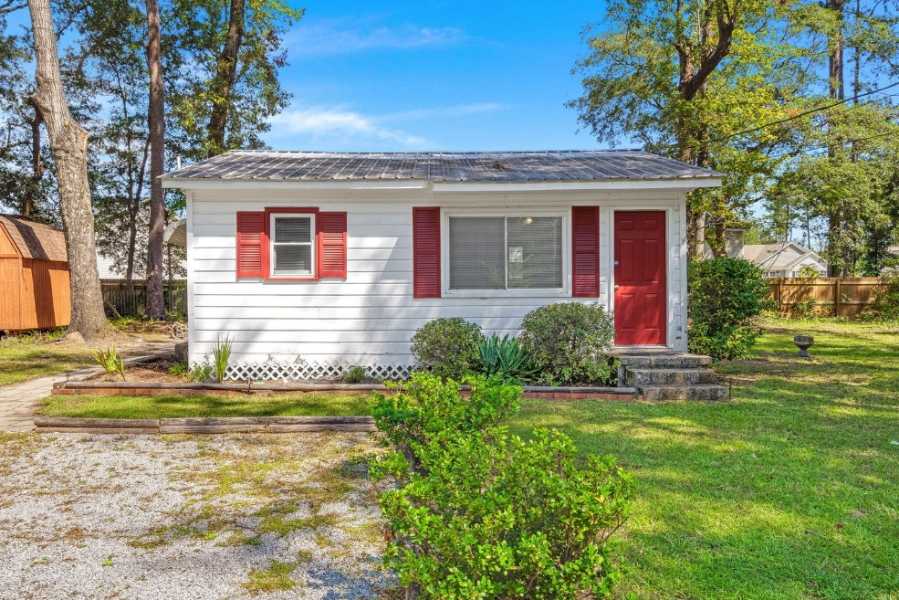
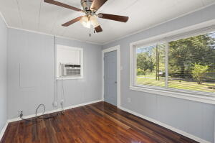
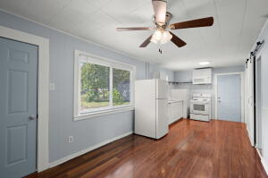
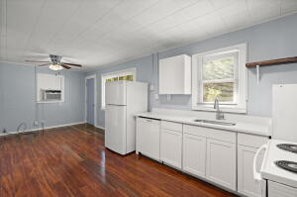
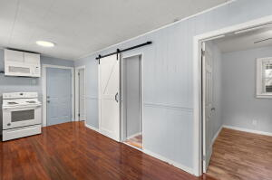
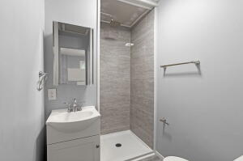
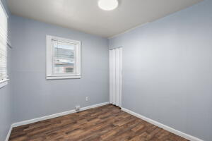
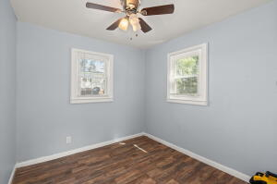
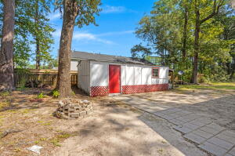
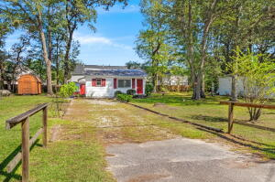



Summerville Cottage for UNDER $200,000!
172 Fannie Drive
Calomet Valley
Summerville, SC 29485
MLS# 23021844
$175,000
2 Bed | 1 Bath | 514 sf
Discover a hidden gem at 172 Fannie Drive. This 2-bedroom, 1-bathroom cottage, nestled in a tucked-away corner of Summerville, SC, captures the essence of timeless southern charm. While the home does crave a touch of modernization, its undeniable character offers an ideal canvas for those with a vision. Upon entering, one is greeted with a layout that, though traditional, offers vast potential. The cozy living room beckons memories of yesteryears and awaits your personal touch to revive its splendor. Both bedrooms, though modest, exude potential, serving as peaceful retreats after a day's work. The kitchen, functional in its current state, stands ready for aspiring chefs and homemakers alike.
What truly sets 172 Fannie Drive apart is its exceptional value. A rare find in today's market, especially under the $200,000 mark. The property's exterior presents a manageable yard, an oasis for those who cherish outdoor moments yet prefer minimal upkeep. For those embarking on their homeownership journey, seeking an investment with vast potential, or whatever it may be, this cottage is more than just a residence; it's an opportunity. The charm of 172 Fannie Drive, combined with its attractive price point, makes it a must-see. Arrange your viewing today! MINI SPLIT BEING INSTALLED NEXT WEEK SO THERE WILL NOT BE A WINDOW UNIT!
Nick Mazzilli
(843) 640-5575
nick@nickmcharleston.com
nickmavencharleston.com
Maven Realty
2180 McMillan Ave
#71672
Charleston, SC 29405

