Slide 1
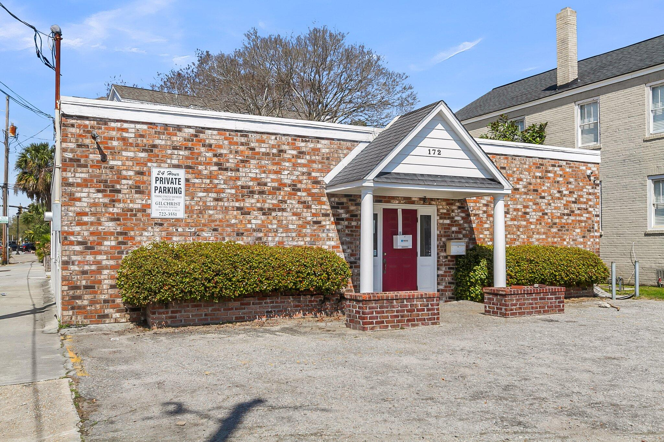
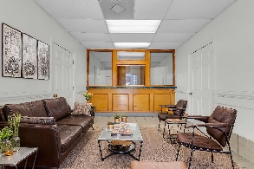
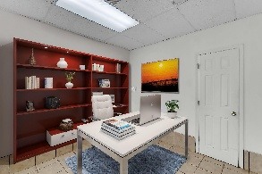
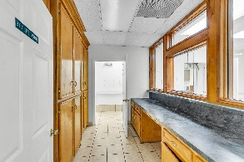
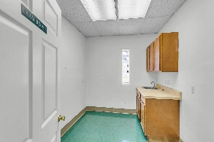
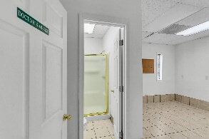
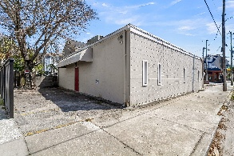


Prime Location
Medical Office - Redevelopment!
172 SPRING STREET
Charleston SC | MLS# 31005702 | $2,500,000
Located at the lighted intersection of Spring St and President St, this 2,064 SF medical office opportunity in a high-demand area. Just minutes from MUSC and hospitals... walkable. This property is turnkey with a little TLC--or a complete transformation, depending on your vision. Efficiently designed floorplan includes a front office, nurse station, five exam rooms, a procedure room, lab, X-ray room, and two private offices (one with a shower). Parking is available in the front for patients and visitors, with designated employee parking in the rear (2-4).Looking to establish a new practice, expand, or invest, this property's location and potential make it a must-see!
Chris Garcia
(843) 557-7100
cmcdaid1@yahoo.com
RE/MAX Southern Shores
9209 University Blvd.
N Charleston, SC 29406

