Slide 1
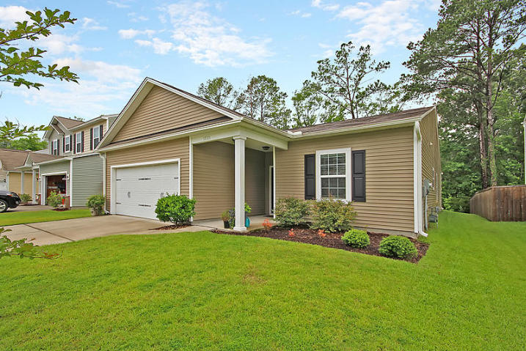
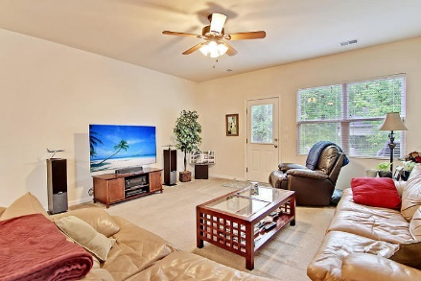
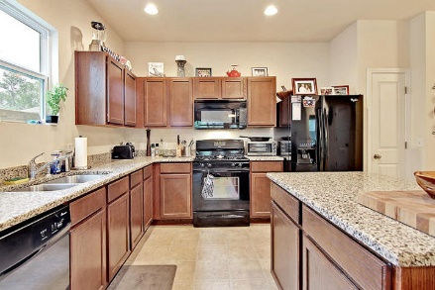
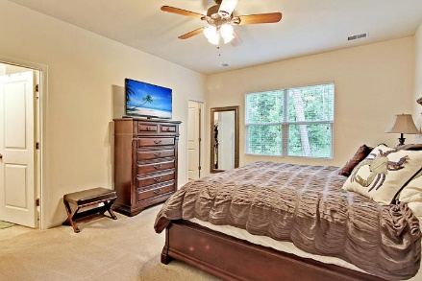
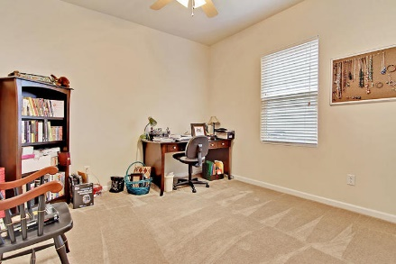
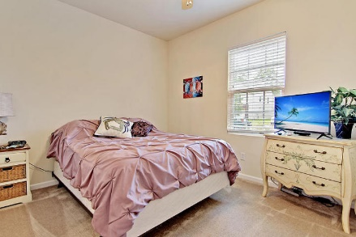
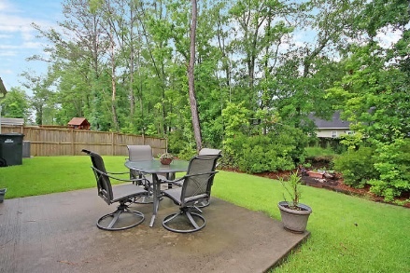
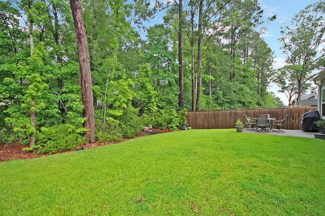
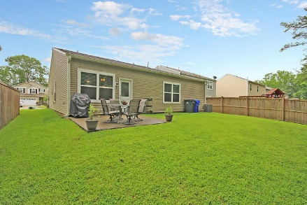


Best Value in Carolina Bay Like New!
1731 Indaba Way
Carolina Bay · Charleston, SC 29414 · MLS# 17015493 · $284,900
4 Bed · 3 Bath · 1,919sf
Like new one-level house with 4 bedrooms and 3 full bathrooms. This house has been meticulously taken care of and is conveniently located near the pool, walking trails, and dog park. It's a short drive to bountiful shopping, the airport, Boeing, beaches, and historic downtown Charleston. Great open floor plan with ceiling fans everywhere. The kitchen has granite counter tops and two pantry closets. There is a large laundry room/mud room as you come in from the two-car garage. The en suite master bedroom is huge and has a large walk-in closet. Of the other 3 bedrooms, 2 have nice sized walk-ins and the other a large sliding door closet. Flood insurance is NOT required!
Lee Lindler Cell (843) 637-0803 | LeeL@GoldenBearRealty.com
Golden Bear Realty | 1900 Seabrook Island Rd | Seabrook Island, SC 29455
www.goldenbearrealty.com

