Slide 1
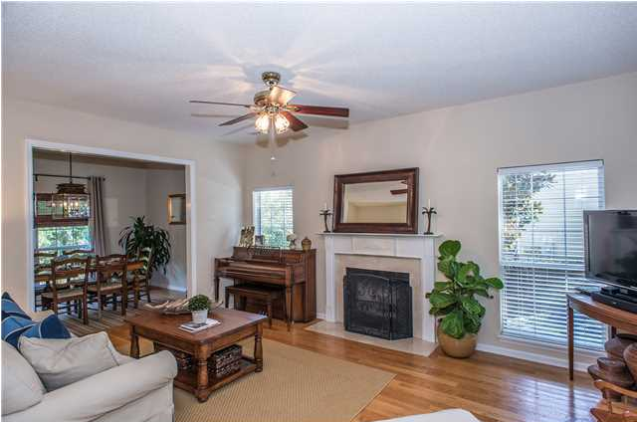
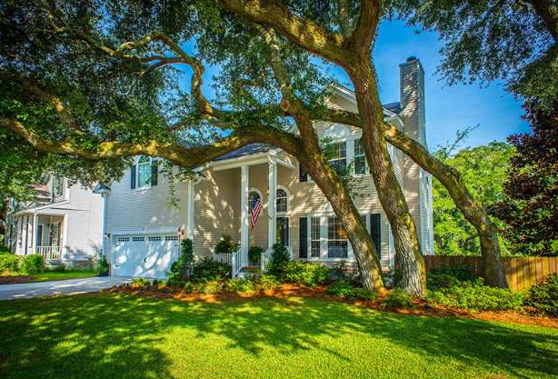
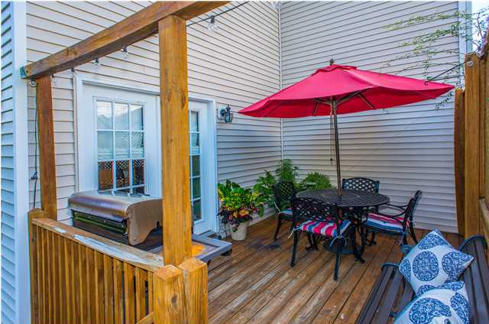
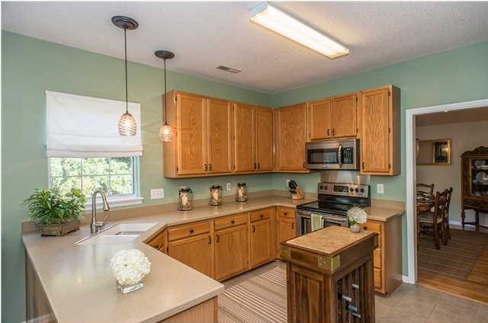
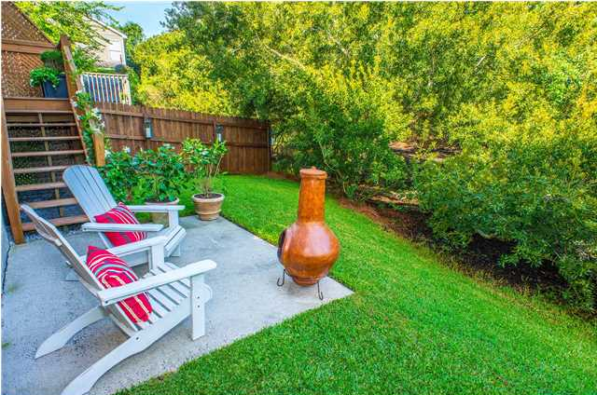
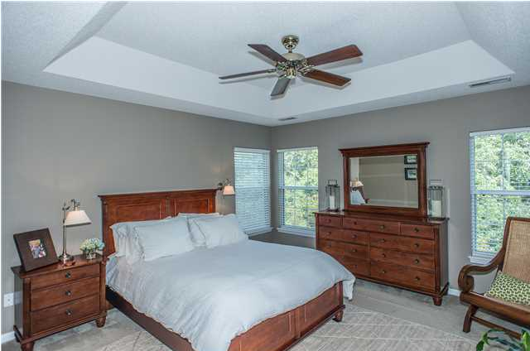
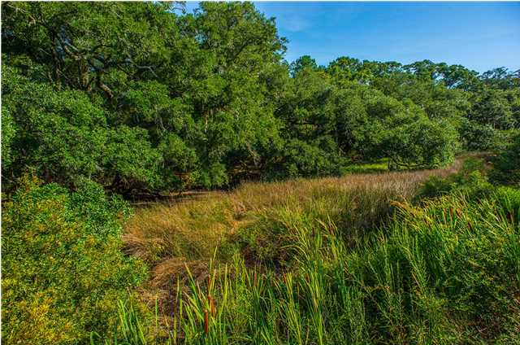


Wexford Sound
1733 Crystal Lake Dr, Charleston
MLS# 1424556 - $320,000
Don’t miss this meticulously cared for home with many upgrades and designer touches! Located in well-manicured and convenient Wexford Sound, this immaculate home sits along the marsh with a fenced private backyard retreat. Enter through the front door to be greeted by a large foyer with a two-story ceiling and an upstairs overlook. The downstairs area features beautiful real hardwood floors throughout except for the kitchen and breakfast area which boast wonderful 12” tile floors. To the right of the foyer is a nice-sized family room with a wood-burning fireplace. The family room flows to the formal dining room through a cased opening and the marsh views from this room are gorgeous. The kitchen features stainless appliances, upgraded hardware and faucet, Corian countertops with an integrated sink, and beautiful pendant lights over the sink and bar top area. There is an adjacent breakfast room which the current owners are using as an additional sitting area. The laundry room and powder room complete the downstairs. Up the stairs you’ll find the master bedroom with a tray ceiling, nice sized master walk-in closet and master bathroom. The master bath has a stand-up shower, separate garden tub and dual vanity sinks. There are two additional guest bedrooms which share a full hall bath. The large room over the 2-bay garage can be an additional bedroom as it does have a closet or serve as a flex room for your needs. The current owner keeps this home in showroom condition and has added many designer touches including beautiful new lighting, attractive updated paint colors and gorgeous bathroom mirrors. The numerous windows, upstairs and down, provide ample natural lighting. On the exterior of the home, you’ll find just as many nice features including the professionally maintained landscaping, a wonderful Grand Oak in the front yard and a private grilling and dining deck on the back. The backyard also boasts a patio deck and a gorgeous Magnolia tree with plenty of shade.

