Slide 1
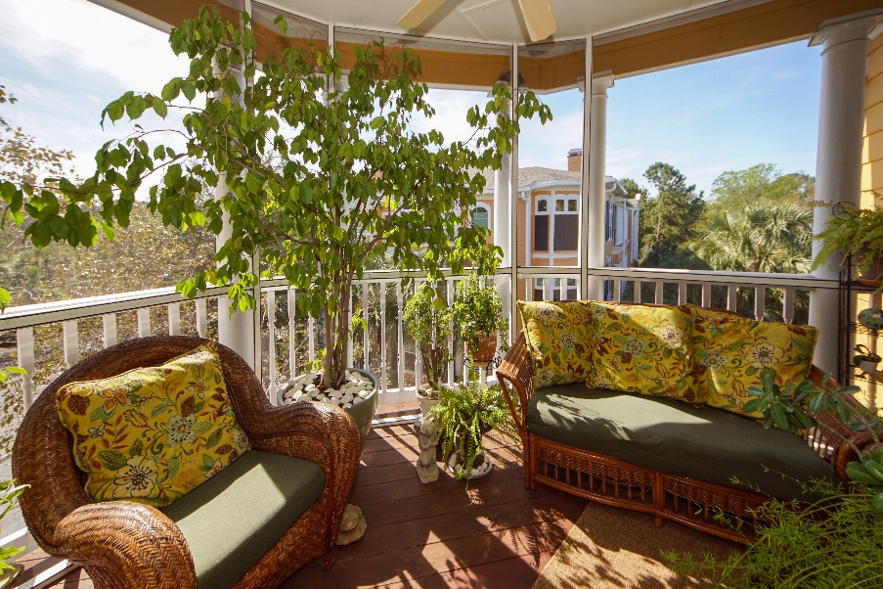

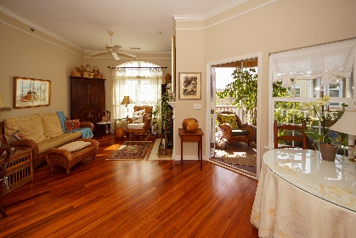
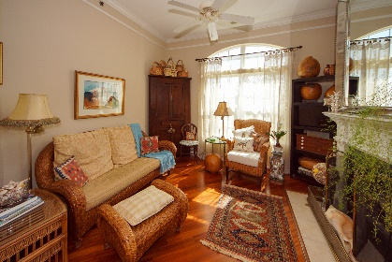
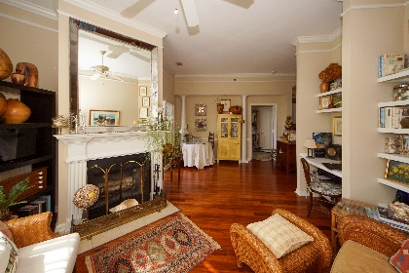
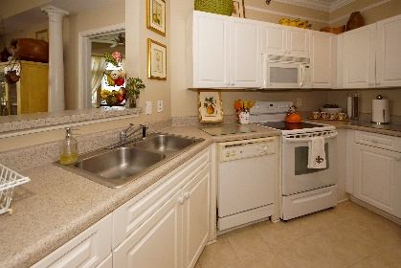
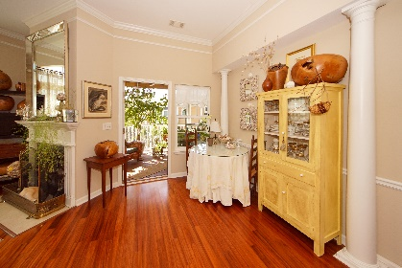
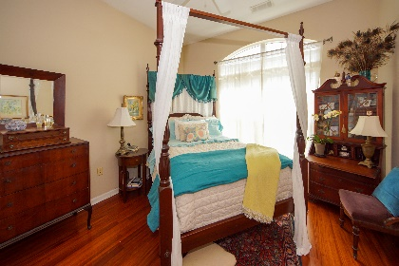
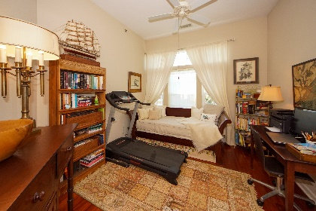
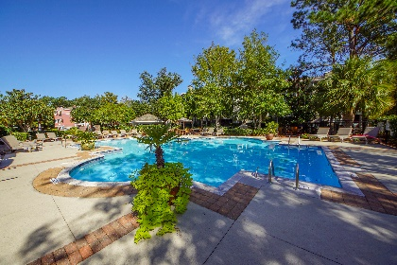



Gated James Island Condo | Minutes to Downtown $3,000 seller credit offered with acceptable offer!
1734 Telfair Way
Mira Vista
Charleston, SC 29412
MLS# 19029323
$221,000
2 Bedrooms :: 2 Baths :: 1,120 sf
This beautiful, bright, and well cared for condo in an unsurpassed location is ready for you to move in! Not familiar with Mira Vista? It's James Island's premier gated community with an unbeatable location. Literally adjacent to the James Island Connector, it is 5 minutes from Historic Downtown Charleston and 10 minutes from Folly Beach. This condo has two spacious bedrooms with large walk-in closets, and two full bathrooms. The 10 foot high ceilings and tall windows invite ample light into the unit. There is beautiful crown molding throughout, that provides an elegant touch - complementing the solid hardwood floors. Enjoy some R&R on the large, newly built, spacious screened porch that overlooks the pond. On cold days, kick back by the fireplace with a cup of tea!
Mira Vista just underwent a total renovation; to include new roofs, hurricane rated windows, siding, balconies and breezeways. Rest assured, you will be moving into an essentially newly renovated building. Need storage? This unit uniquely comes with grandfathered rights to assume the adjacent storage closet lease for $20 per month! Perfect for your storage, bikes, kayaks, or paddleboards. You can't find storage for that price anywhere; and it's right next to your front door! HOA Fees include building insurance, flood insurance, pest control, exterior maintenance, landscaping, trash compactor, upkeep of the beautiful pool, clubhouse, fitness center, walking trails, and business center...which is HUGE!!! You even have an on site maintenance person! You would be hard pressed to purchase homeowners and flood insurance more affordably than the HOA fees offer them! Great schools! The Seller is offering a $3,000 credit to the buyer with an acceptable offer! Easy to show!
Eric Draper
(843) 442-7118
eric.draper@gmail.com
Jon Moore
(843) 732-3365
jon@charlestonrealestategroup.com
www.charlestonrealestategroup.com
Charleston Real Estate Group | 443 Folly Road | Charleston, SC 29412

