Slide 1
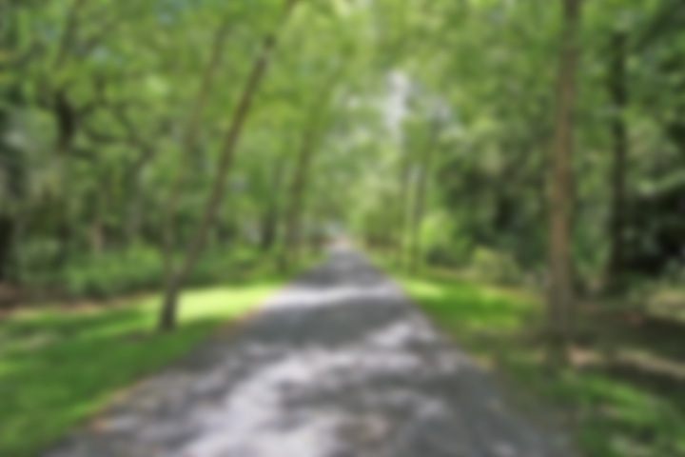
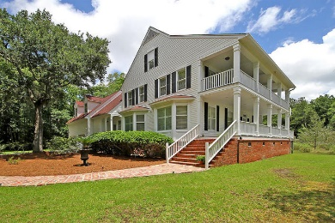
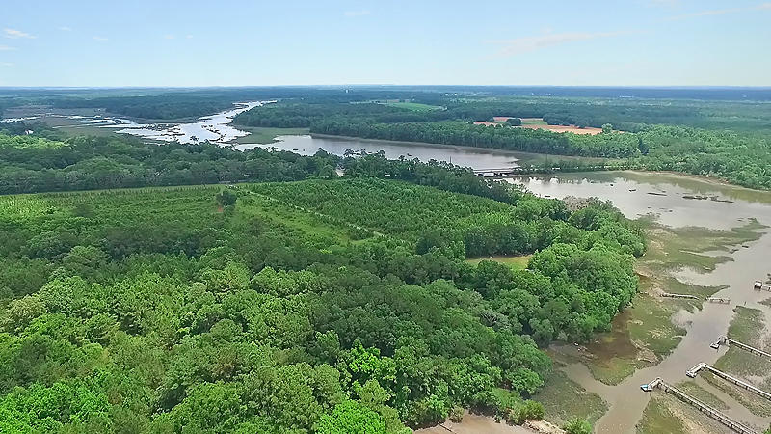
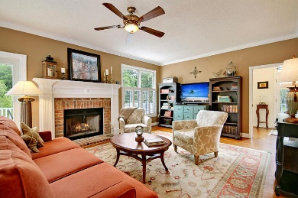
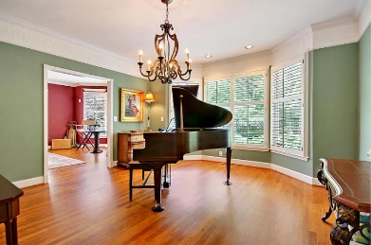
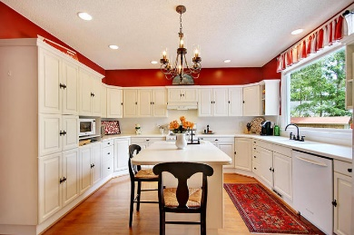
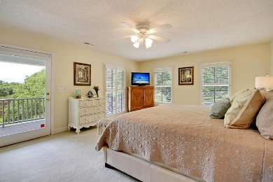
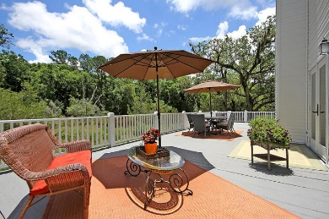
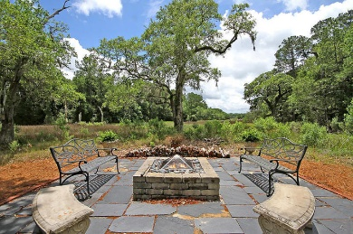
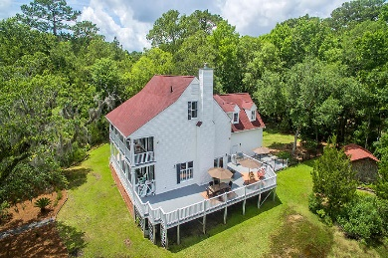


Lowcountry Paradise
1735 Clark Hills Circle
Churchill Landing · Johns Island
MLS# 18015672 · $647,000
2.5 Acres
Take the long tree-lined drive towards your new home and take in the natural beauty and serene atmosphere of this quiet neighborhood. Feel the weight of the world lifting as you admire your beautiful two-storied home with double piazzas overlooking a large expanse of wonderful marsh and tidal creek. This spacious home has four bedrooms, each with its own full bathroom, plus a beautiful powder room off of the foyer. Located on 2.5 acres this retreat provides great privacy and room while still being conveniently located to shopping, restaurants, downtown, and the beaches. Inside there is abundant natural light and plenty of room to entertain in the formal living room, family room, and formal dining room. The very functional kitchen has plentiful cabinets, white Corian counter tops, a large island with its own prep sink and disposal, a gas range, and a large picture window. There is a casual dining area that features a butler's desk and storage that is perfect for a bar. From the family room, open the French doors to the deck when the weather is just right, or for those cool nights enjoy the wood burning fireplace. The massive deck connects to a fenced side yard that is perfect for kids or dogs.
Enjoy the night sky and grand oaks from the slate patio and fire pit area that reach out into the marsh. You will discover great views all around. There is also lots of storage including the oversized 2-car garage with its own AC system, wall cabinets, shelving, tool bench, refrigerator, and utility sink; plus an outside storage shed. Other features include crown molding, pocket doors, plantation shutters, two bay windows, two stairways, hardwood flooring throughout the downstairs, nicely tiled bathrooms, two late model water heaters (one tankless), two late model HVAC systems, and an alarm system.
Lee Lindler
Cell (843) 637-0803 | LeeL@NVRealtyGroup.com
NV Realty Group | 1900 Seabrook Island Rd | Johns Island, SC 29455
LeeLindler.NVRealtyGroup.com

