Slide 1
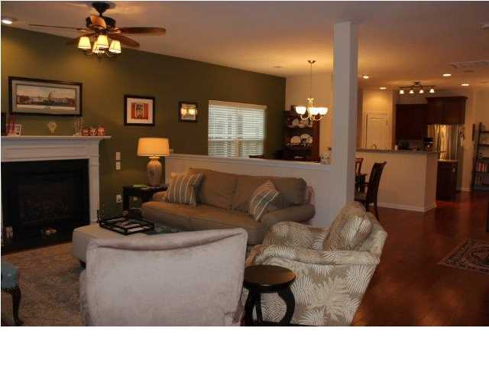
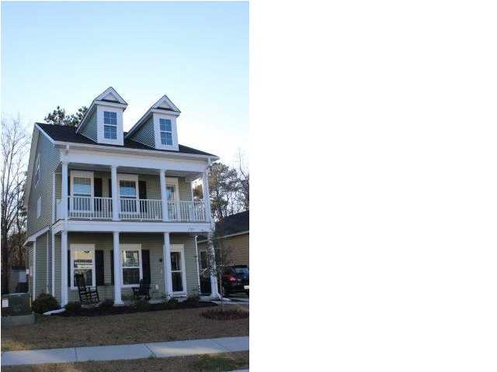
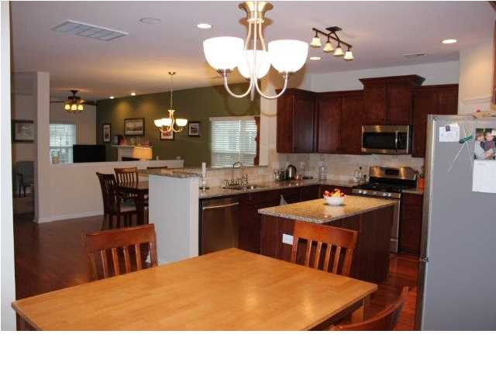
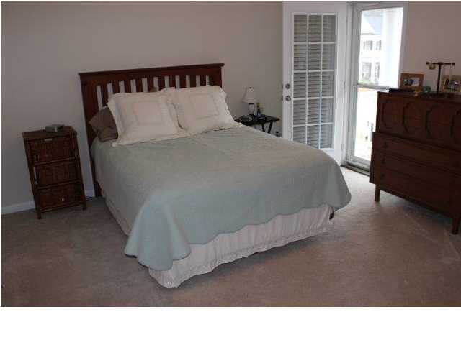
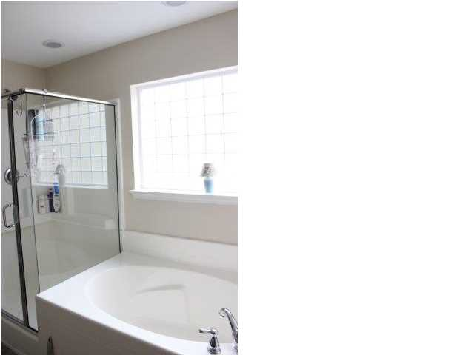
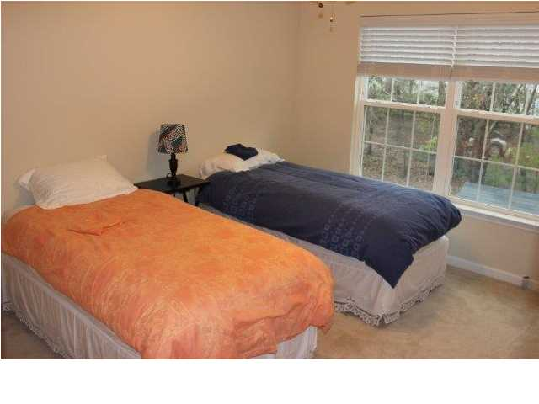
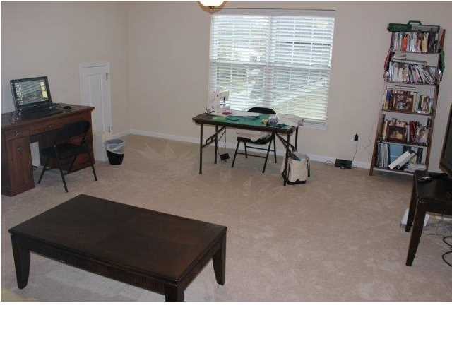


Great Johns Island Location! Hardwood Floors Galore!
1735 Towne St
The Cottages at Johns Island ~ MLS# 1406870 ~ $239,900
Priced to sell! Now with a little help from the Seller. SELLER OFFERS 3% (WHICH IS $7,197) OF THE SELLING PRICE TO THE BUYER TOWARDS CLOSING COSTS WITH A FULL PRICED OFFER.
Welcome home to this quaint new community within ten minutes of the Most Historic City in the USA-Charleston. This home is in tip-top condition. The home boast a double front porch adding to the Southern charm of the Cottages of Johns Island. The open floor plan gives a feeling of spaciousness making it easy to decorate and to interact with your family or with your guests. Stretching from the front to the back door, the warm hardwood floors are impressive. The kitchen is decked out with granite counter tops, much upgraded stainless steel appliances including a gas stove with a convection oven and an island. There are two dining areas for formal and casual dining. The Family Room has a fireplace that is an appreciated asset with this past long winter. The second floor has the Master Suite which opens to the upstairs porch. There are also two guest bedrooms and a hall bath on this floor. The third floor is a wide open room that is currently used for the computer, for crafts and sewing and for watching TV and playing games. This room is flexible and can be used for a fourth bedroom, a home office, a playroom or a media room. Among the many assets of this house is the low maintenance exterior. Enjoy living in this quiet neighborhood on Johns Island. Come see 1735 Towne Road.
Kay Kennerty, ABR, CRS, GRI
Office: 843-884-7300
Mobile: 843-345-5011
Kay@agentownedrealty.com
www.kaykennerty.com
The AgentOwned Realty Company
824 Johnnie Dodds Blvd
Mt. Pleasant, SC 29464

