Slide 1
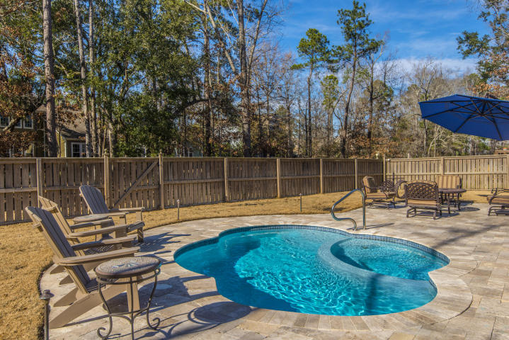
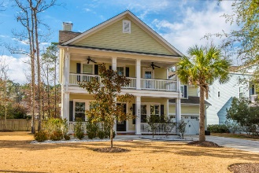
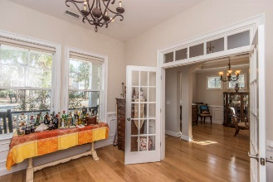
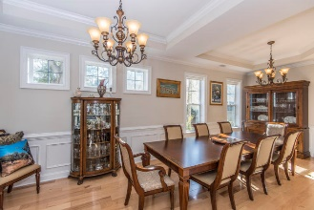
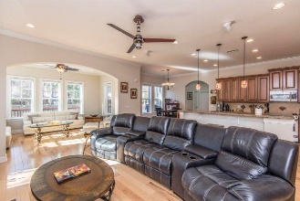
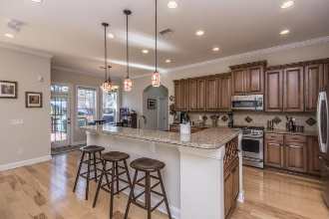
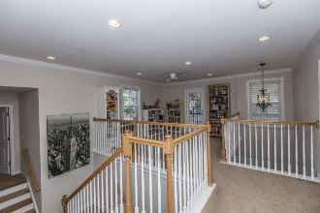
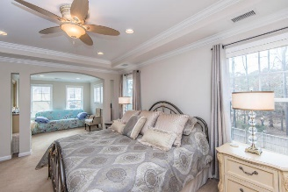
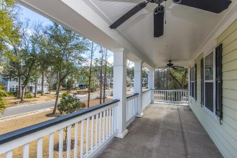
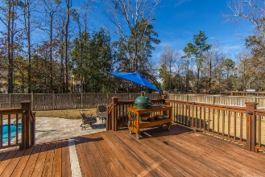
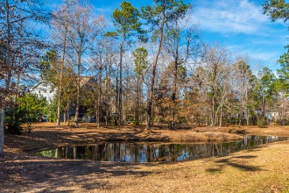


1736 Wellstead Street
Park West :: Mt Pleasant :: MLS# 18001999 :: $629,000
Beautiful, spacious home in the highly
sought after Pembroke section of Park West
Must See! Beautiful, spacious Hampton floor plan in the highly sought after Pembroke section of Park West. This home offers plenty of upgrades including a sparkling saltwater pool with a Jacuzzi tub surrounded by a custom-built travertine tile patio & deck. A perfect oasis for entertaining company or just enjoying a relaxing sunny day poolside. Enjoy pond views from the sun room off the open kitchen and family room. More upgrades including custom Hunter Douglas blinds, 10 ft tray ceilings and hardwood flooring downstairs. This chef style kitchen has upgraded cabinets, granite counters and a long bar top perfect for stool seating. This home features 5 bedrooms and a luxury tile shower in the Master Bath, w/ his & her closets. Irrigation system, leaf guard gutters, and custom crown molding throughout the house. Worry free move-in ready with a brand-new HVAC installed 10/2016. Spray Foam Insulation from Energy One America in the attic 7/2016, which provides a moisture & air barrier with an energy efficiency and savings up to 40% off energy bills. Don't miss this incredibly efficient and gorgeous home!
Stuart DeVault
(843) 754-1769
stuart@carolinaone.com
www.stuartdevault.com
Carolina One Real Estate
2713 Highway 17 North
Mt. Pleasant, SC 29466

