Slide 1
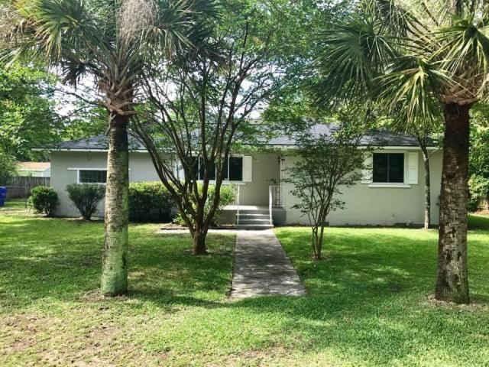

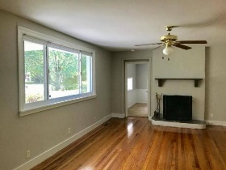
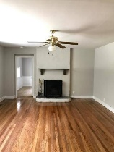
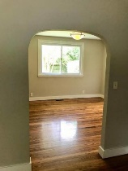
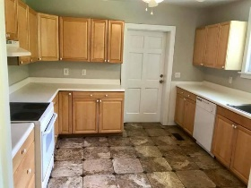
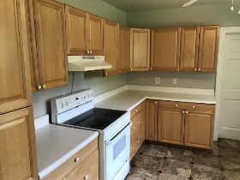
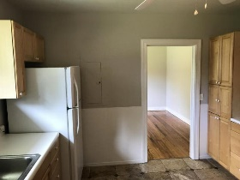
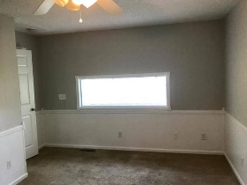
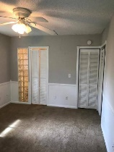
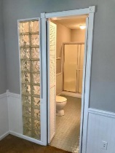
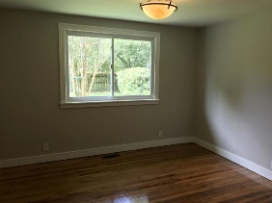
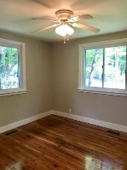
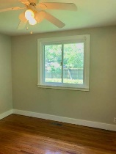
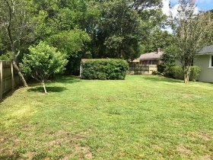
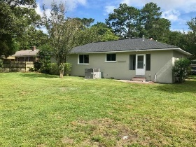


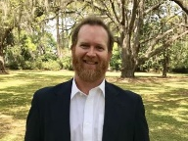
$20,000 Price Drop – A Solid Deal!
1737 Gilbert Street
Centerville
Charleston, SC 29412
MLS# 17015916 | $309,900
3 Bedrooms :: 2½ Bath :: 1,712 sf
Well-maintained 3 bed 2 1/2 bath boasting over 1700 sq. ft in convenient location on quiet street. New paint inside and out. Newer roof. Newer windows throughout. 5 yo gas HVAC. Refinished hardwood floors. Wood burning fireplace. Lots of natural light. Mudroom/Laundry room.
Large backyard w/ privacy fence. Newer tile floor in kitchen. Save thousands (X Flood zone). Flood ins. not required. Walking distance to new Starbucks, Chic-Fil-A, Wild Blue Ropes, Sermets, Mondos, Ft. Johnson Middle School. Excellent location to avoid busy Folly Rd. traffic. 5 min. to downtown. 10 min to Folly beach. 1/2 mile to JI County Park. Exterior storage shed in backyard and well pump for irrigation.
Eric Draper
(843) 442-7118
eric.draper@gmail.com
Reid Adams
(919) 638-5618
reid@charlestonrealestategroup.com
www.charlestonrealestategroup.com
Charleston Real Estate Group | 792 Folly Rd. C1 | Charleston, SC 29412

