Slide 1
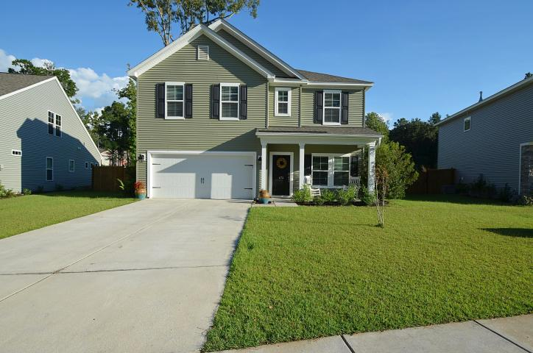
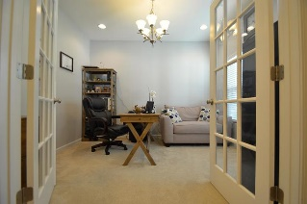
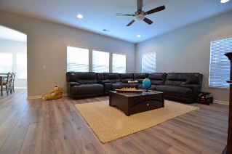
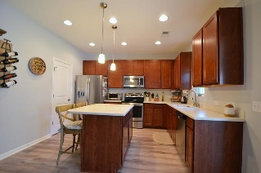
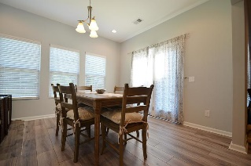
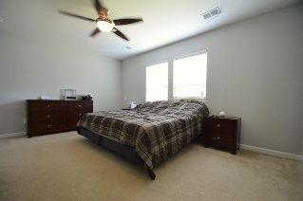
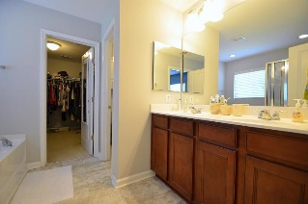
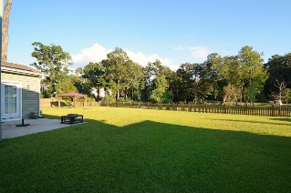
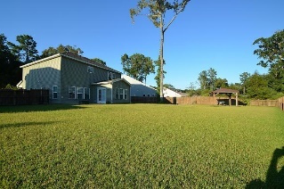
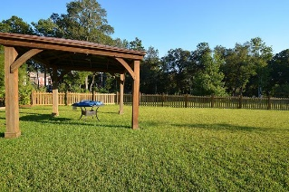

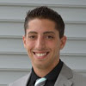

173 Gazania Way
Grand Bees
Charleston, SC 29414
MLS# 18025852
$359,990
Open House ~ Saturday ~ 12-2
Just Listed
+
Open House
Saturday, March 24th 11-1
Welcome to the perfect home. A great layout with room for entertaining inside and out. Enclosed sunroom, huge living room, and a kitchen made for any chef with plenty of prep space. This home boasts 3 large bedrooms, 2.5 baths, and situated in the perfect spot.
No neighbors across the street or behind you. There is plenty of space between your neighbors on either side. With a huge back yard there is room for the kids and fido, complimented with a well built covered eating area with electric to it.
Enjoy the little ''river'' behind the home and more green space. This is what you've been looking for.
Andrew Sorrentino
(843) 371-6218
andrew.sorrentino@agentowned.com
Kelly Rozier
(843) 209-3129
kelly.rozier@agentownedrealty.com
The AgentOwned Realty Co | 902 Savannah Hwy | Charleston, SC 29407
Real Estate • Mortgage • Insurance
www.AgentOwned.com

