Slide 1
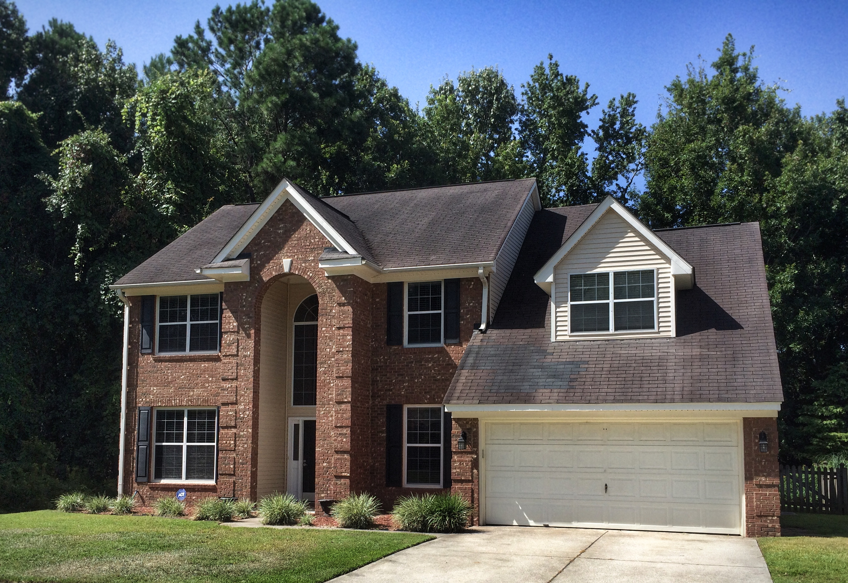
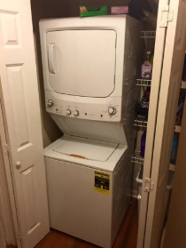
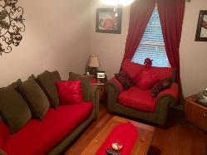
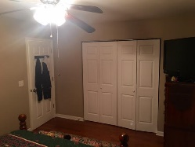
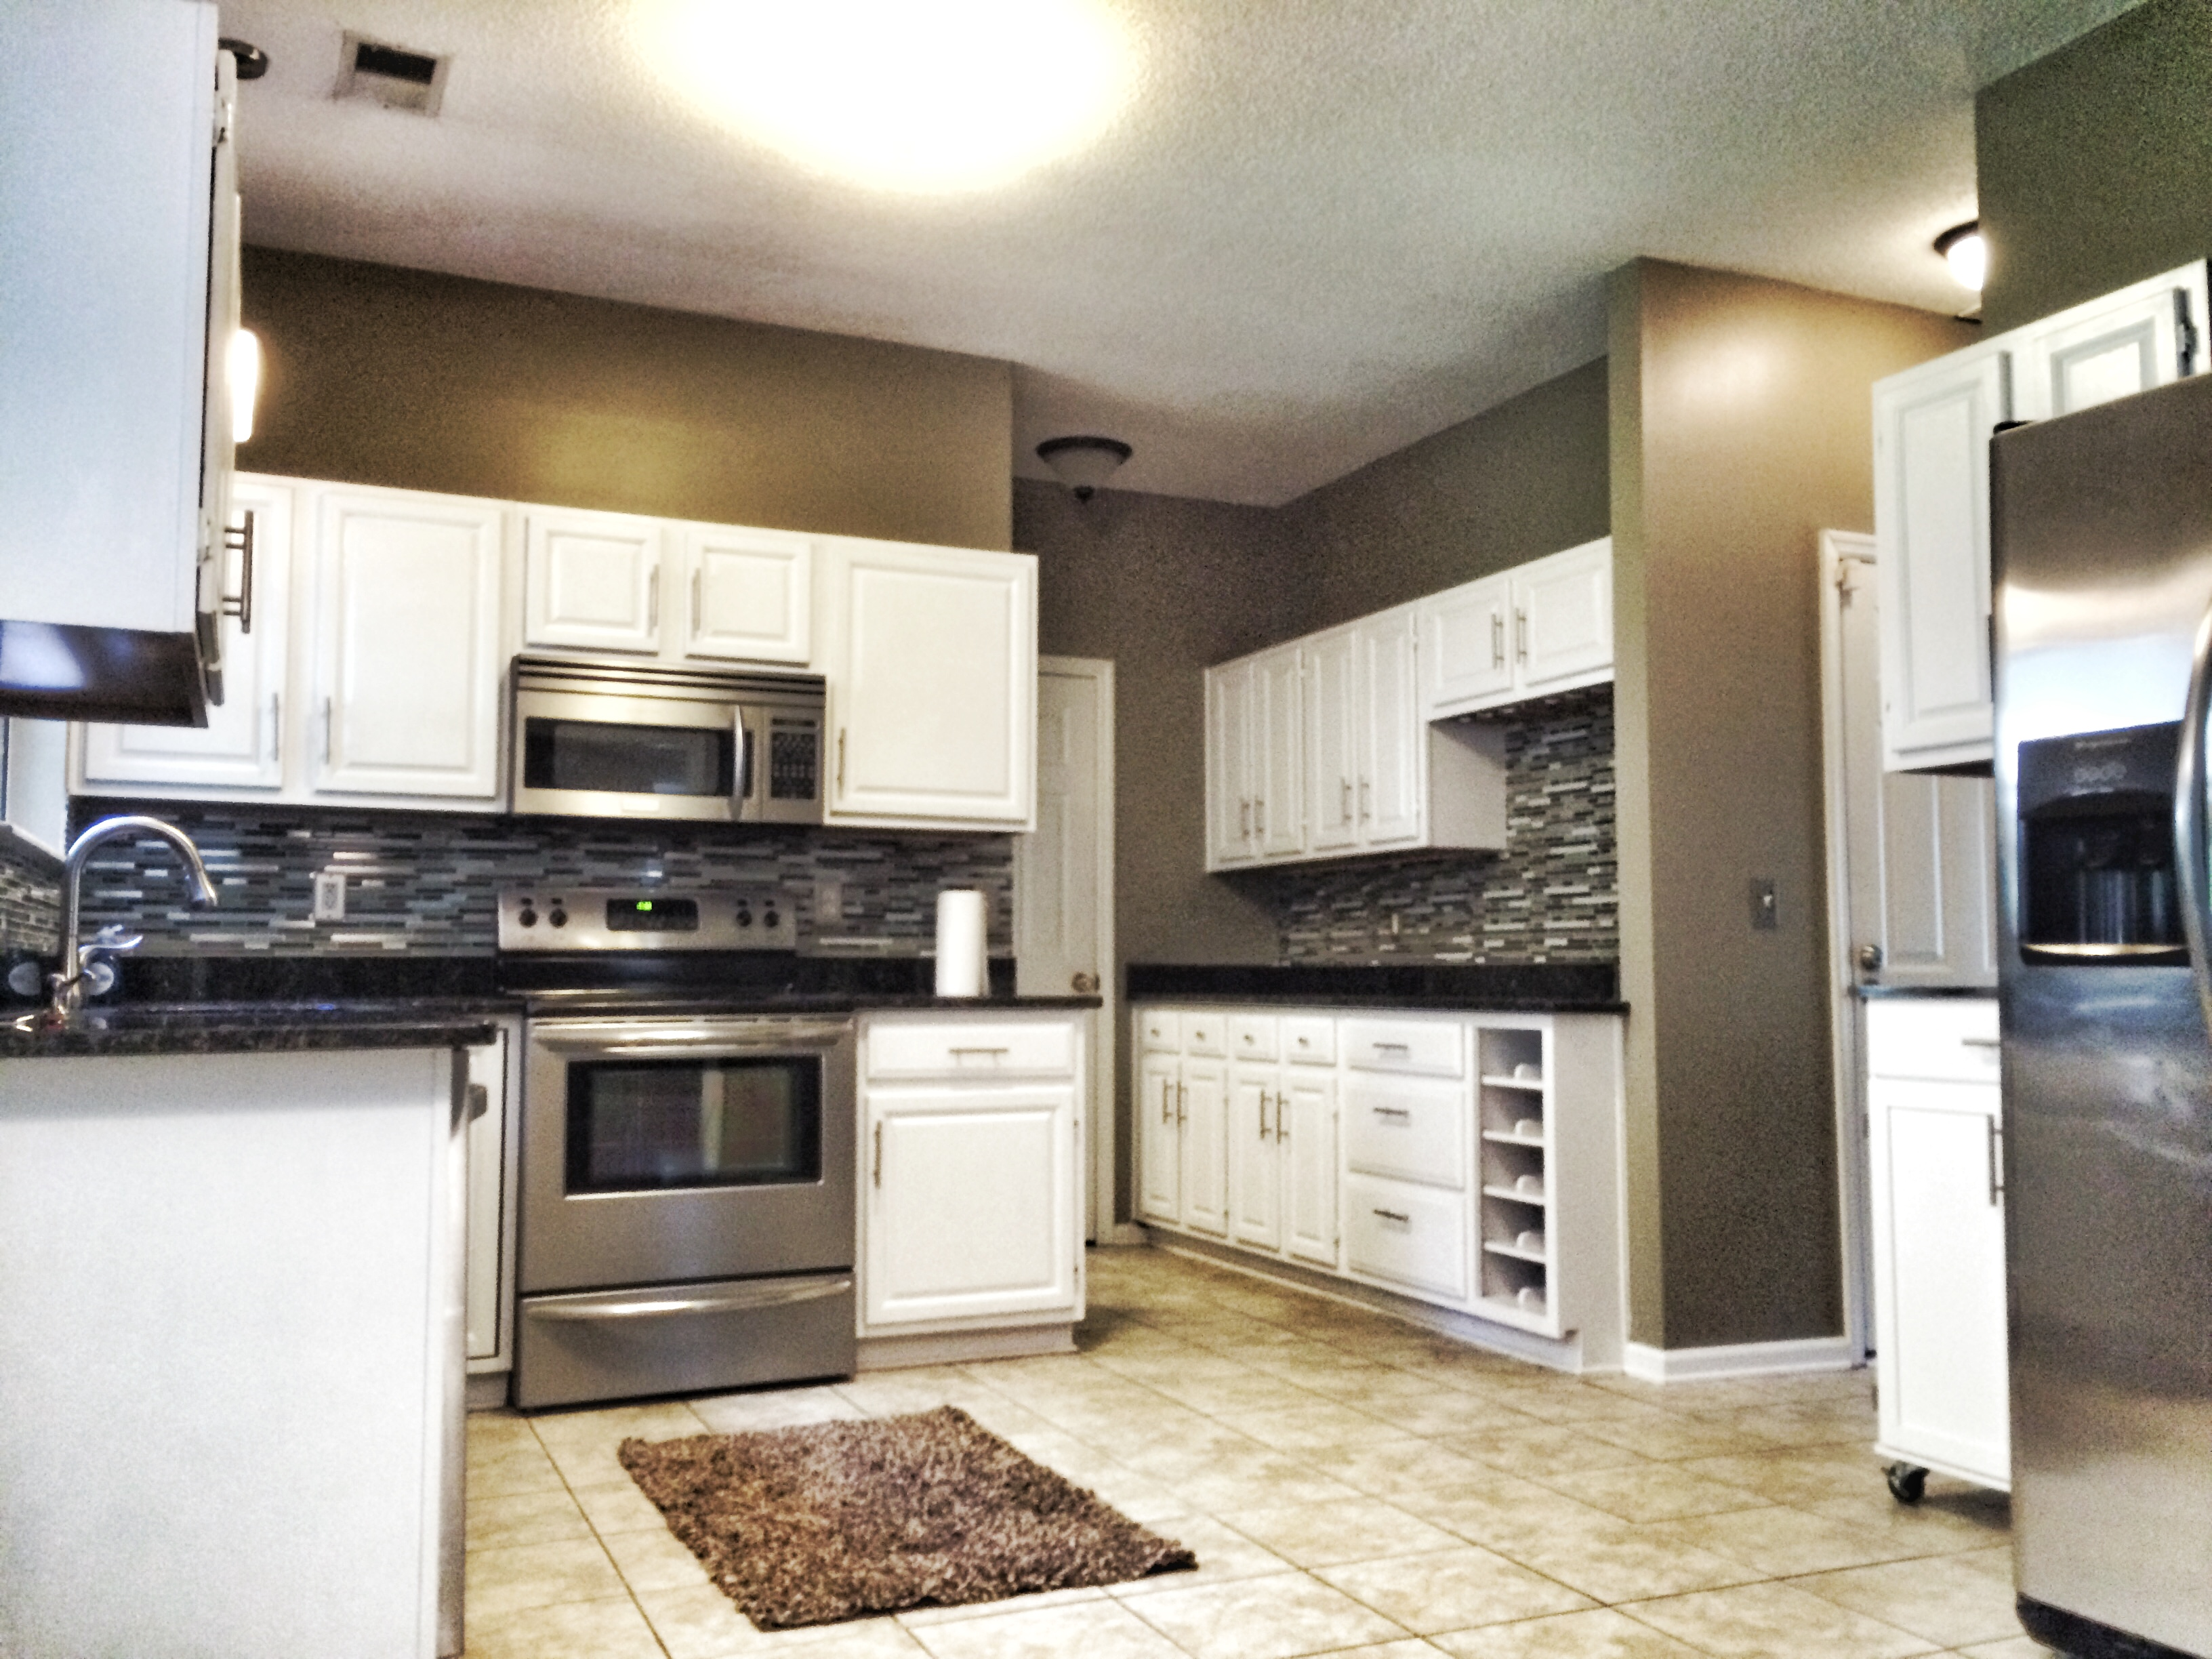
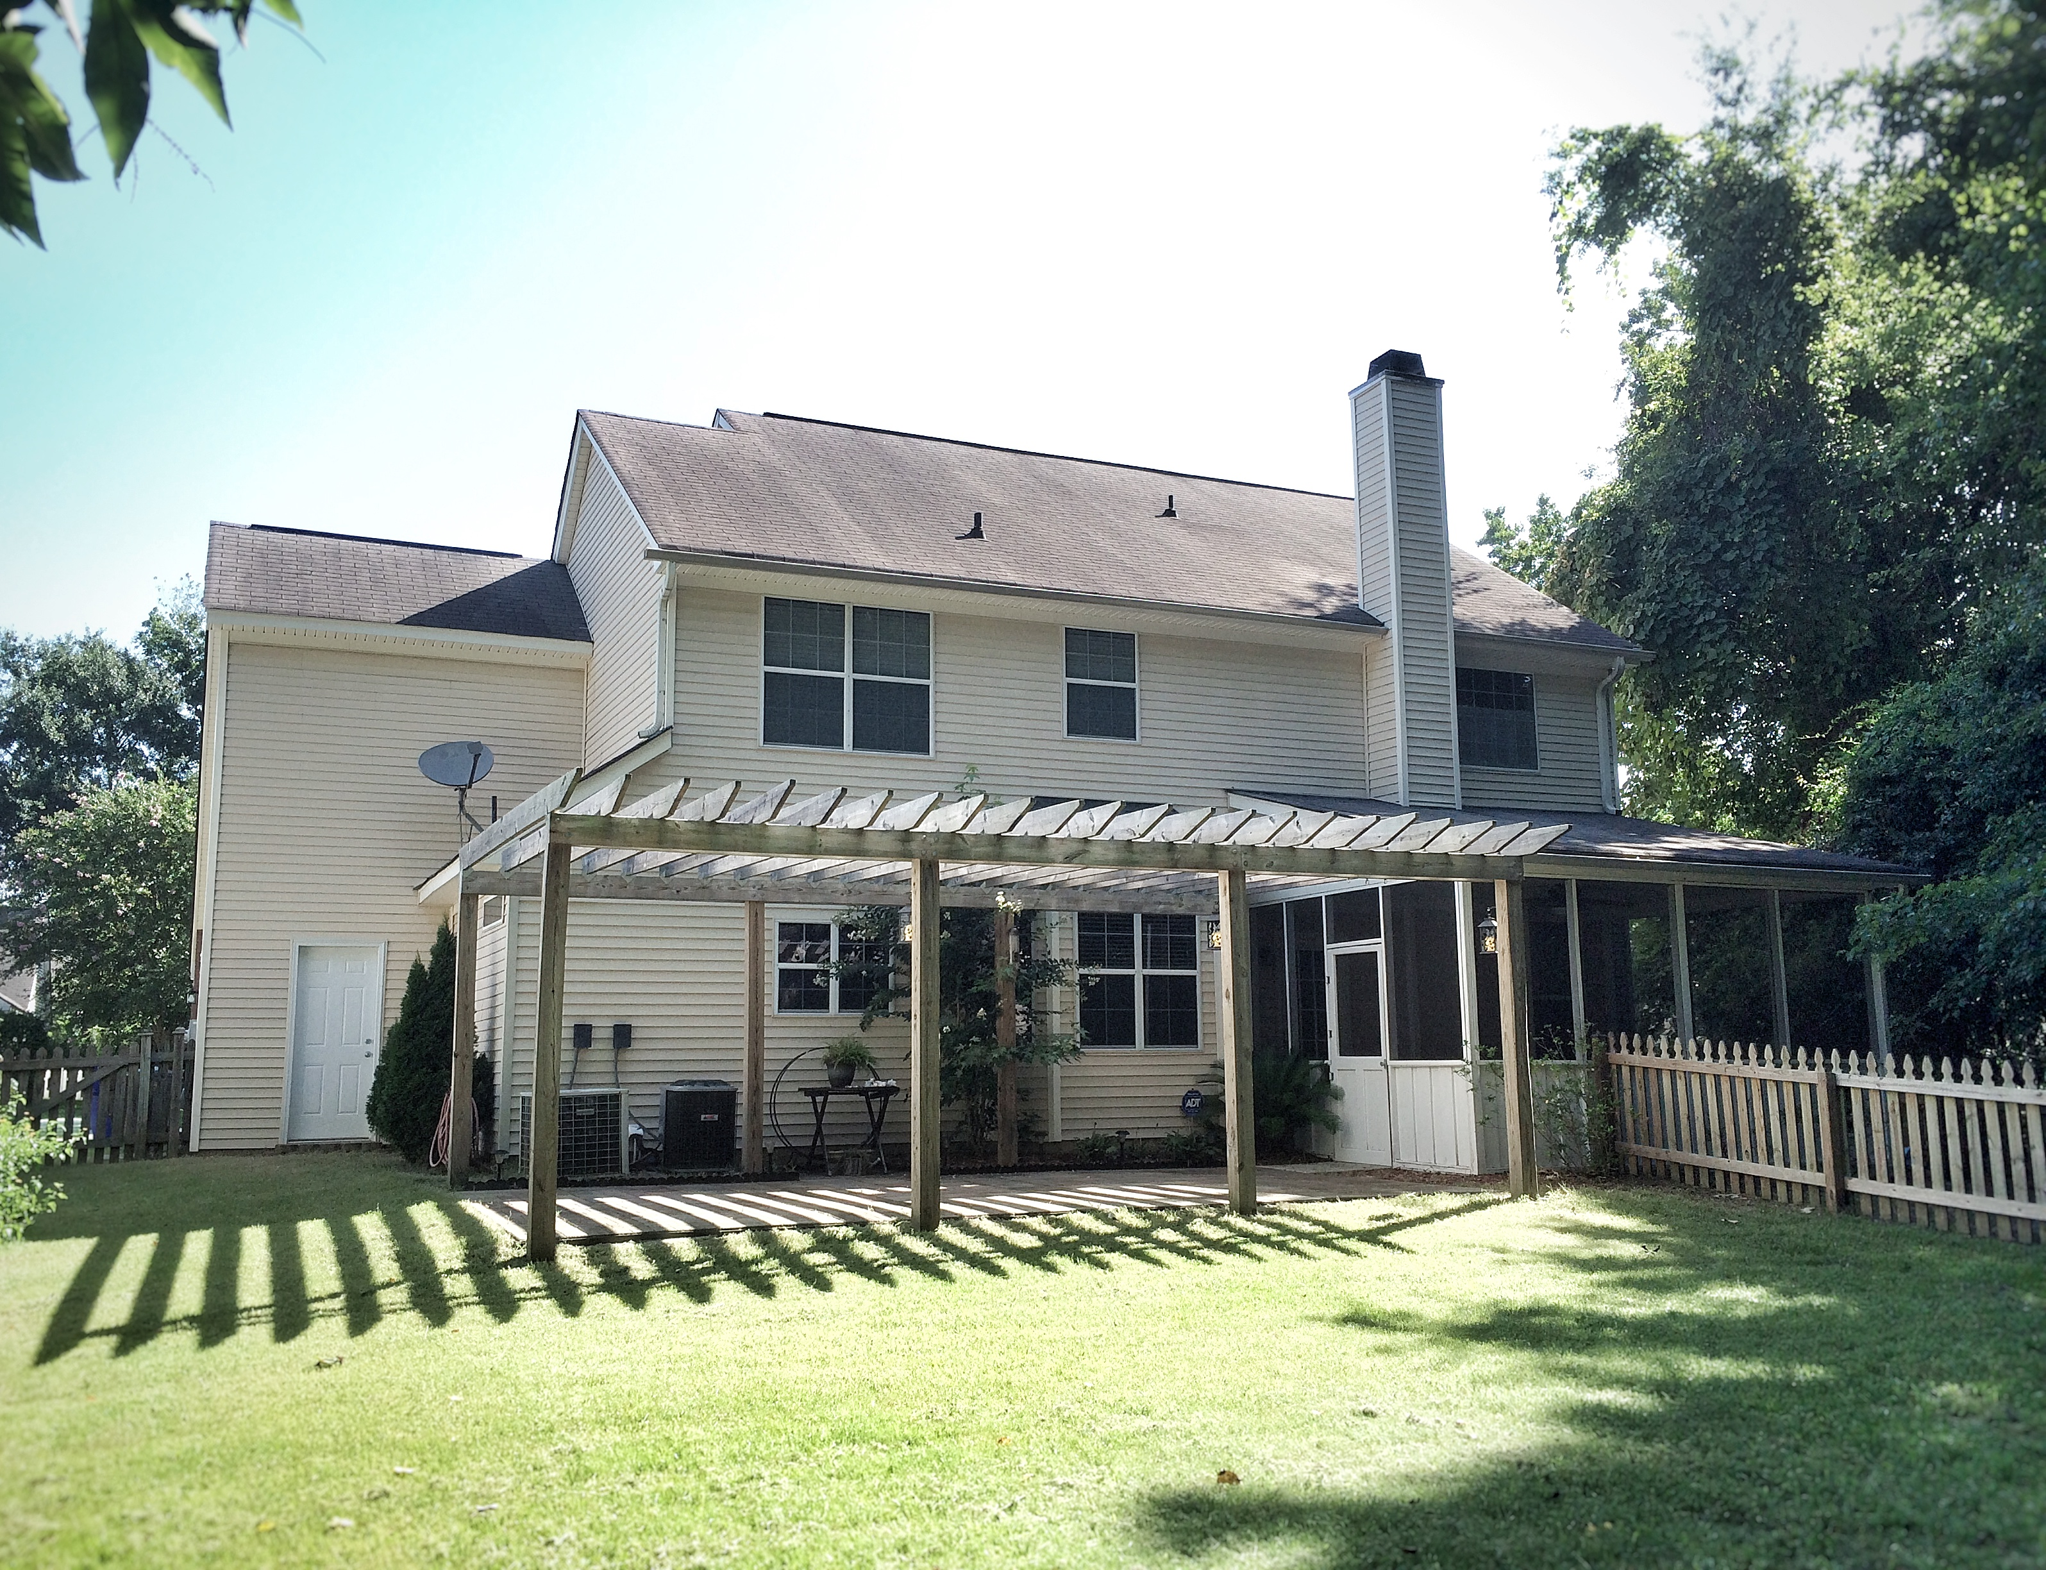

173 Historic Dr Mount Pleasant, SC 29464
Coming August 1st! 4 bedroom home in Belle Hall Plantation!
TYLER BERGIN
Office - (843) 884-7300
Mobile - (843) 475-4670
tyler.bergin@agentownedrealty.com
AgentOwned Realty Co. Premier Group, Inc. | 824 Johnnie Dodds Blvd | Mt Pleasant, SC 29464

