Slide 1
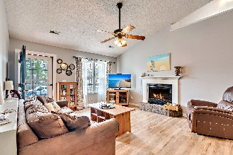
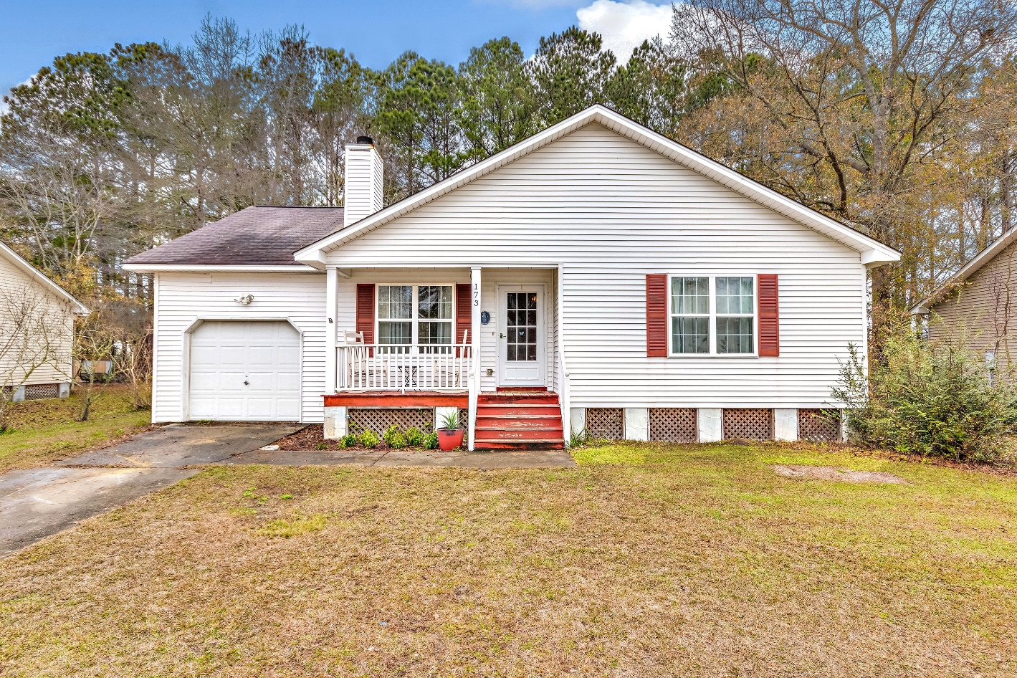
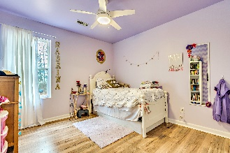
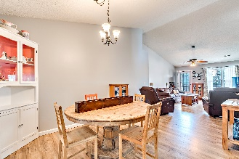
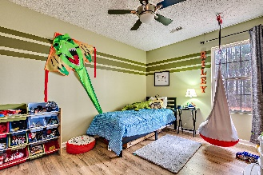
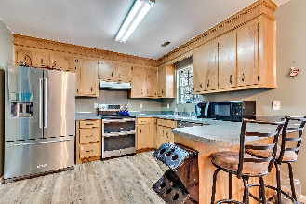
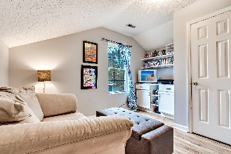
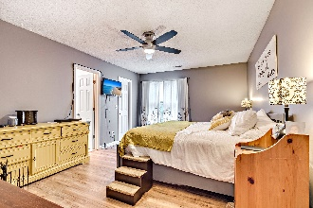
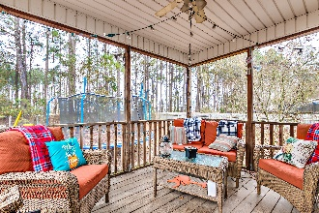
Welcome Home! Are you curious about what makes Summerville such a wonderful area?
173 Iron Road
Tramway ~ Summerville, SC 29486
MLS# 19000239 ~ $200,000
Check out this house in the friendly subdivision of Tramway with excellent schools nearby. The owners have updated almost everything! There are stainless steel appliances in the kitchen and the HVAC system is only 3 years old. You'll be pleased with the laminate flooring throughout the living areas and bedrooms. Care has been put into the fresh paint in every room. The newly remodeled hall bathroom sports a new toilet, a beautiful vanity/sink and new light fixtures. There is a screened in back porch and a huge fenced backyard that is perfect for entertaining. The horticulturist in you will appreciate the four raised beds for gardening. Schedule your tour soon. This house is move in ready.
Willa McGirth-Moody
willamcgirth@aol.com | 843-276-2021 | www.willasellscharleston.com
Brand Name Real Estate | 4 Carriage Lane, Suite 106 | Charleston, SC 29407

