Slide 1
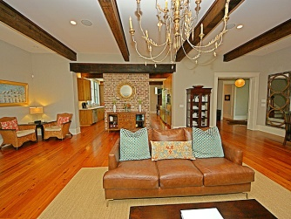
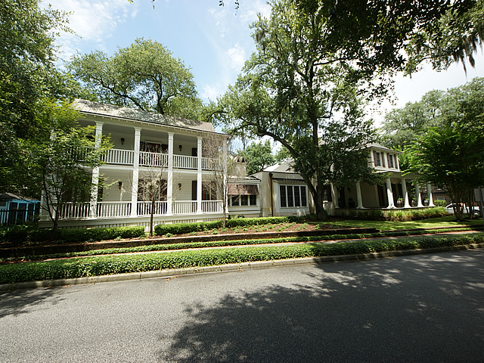
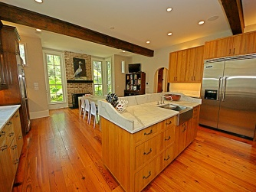
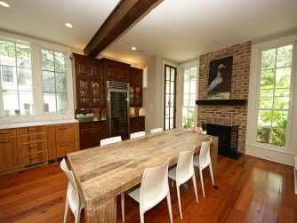
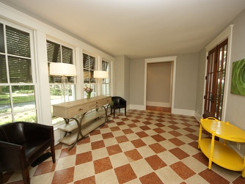
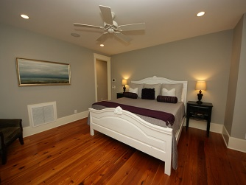
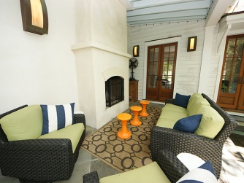
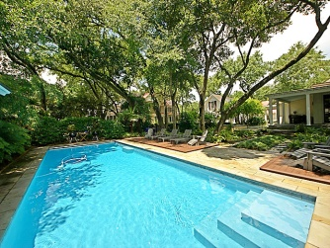

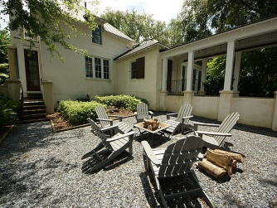
Open House :: Friday 8/15 :: 4-6p
173 N Shelmore Blvd
I’ON :: Mount Pleasant
MLS# 1421725 :: $1,925,000
If you’re looking for a Lowcountry home with contemporary qualities, this may be it.
Located in the desirable Mt Pleasant community of I’ON, within close proximity to downtown Charleston, Waterfront Park, shopping, and restaurants. I’ON is an established community and is highly decorated for its design and function in creating a quality of life within itself. The home was built by Daly & Sawyer, designed by Beau Clowney and landscaped by Sheila Wertimer. The home is on a sought after double lot and features a saline swimming pool with a separate pool house equipped with a refrigerator, sink, surround sound and bathroom with outdoor shower. The property continues with a fully fenced yard which includes a water feature, expansive blue slate terrace, TREK decking around the pool, a large covered patio for dining and entertaining, and an outdoor wood burning fireplace. A large gas grill is located off the kitchen on a separate patio with an adjacent rock courtyard with fire pit. Inside, the great room is spectacular with exposed beams, heart of pine floors, wood burning fireplace and custom French doors opening onto the blue slate patio and terrace. The gourmet kitchen offers everything a family and host could possibly need. Features in the kitchen include all stainless steel appliances: built–in 6 burner Viking gas range, side by side Viking refrigerator, 150 bottle Viking wine refrigerator, GE Monogram dishwasher plus two additional dishwasher drawers, built in microwave, warming drawer, marble counter tops, custom pine slat cabinets, gas fireplace and a large butler’s pantry with built in ice maker. Additional features of the home include Rocky Mountain hardware and Perrin & Rowe faucets, both with a lifetime warranty. The tumbled marble breezeway leads to the master bedroom with stackable washer/dryer and custom walk in closet. Master bath has marble throughout, double sink vanities, jetted tub and steam shower. The second floor is made up of two separate sections. The first section can be accessed from the foyer and includes two bedrooms, two full en suite bathrooms, a laundry room and a huge game room. A staircase from the master suite leads to the second section that features a living room, bedroom with full en suite bathroom, and a separate large cedar closet. There is an additional guest bedroom with full en suite bathroom located on the first floor off of the kitchen, adjacent to an office space and powder room. There is a large mud room off of the kitchen with extensive bamboo shelving that leads through a covered breezeway to a detached 2 car garage with a spacious finished room above, currently used as a gym and previously as an office. Audio/visual equipment conveys.
Karla Leahy
Realtor CRP, ASP, QSR
karlaleahy@gmail.com | (M) 843-452-6670
www.yourlowcountryproperties.com
Harbor City Real Estate Advisors | 510 Live Oak Drive | Mt Pleasant SC 29464

