Slide 1
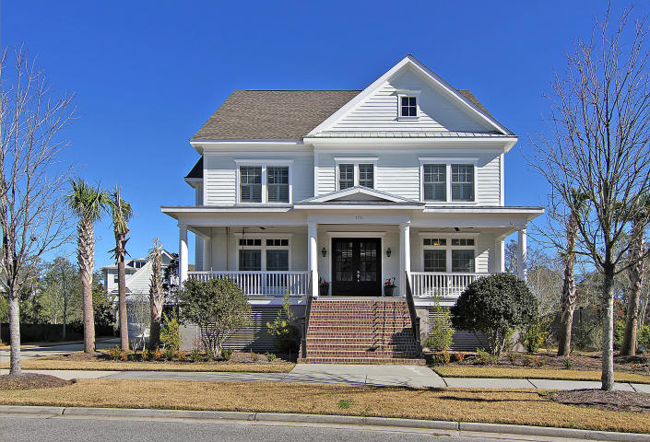
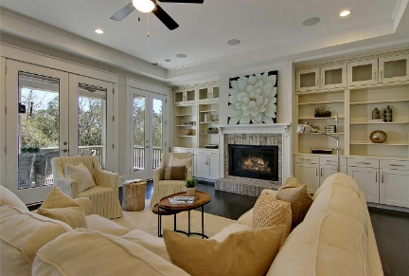
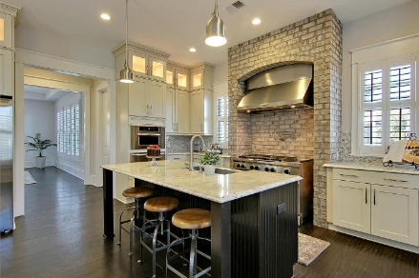
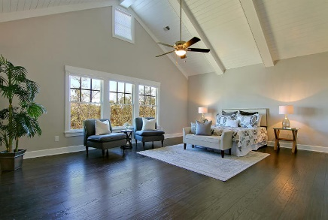
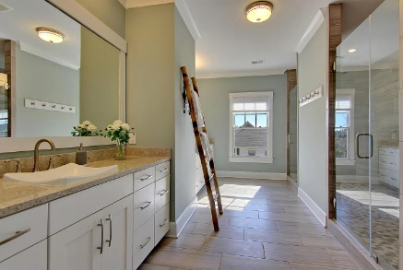

Ideal Location, Ideal Home, Ideal Lifestyle!
173 River Green Place
Daniel Island Park
Charleston, SC 29492
MLS# 17001729
$1,375,000
6 Bedrooms | 6+2/2 Baths
Welcome Home! 173 River Green Place is waiting for you! Located in the prestigious Daniel Island Parkside, 173 River Green Place includes Daniel Island Club Social Membership privileges, with the opportunity to upgrade to a Sport Membership, or a transferrable, full Non-Recallable Golf Membership.
Step inside this custom island home and be impressed immediately with the spaciousness and custom finishes. This home is adorned with gorgeous hardwood floors, beautiful cabinetry, gas fireplace, custom tile work, elegant molding and trim work, high-end appliances and designer details throughout.
Awaiting your discriminating eye is over 4800 square feet of luxury design and detail in this home which encompasses 6 bedrooms, and 6.5 baths. Multiple porches avail themselves to you for your relaxing morning coffee, or entertaining with friends in the evening overlooking your beautiful lawn, and the marsh grasses.
Lowest price per square foot on the desirable Park Side of Daniel Island! Schedule your showing today and start enjoying all that 173 River Green Place, Daniel Island Parkside has to offer!
Robin Iriart
Mobile 843-568-7720
Office 843-284-8834
Rickrobin@comcast.net
Gatehouse Realty, LLC
708 S. Shelmore Blvd, Ste. 102
Mt. Pleasant, SC 29464
www.gatehousecharleston.com

