Slide 1
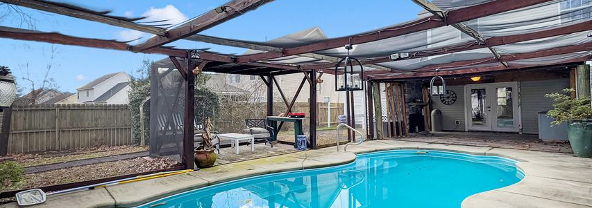
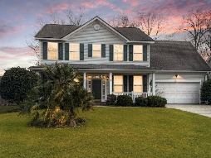
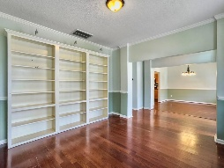
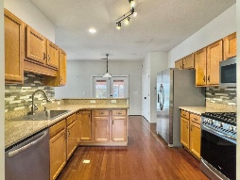
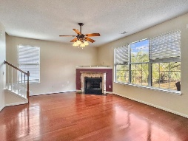
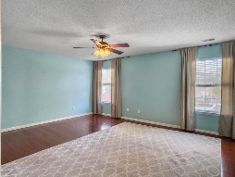
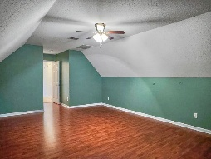
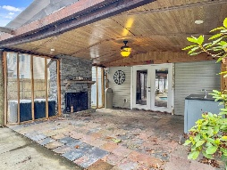

Vacation in Your Own Backyard!
Michael Moseley
843-442-0959
michaelsmoseley@gmail.com
charlestonrealestateandgolf.com
173 Hainsworth Drive
Marsh Hall | North Charleston, SC 29418 | MLS# 25000964 | $445,000
Welcome to 173 Hainsworth, a vacation in your own backyard. Perfect timing as we look towards Spring and Summer, relaxing by the saltwater pool, or jumping in to cool off after a hard day. Upon entering, you will notice the gleaming wood floors that encompass the downstairs. The kitchen features granite counters and a gas range and overlooks the family room making it a great place for conversations during busy mornings and calming nights. On chillier nights, enjoy a quiet night by the gas log fireplace or call the neighbors for a BBQ on your covered patio displaying an outdoor fireplace. Upstairs you will find an oversized master bedroom suite with wood floors, bathroom with double sinks, garden tub and separate shower, and vast master closet with built in shelving. Additionally, the are two bedrooms with adjoining jack and jill bathroom. The frog has been used as a home theater in the past but could be utilized as a 4th bedroom for the growing family. The HVAC was replaced in 2022, roof in 2018 as well as solar panels installed to maximize energy efficiency. The garage is a perfect place for the wood worker and the sheds in the back are a great space for all your lawn equipment. Don't miss out on this opportunity, especially at this price!
Carolina Elite Real Estate | 1081 East Montague Ave | N Charleston, SC 29405

