Slide 1
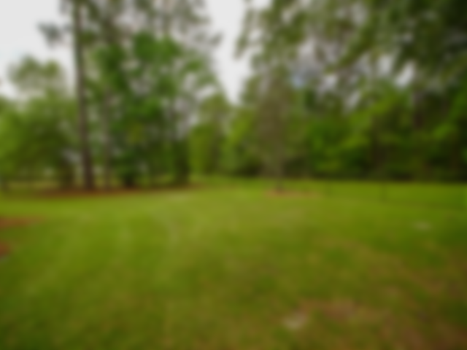
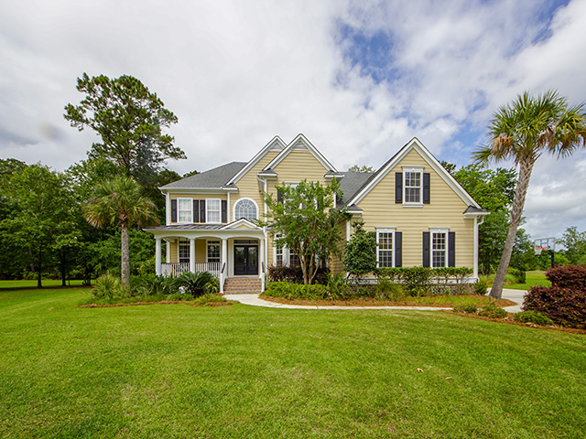
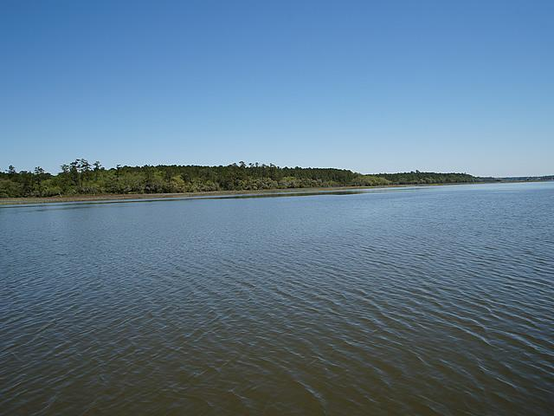
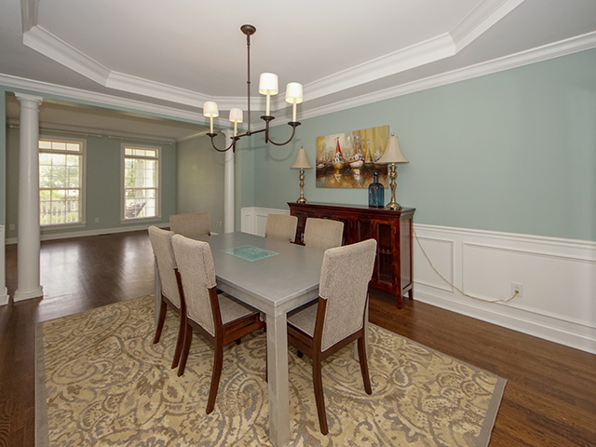
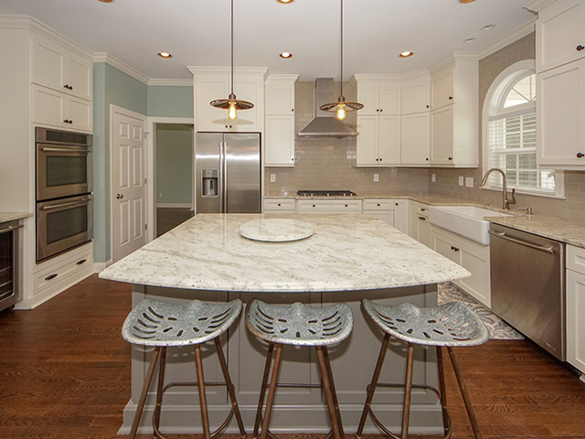
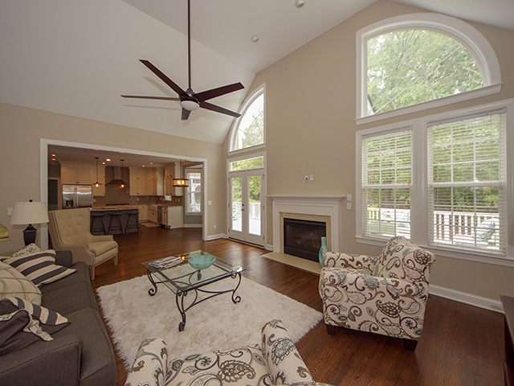
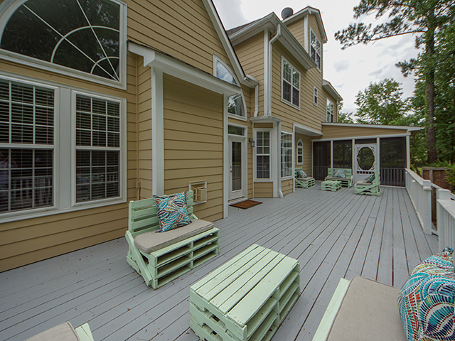
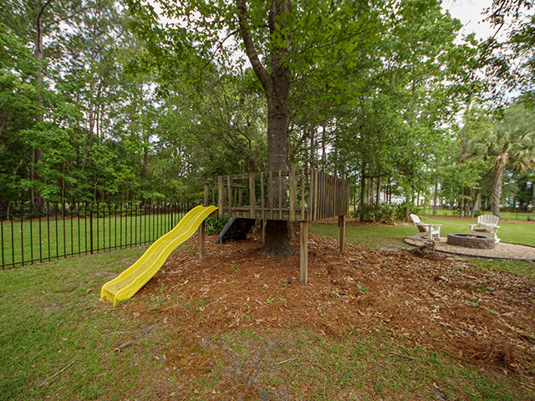
Dunes West ~ Price Reduced
Owner is Anxious!
1740 Greenspoint Court
Mount Pleasant, SC 29466
MLS# 18018730 | $650,000
Welcome home to your recently renovated, spacious 5BR/4BA home w/ 3rd floor rec/playroom nestled on 1/2 acre private, cul-de-sac lot. This home boasts 3790 sqft w/ many upgrades & is move-in ready. Gourmet kitchen completely renovated by Jilco Kitchen & Bath w/new custom cabinets, granite countertops, under counter lighting, soft close drawers, all new Jenn Air appliances, dual convection oven w/ culinary center, gas range, separate ice maker, wine/bev. fridge, built-in microwave drawer, Farmhouse sink, & cabinets that extend to ceiling. Hardwood floors throughout & new carpet in bedrooms. Large living room w/ custom bookcases. Bedrooms have custom closet systems. Master suite has a separate sitting room perfect for gym/office/nursery. All bathrooms have granite countertops.
Large deck and screened porch great for entertaining. Enjoy a glass of wine or roast marshmallows with the kids at the backyard fire pit. The spacious backyard is fully enclosed with an iron fence, in addition to the invisible fence that encloses both the front and back yards. In-ground basketball goal. Pond views on 3 sides. 3-car garage with storage. Two new 16 Seer Heil HVAC units in 2017. Dunes West is a 24-hour private gated community with state-of-the-art fitness facilities, tennis, zero-entry pool, bike paths, boat ramp, and boat storage. Clubhouse sits on Arthur Hills designed golf course named a "Top 10 Resort Course" by Golf Magazine & Golf Digest.
Charles Salmonsen
M (843) 224-0300 | O (843) 388-6613 | charles@salmonsen.com
Salmonsen Realty | 864 Lowcountry Blvd Ste B | Mt Pleasant, SC 29464

