Slide 1
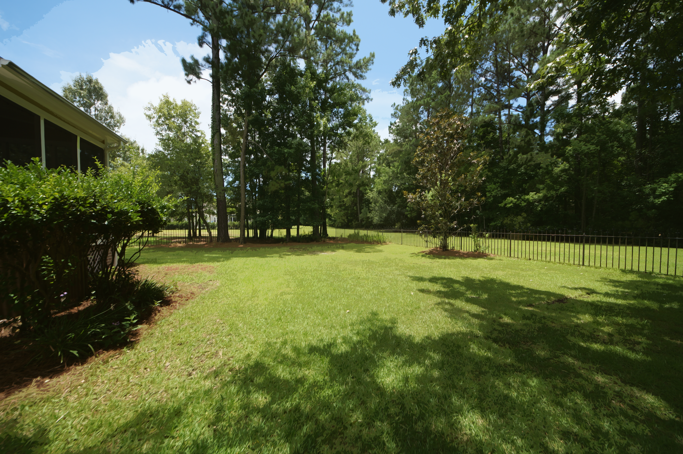
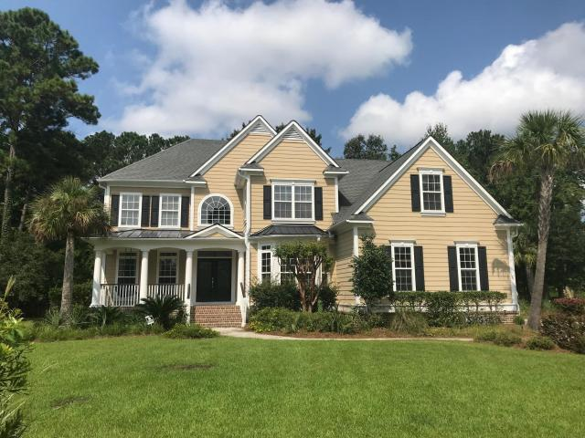
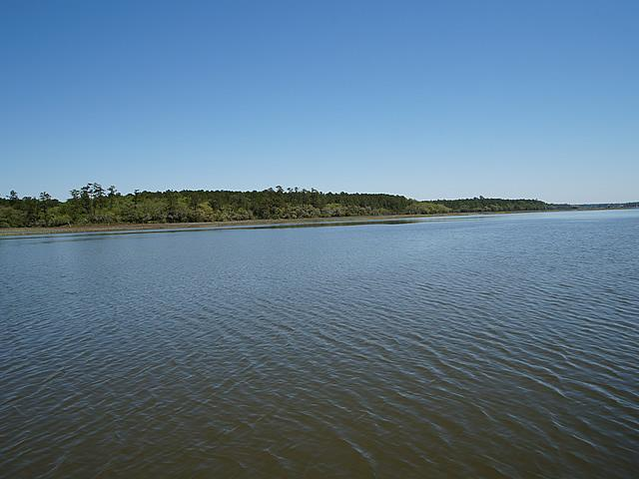
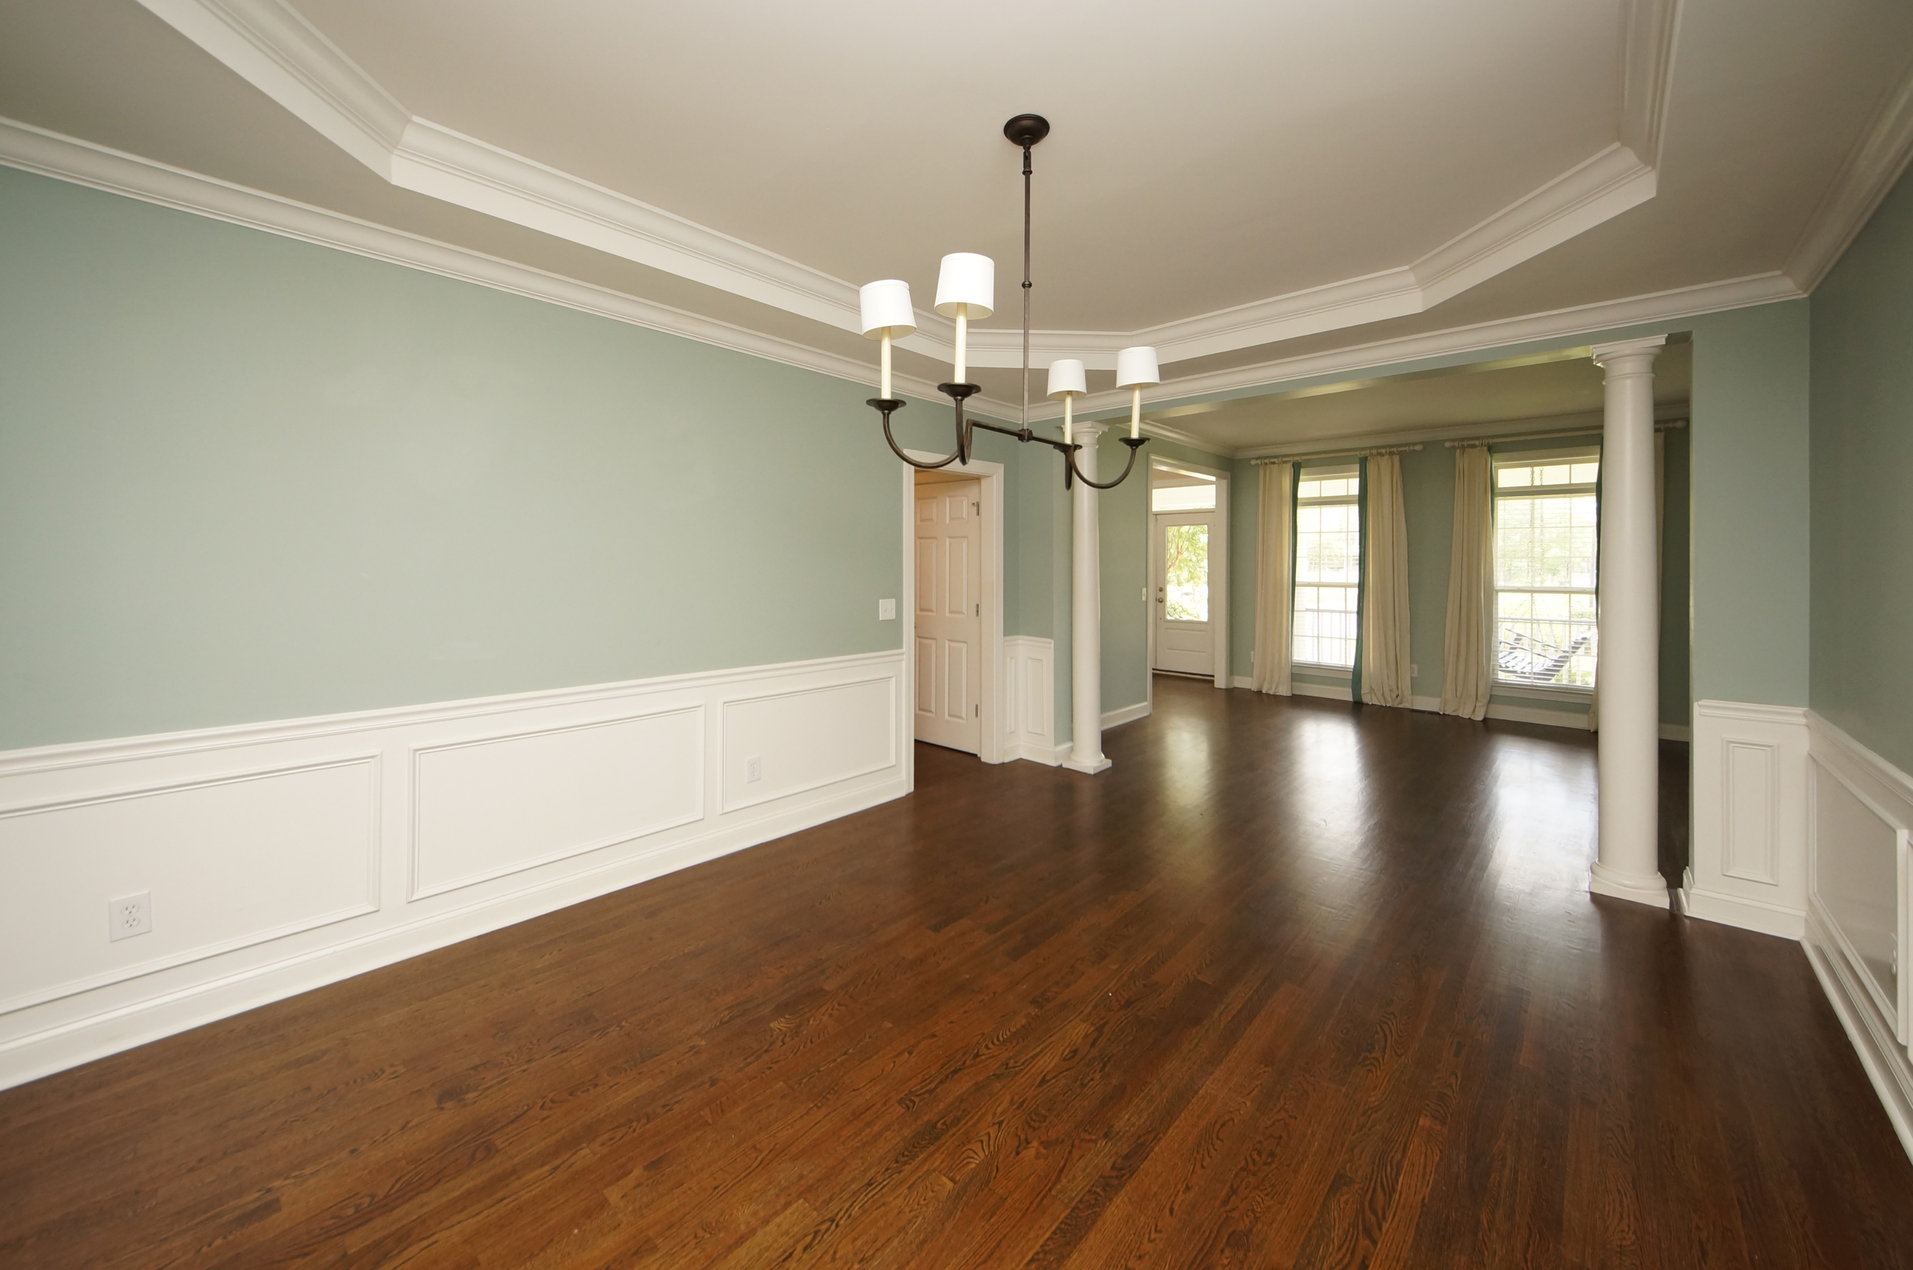
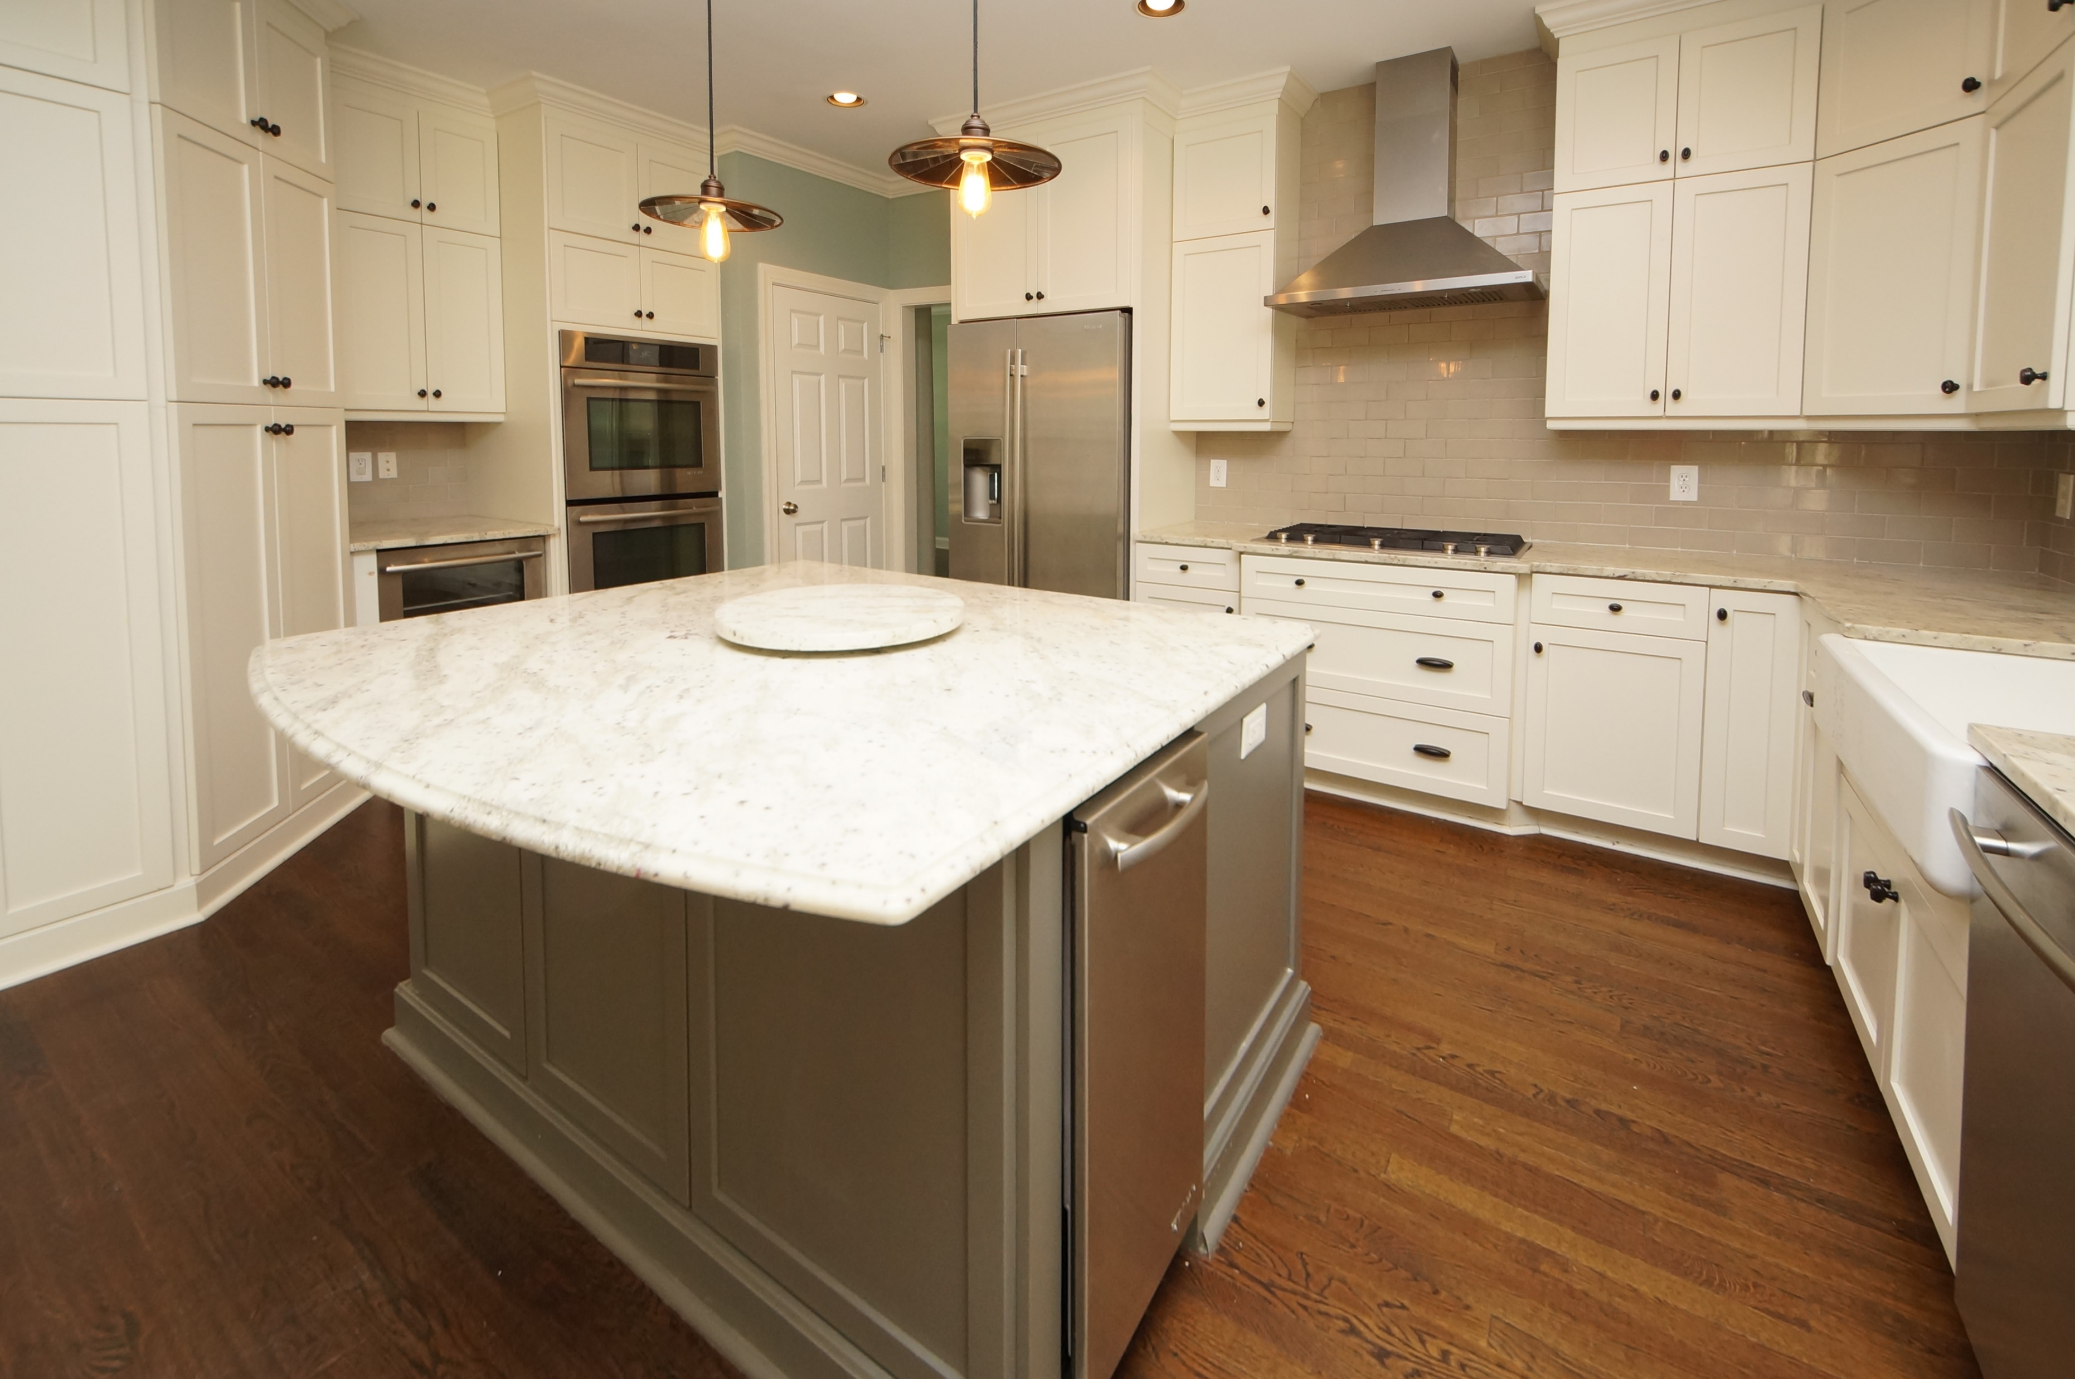
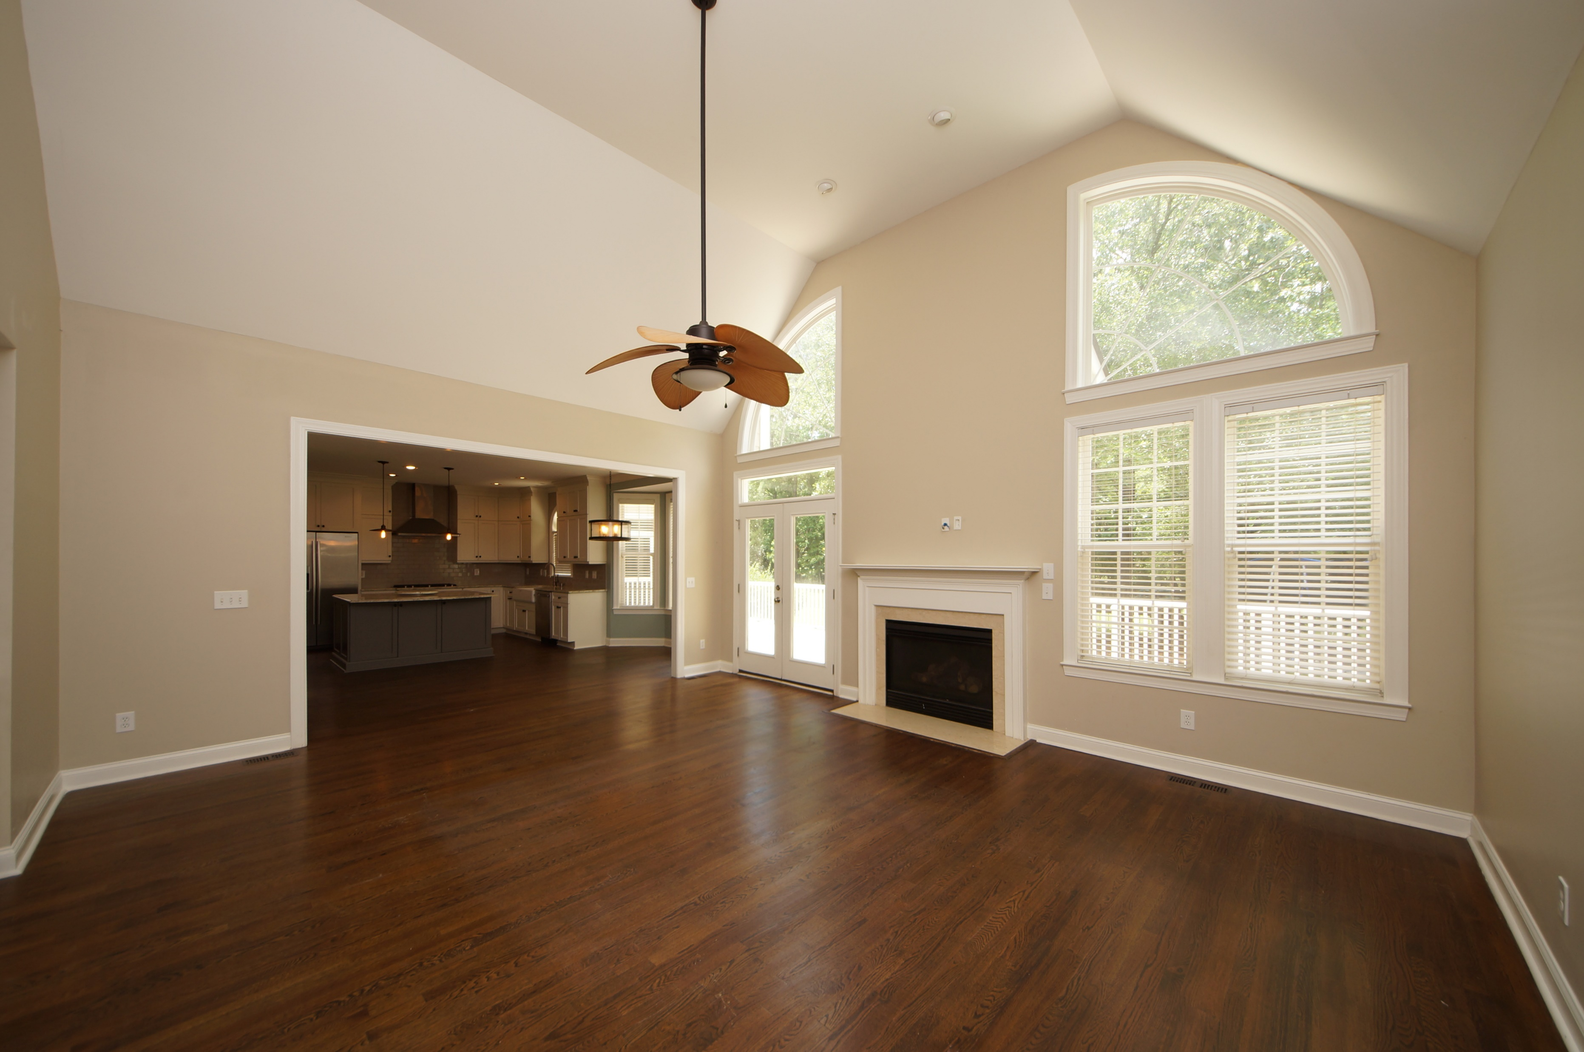
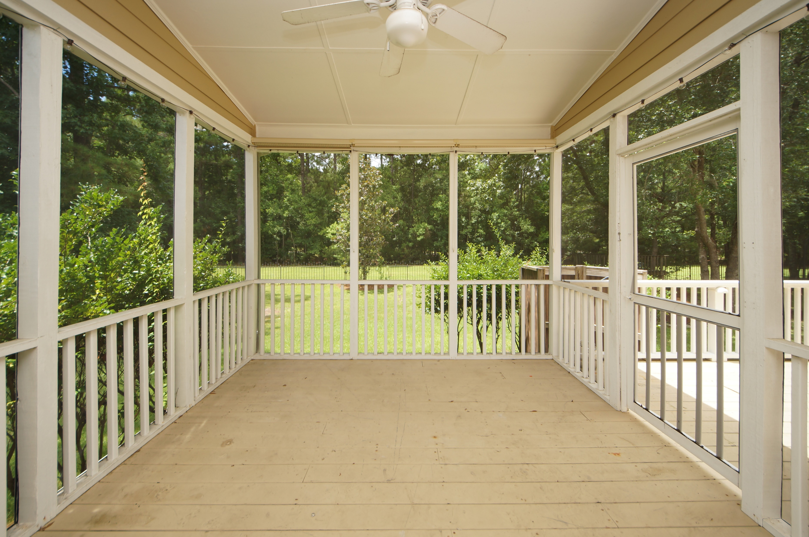
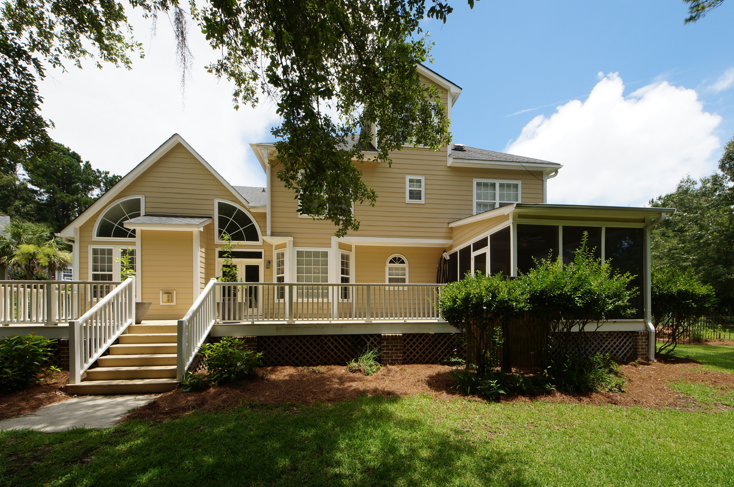
Dunes West ~ Owner is Motivated!
1740 Greenspoint Court
Mount Pleasant, SC 29466
MLS# 18018730 | $719,888
Welcome home to your newly renovated, spacious 5 BR/4 BA house with a 3rd floor rec/playroom nestled on a half acre private, cul-de-sac lot. This home boasts 3790 square feet with many upgrades and is move-in ready. Gourmet kitchen has been completely renovated w/new custom cabinets, under counter lighting and soft close drawers, all new Jenn Air appliances, dual convection oven with culinary center, gas range, separate ice maker and wine/beverage fridge, built-in microwave drawer, Farmhouse sink, and cabinets that extend to ceiling. Newly refinished hardwood floors throughout and new carpet in bedrooms. Large living room with custom bookcases. Bedrooms have custom closet systems. Master suite has a separate sitting room perfect for media, office or nursery. Large deck and screened porch great for entertaining. Fully enclosed backyard with iron fence in addition to the invisible fence that encloses the front and back yard. Pond views on 3 sides. 3 car garage with storage. Two new 16 Seer Heil HVAC units in 2017. Dunes West is a 24 hour private gated community with state of the art fitness facilities, tennis, zero-entry pool, boat ramp, and boat storage. Clubhouse sits on Arthur Hills designed golf course named a "Top 10 Resort Course" by Golf Magazine & Golf Digest.
Charles Salmonsen
M (843) 224-0300 | O (843) 388-6613 | charles@salmonsen.com
Salmonsen Realty | 864 Lowcountry Blvd Ste B | Mt Pleasant, SC 29464

