Slide 1
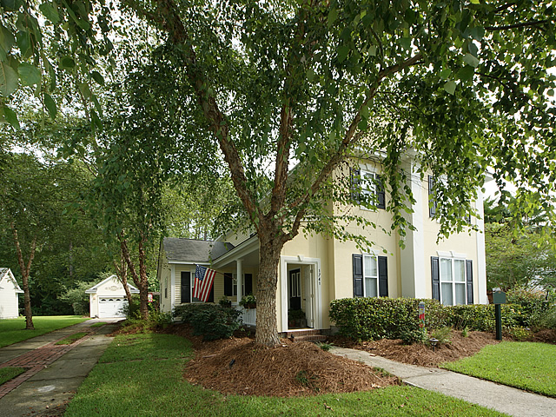
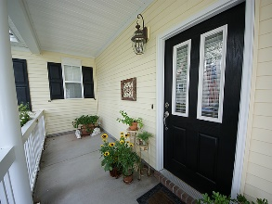
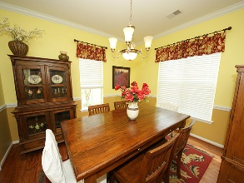
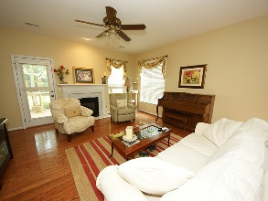
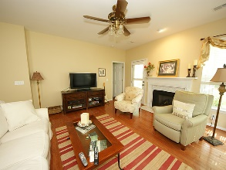
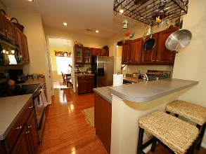
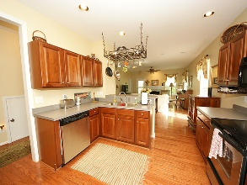
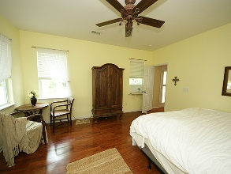
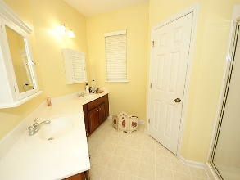
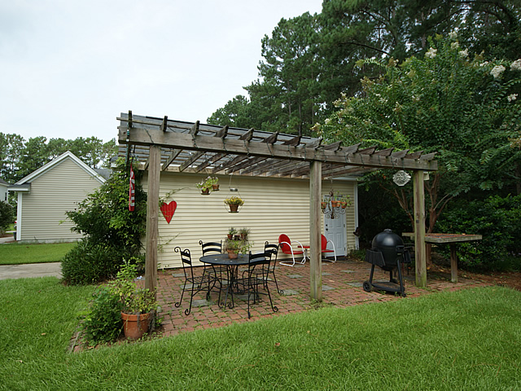
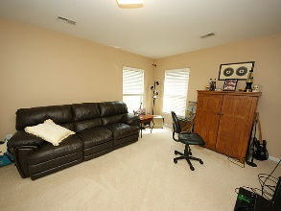
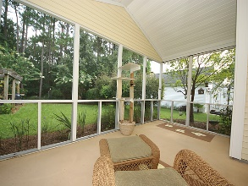
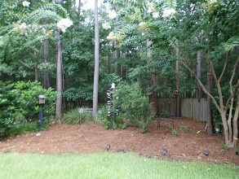
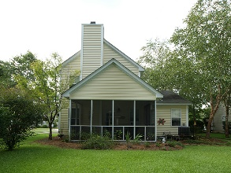


Rest and enjoy the sound of the birds
In the center of it all! Walk/Bike to Everything
1741 Alan Brooke
Park West ~ Mount Pleasant ~ MLS# 16018295 ~ $369,400
Neighborhood is perfect for all needs. Neighborhood has schools, play parks, pool, walking trials, biking trails, shopping, tennis courts and sporting fields. Walk or bike to many functions and fun. Everything is in walking or biking distance. This is a one owner home with a beautiful backyard to enjoy time with family or friends.
AgentOwned Charleston Group
902 Savannah Hwy
Charleston, SC 29407-7802
Lisa Deaton
843-224-7878
lisamdeaton@comcast.net
www.agentownedrealty.com

