Slide 1
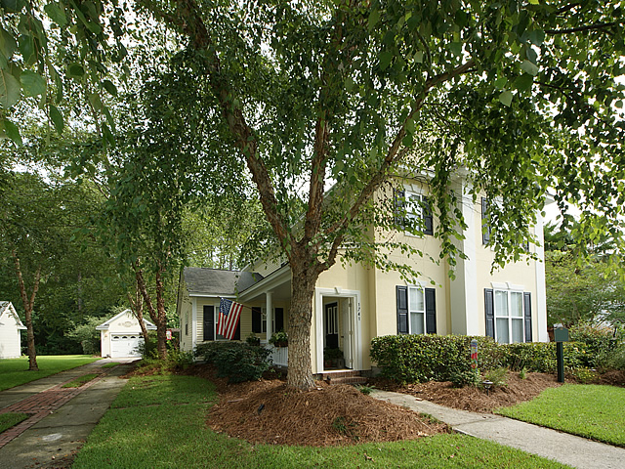
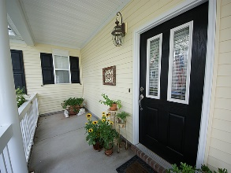
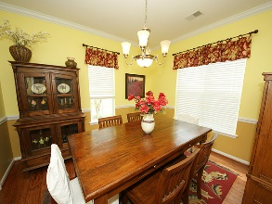
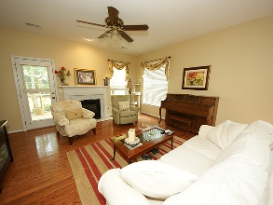
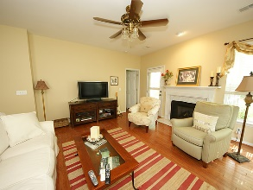
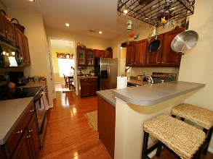
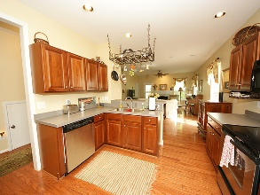
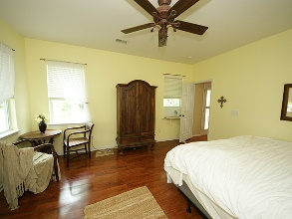
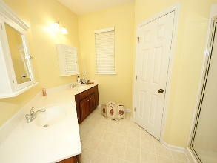
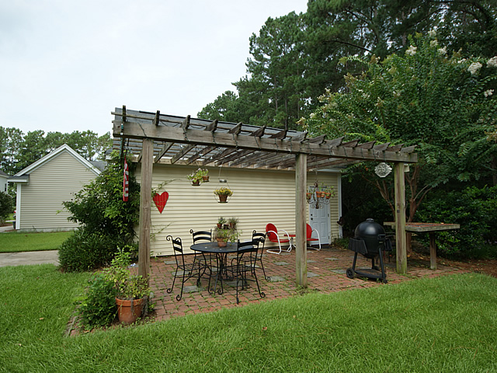
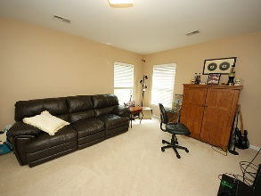
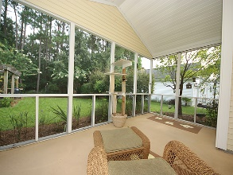
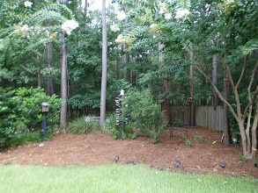
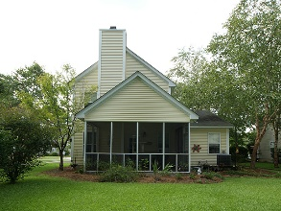


Price Reduced!
Price Reduced! In The Center Of It All! Walk/Bike To Everything!
1741 Alan Brooke
Park West ~ Mount Pleasant ~ MLS# 16018295 ~ $353,800
Neighborhood is perfect for all needs. Neighborhood has schools, play parks, pool, walking trails, biking trails, shopping, tennis courts and sporting fields. Walk or bike to many functions and fun. Everything is in walking or biking distance, including biking to schools. Owners bike to multiple eating areas, grocery store and many activities. Also, there is dock/park minutes away from home (walking distance) were you can crab, fish or kayak. This is a one owner home with a beautiful backyard to enjoy time with family or friends.
AgentOwned Charleston Group
902 Savannah Hwy
Charleston, SC 29407-7802
Lisa Deaton 843-224-7878
lisamdeaton@comcast.net
www.agentownedrealty.com

