Slide 1
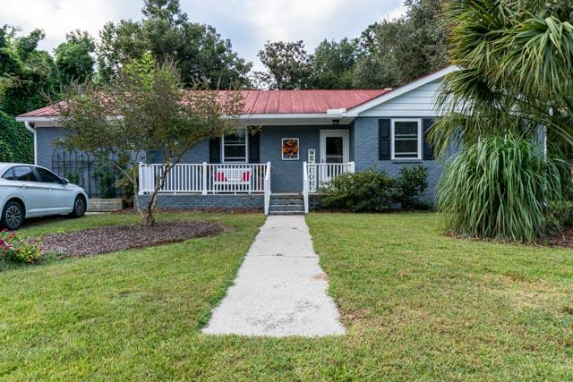
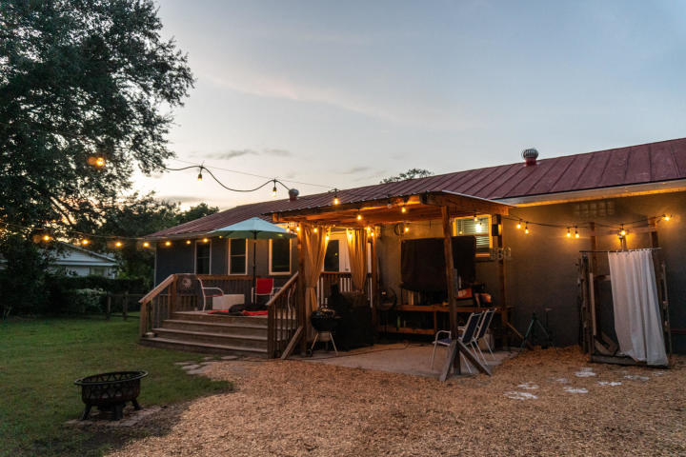
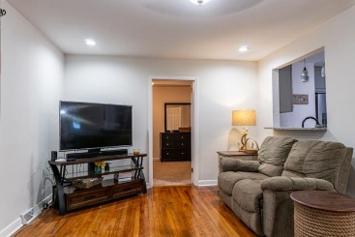
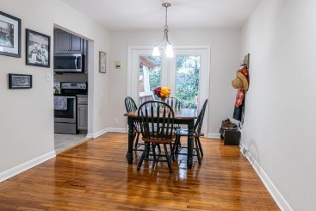
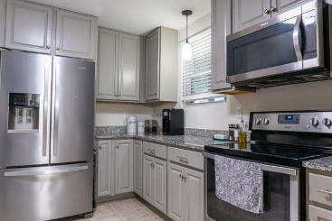
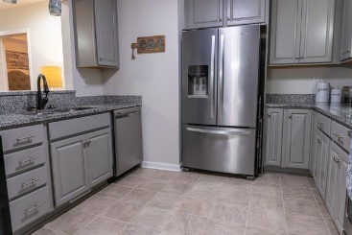
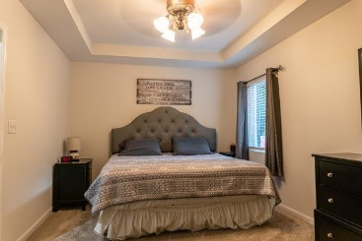
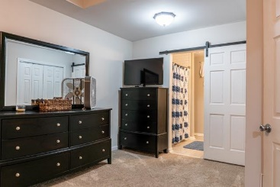
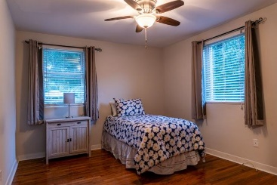
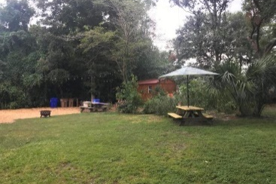
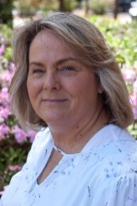

1743 Lady Ashley Street
Centerville | Charleston | MLS# 20024991 | $364,400
Beautiful James Island Gem – New Price
APPRAISAL IN HAND, PRICE REDUCED UNDER APPRAISED VALUE, BUYER'S AGENT COMMISSION INCREASED AND SELLER'S CONTRACTOR INSPECTION COMPLETED! BEAUTIFUL UPDATED GEM on James Island in the very desirable neighborhood of Centerville with 4BR and 2BA which is close to Folly Beach, Downtown and great restaurants. There are gleaming hardwood floors, the kitchen has beautiful cabinets, granite countertops and stainless appliances. The duct work was replaced in 2019, the home also includes a front porch, guttering system, moisture barrier, gas tankless water heater, outside living area, large deck, 12x16 wood storage shed and a outside shower with hot and cold water. Spacious 1/3 acre lot. The front loader washer and dryer will convey which were purchased new in 2017. NO FLOOD INSURANCE AND NO HOA
Kathy DuPree
843-696-7774
lowcountrykathy@gmail.com
Brand Name Real Estate | 4 Carriage Lane Suite 106 | Charleston, SC 29407

