Slide 1
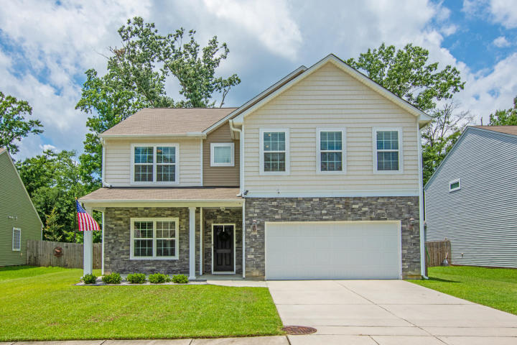
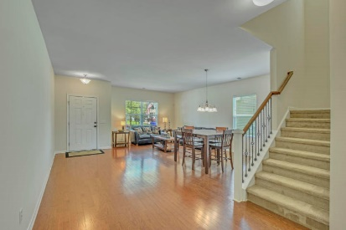
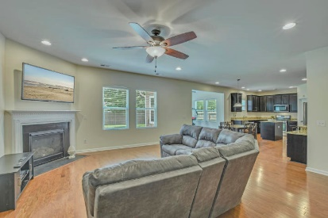
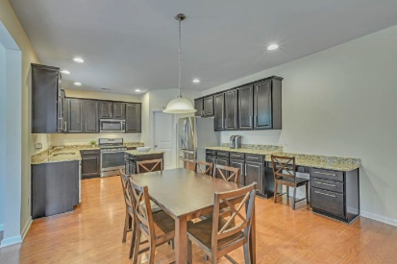
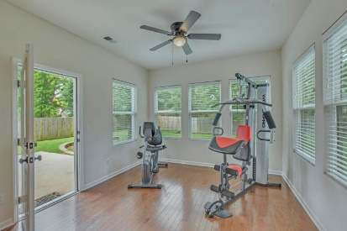
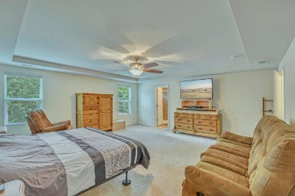
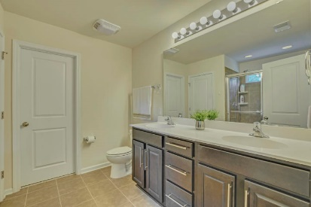
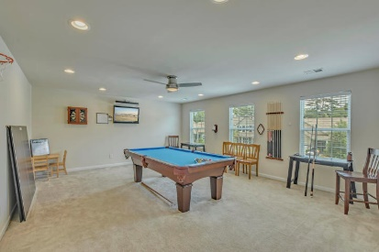
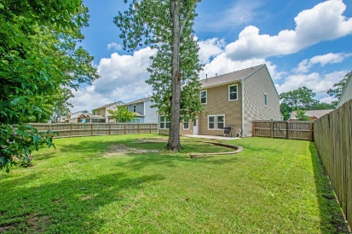

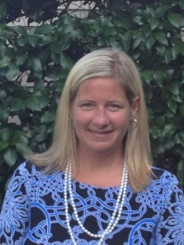
1747 Indaba Way Carolina Bay ~ Charleston, SC 29414 MLS# 19018441 ~ $397,500
Great Deal in a Great Neighborhood
Looking for a home with LOTS of space in a great, amenity filled neighborhood? This 5 bedroom home, 3633 sqft, 3 full bath with HUGE bonus room has everything your looking for. As you enter you will be greeted with gleaming hardwoods, living/dining combo, family room w/fireplace, upgraded eat in kitchen with granite and stainless steel, a sun room and downstairs bedroom with full bath. Upstairs boasts a large master bedroom and bath with upgraded shower and 10x10 walk in closet, 3 additional bedrooms with large closets and a HUGE bonus room that could be 6th bedroom, playroom or game room. The owners have taken great care of this home also adding features like a generator outlet, gutters and fence. Carolina Bay offers play/dog parks,3 pools, walk/jog trails, nearby schools and a new library.
Lane Boris Office - (843) 864-9150
Cell - (843) 864-9150
lboris@carolinaoneplus.com www.LaneBoris.com
Carolina One Real Estate
873 Orleans Road, Ste 102
Charleston, SC 29407

